Slide 1


NOVEC EXpansion Identification System
NEXIS
SYST 699 – Spring 2015
Final Presentation
Tygue Ferrier
Brian Smith
Austin Orchard

Slide 2



Curre⁻nT SoluTioΩs
εst. 2015
sh cking y good ideas
Tygue is pursuing a masters in Systems Engineering with the ATS concentration. He will apply this masters degree to his career as a systems integrator for the FAA. As an integrator he carries a broad technical skill set that is enhanced by his systems engineering tools. He currently aids Thales Group Aviation Solutions Division with integration and testing initiatives of Automated Air Traffic Control systems.
Brian is Graduating with a Master's Degree in Operations Research from GMU in May 2015. Brian currently works as an Optimization Research Specialist for NCI on the Incentive Auction Task Force at the FCC. Previously, he taught math and physics for 10 years at Trinity School at Meadow View. Brian has a BS in Mathematics from the Catholic University of America.
Austin is a graduate student pursuing a Masters of Science of Systems Engineering. He currently works at Exelis in the Civil and Aerospace division as a systems engineer designing mission critical air traffic management solutions. Exelis is a global aerospace, defense, and information systems and services company that provides services to a broad range of stakeholders.

Slide 3
Executive Summary
Current State
Inefficient methods and means for planning for future asset deployment
Developed Solution
Collect, Process, Report on regional development projects
Impact
Increased Situational Awareness
Decreased time and errors in data collection and processing.
Deliverables:
con ops, system requirements, functioning code, database design, user’s manual, final report
Notes:
Approached by a local utility provider facing challenges data collection processes
Our solution was to design and develop a tool to fill this functional gap
this tool delivered new capabilities and access to data previously unavailable
By automating the process we reduced the man ours and errors associated with manual data collection

Slide 4
Agenda
Project Definition
  Background
  Gap Analysis
  Problem Statement
Technical Approach
System Design
  Design Process
  System Design
  Technical Challenges
Software Development
Impact
Future Work Questions
Notes:
This semester SE OR skill sets and develop a new capability for our client
Out briefing will outline the work we completed over the course of the project
begin by discussing the background and demand for our system
Continue by discussing our design and development efforts
conclude by expounding on the impact of our tool and providing a path forward for future work

Slide 5
Project Definition
Background
Gap Analysis
Problem Statement

Slide 6

Northern Virginia Electric Cooperative
Leading Electric Distribution Cooperative
Over 30 Years of excellence
Serves over 155,000 homes and businesses
  Clarke, Fairfax, Fauquier, Loudoun, Prince William, and Stafford counties
Notes:
This semester we had the opportunity to work with the Northern Virginia Electric Cooperative.
One of Largest electric cooperatives in the country
> 150,000 homes business
Not for profit corporation owned and controlled by it’s customers
2013 J.D power associates ranked 3rd out of largest utility companies

Slide 7
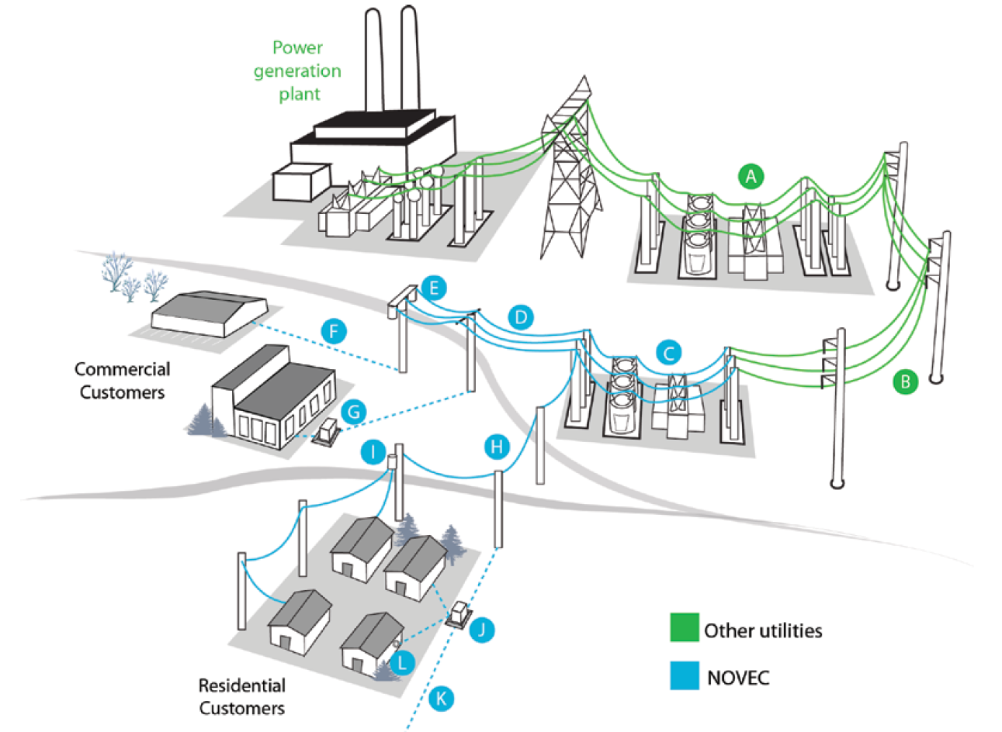
NOVEC Operational Environment
Notes:
NOVEC operates within a complex power distribution supply chain
It is first important to understand where NOVEC fits within power distribution supply chain.
Power is generated at the power plant
transmission lines -> transmission substation -> distribution substation
NOVEC distributes to consumers

Slide 8



Business Model
Collect – Model – Plan – Purchase & Deploy
Collect [data]
  Consumer Category, Historical Usage, Weather
Modeling
  Long Term (30 year)
  Short Term (3 day)
Plan
  Analyze results
Purchase & Deploy
  Purchase electricity
  deploy assets
NOVEC Forecasting System
Project Managers
Forecasting
Models
Analysts
Leaflets
,
Meetings
Town Hall
,
New Projects
Manually Communicated
...
LOLA
Legacy Data
Notes:
Asset planning, long term capital investment
electricity purchasing, wholesale negotiations
Rely on community flyers and town hall meetings
development PMs notifying completion
Manual data collection

Slide 9
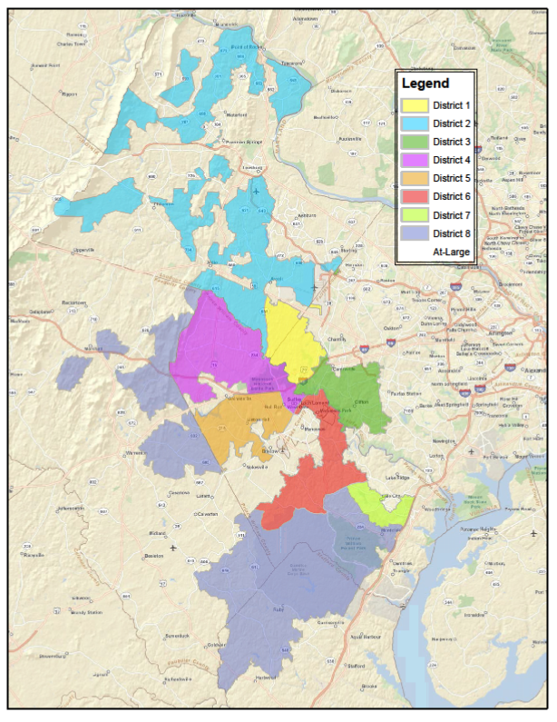
NOVEC Service Area
Service Area
  9 Districts
Consumer Profile
  Residential
  Commercial
  Rural
Notes:
NOVEC provides electricity to consumers over a vast service area
Knoxville to Stafford
Made up of multiple disparate areas
regional development data does not provide the level of granularity needed to accurately forecast usage trends
Vastly different consumers
HD residential sub developments
Commercial building
Rural farms and communities

Slide 10
Gap Analysis
Current State
Long term modeling
  does not account for future growth
  lacks location data
  planning lags development
Future State
Collects regional development data
Provides spatial awareness of new development
Generates reports for forecasting and modeling

Slide 11
Statement of Problem
NOVEC currently does not have the ability to efficiently collect, maintain and analyze information on development projects in the various counties that NOVEC serves.
NEXIS will automate the data acquisition and processing of ongoing development projects from various county databases. The system will store and update the database on a user configurable interval. Users will be notified of project status changes upon update. NEXIS will generate reports containing important data on new and existing projects. This data will then be used to augment existing forecasting models.

Slide 12
NEXIS
Criteria for Success -> Prototype for Loudoun County
  Functional Database
  Modify database records
  Generate Reports for forecasting and modeling
12
Notes:
Ingest and parse data
Process data
Update users to changes in projects
Generate reports used for forecasting

Slide 13
Technical Approach
Design Approach
Stakeholder Engagement

Slide 14
System Design Approach
Concept of Operations
System Delivery
System Requirements
System Verification and Validation
High-Level Design
Integration
Detailed Design
Unit Testing
Software Development
Notes:
Systems Design Approach
Our design approach follows the systems engineering V model. We used this model because it allowed us to define the artifacts needed to adequately define our solution. We started by defining the concept of operations and requirements to structure our baseline. These documents were delivered to the customer for buy in before the high level systems and detailed systems design. Using our detailed systems design we engaged in software development followed by testing initiatives. This design process was easy to follow and allowed us to use our limited time efficiently.
Conical system engineering V curve
Limited time
identified the artifacts needed to adequately define our solution

Slide 15
Stakeholder Engagement
Define technical data package
Engage Stakeholders early and often
Elicit Stakeholder buy in
Implement formal change review processes
Notes:
Engagement Plan:
In order to elicit all the needs of our stakeholders we developed a strong communication plan that engaged all stakeholders throughout the project lifecycle. This helped us develop a better understanding of our stakeholder needs. By engaging the customer early and often it allowed us to achieve buy in for our work products. Aditionally we engaged withd party stakeholders from various regional government agencies, like Loudoun County, during the latter half of the design process.

Slide 16
System Design
Design Process
Capabilities
Use Cases
Technical Challenges

Slide 17
Design Process
Notes:
Design Process:
Here we have our systems design process. This mapping attributes each of our work products developed during the design cycle. Similar to the V model it starts at the top from the conceptual viewpoint, then works into defining resource flows and activities, then functions and at the bottom traceability. By following this step by step process it allowed us to fully define the system while maintaining traceability to other work products.

Slide 18
Capabilities Road Map
CV-3 Capability
Model Description
Notes:
Capabilities Roadmap:
This chart identifies the vision of the NEXIS system. The vision will be realized by meeting three end goals. Goal one is to increase situational awareness of spatial data in the NOVEC service area. We will meet this goal by implementing three capabilities. “Development Awareness” which will provide an enhanced interface the NOVEC has with the LOLA database; “Manage NEXIS data” will provide NOVEC with the ability to locally store and manage the data in a standardized format that works with their forecasting models; lastly “Report NEXIS results” will provide an overview of the database update results with regards to spatial data. Goal two “Increase Data Visualization” and goal three “Increase Forecasting Accuracy” will build upon the underlying functionality implemented during Phase 1 by providing better data visualization and finally entering the modeling domain of NOVEC’s business model. We have pushed these capabilities out of scope due to the limited time we have for systems development.

Slide 19
Use Cases
Notes:
Use Cases:
We structured our project from the user’s perspective. Our user centric philosophy remained important throughout the design process because it allowed us to build our design around the User’s point of view. Here we see the three user classes deployed by NOVEC, the analyst, general user, and the administrator. There are also two additional stakeholders from Loudoun County that will provide data updates. There are three nominal use cases that map directly to the capabilities required to meet the system goals: Collect Development Data; Generate Reports; and Amend Data entry.

Slide 20
Technical Challenges
Data acquisition
  Interface to LOLA database
Data storage
  Incorporating system expansion to other counties
Service area determination
  Constrained to using GIS shapefile for service area
  Correlating LOLA database with location data
Notes:
Technical Challenges:
Throughout our design process we encountered several roadblocks that had to be overcome. Our data acquisition underwent an evolution during the design and required careful consideration as this issue encompassed the enhanced interface with the LOLA database. Before we moved to the detailed design we needed to define a standardized data format that would be recognized across the service area not just in our proof of concept. We were provided a cots GIS shape file to help with our development. This is the standardized format that NOVEC uses to store their service boundaries and proved difficult to implement technically.

Slide 21
Software Development
Data Acquisition
Database
Software
GIS

Slide 22
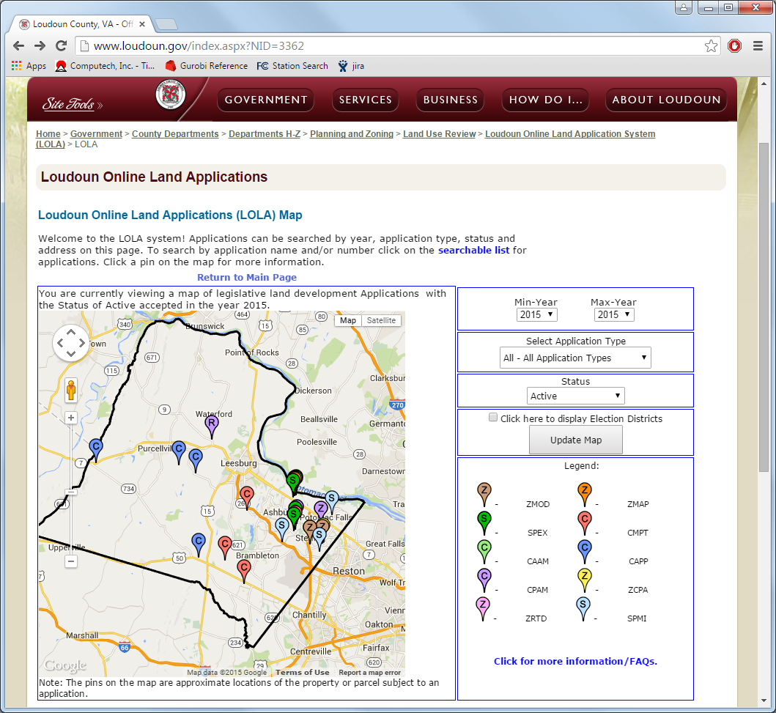
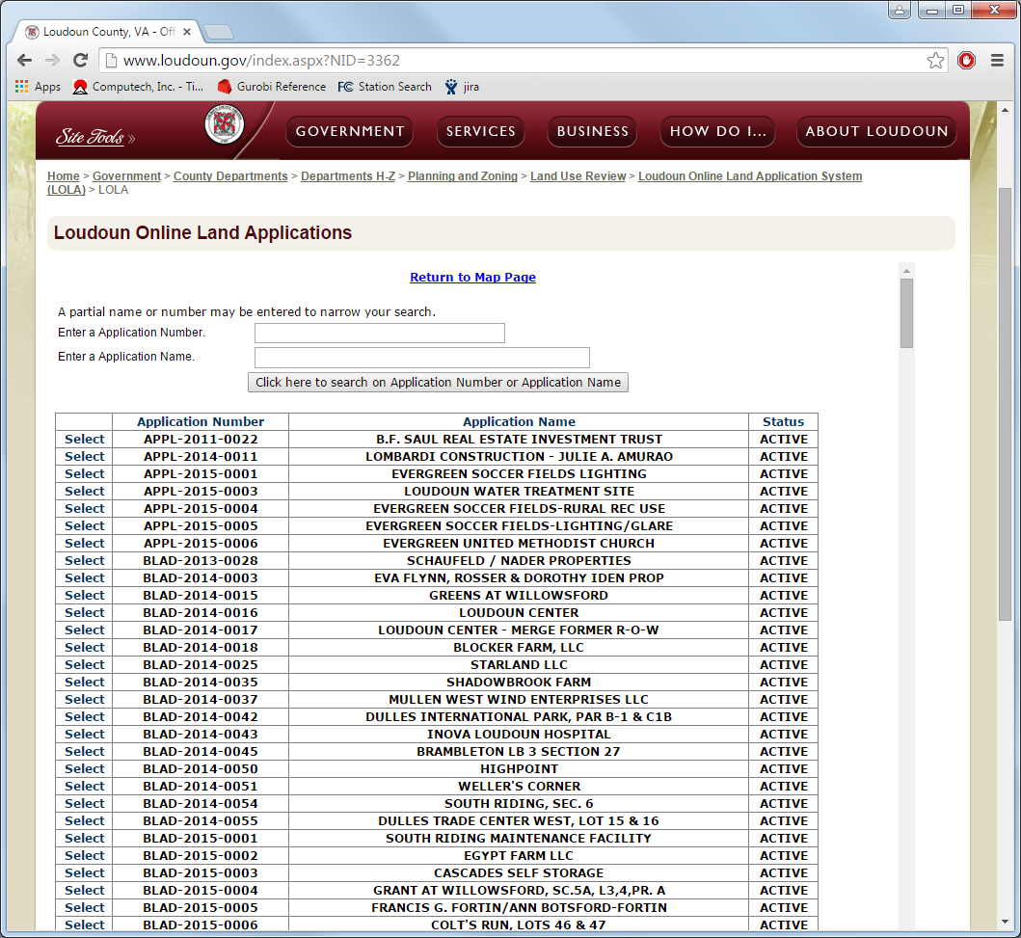
Web Scraper

Slide 23
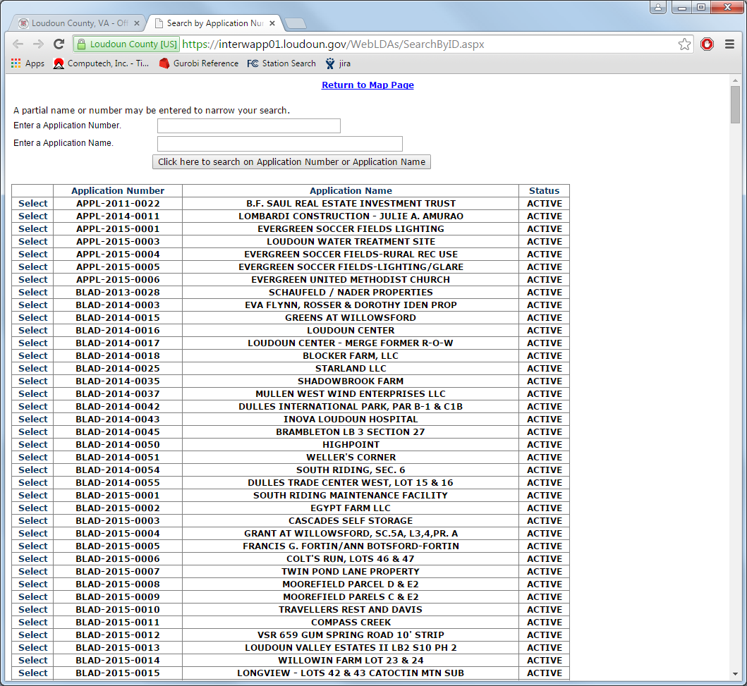
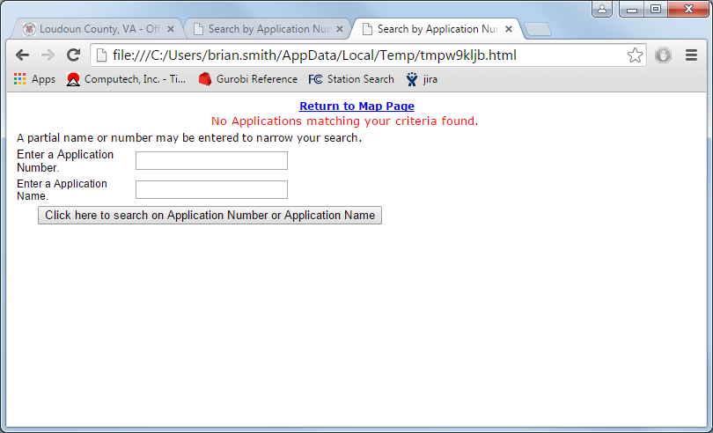
Web Scraper

Slide 24
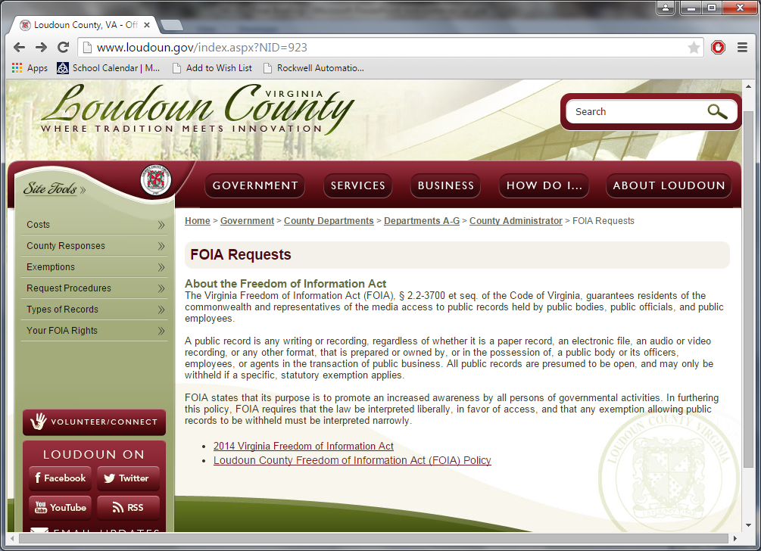
Loudoun County

Slide 25
Capability Trade-off
Two approaches to Data Acquisition Capability
 | Intended Benefits | Identified Risks
Data Scraper | - More complete automation - Minimize human error | - Data may be out of date - Developed website may become out of date - No buy in from Loudoun County
CSV Dump | - Minimize raw data errors (no middle man website) - More control of source data format (No data pre-processing needed) | - Added stakeholder (LC) - FOIA control of data - Human interface

Slide 26
Database
Database created using MySql
  Open Source
  Scalable
  Flexible
  NOVEC currently uses MySql

Slide 27
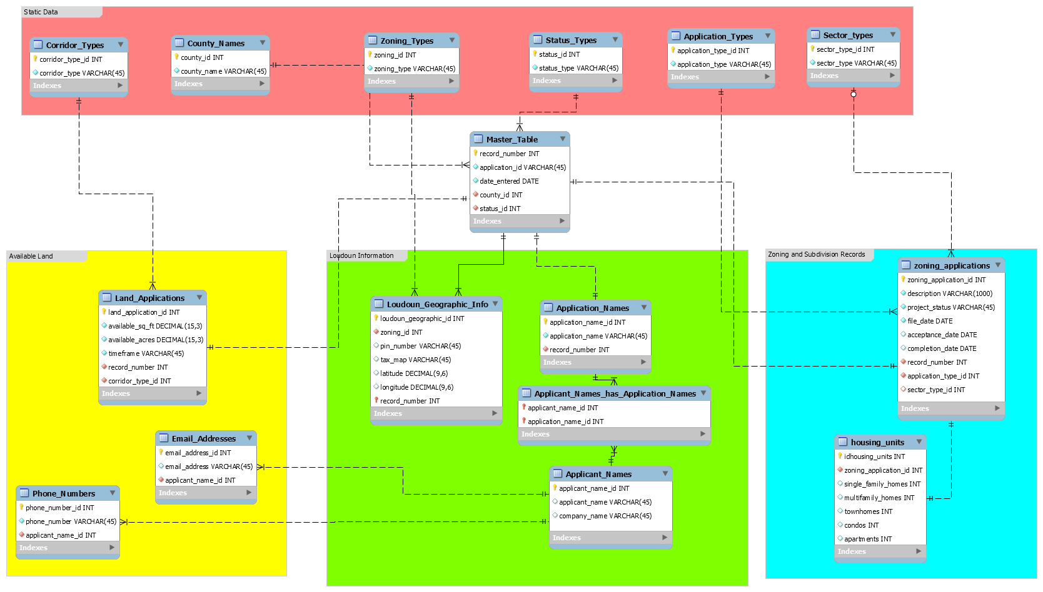
Database Design

Slide 28
Python
Open Source
Self documenting
Robust libraries
  Web crawlers, csv readers/writers, GIS functions

Slide 29
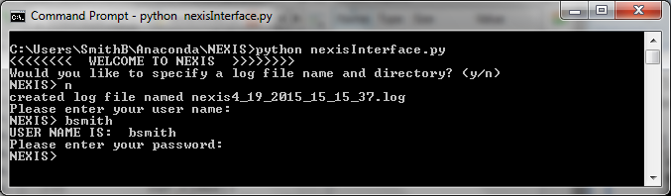
NEXIS Operations
Text interface

Slide 30
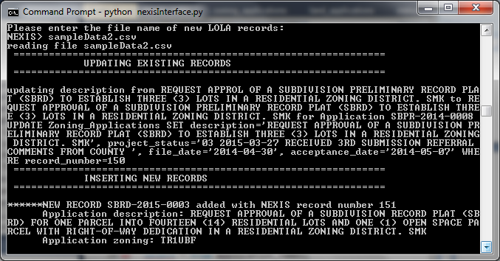
Updating Database
Reads the csv and writes updates to the log

Slide 31
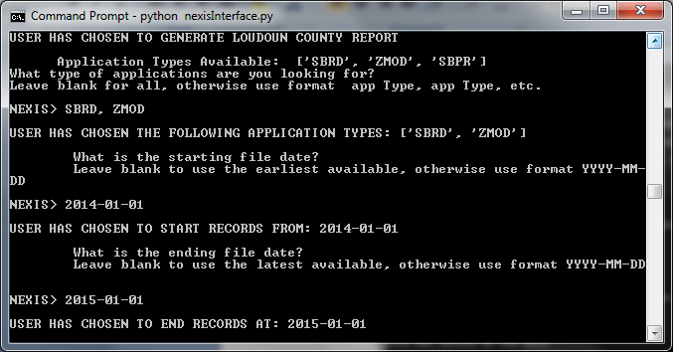
Creates Reports
Determines which records fall within service area and near service area.
Customizable by record type and file date

Slide 32
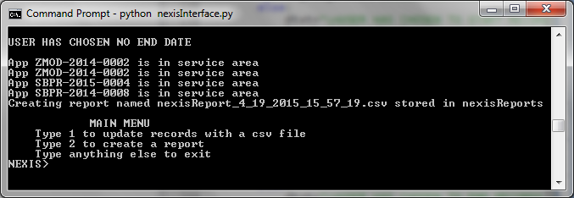
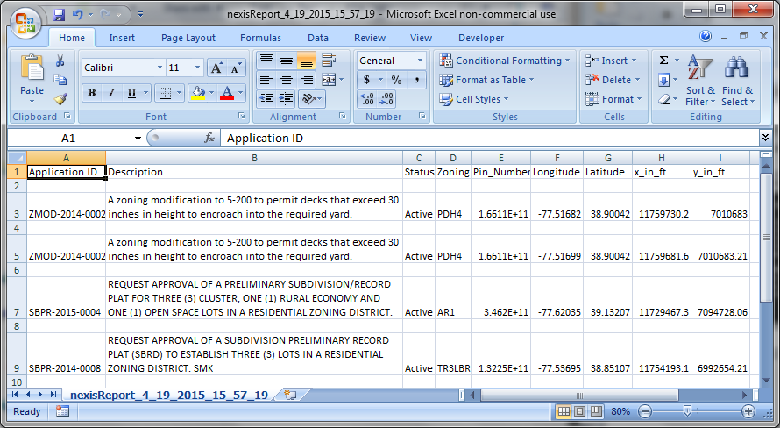
Creates Reports
Writes records to a csv

Slide 33
Impact

Slide 34
Impact
Ability to store important information from across NOVEC’s service area
Ability to provide spatial data for more accurate forecasts
Number of Records | Nominal Errors | System Errors | Error Reduction | Time Savings (min)
5 | 2.8 | 0.0 | 2.8 | 24.5
50 | 27.5 | 0.5 | 27.0 | 254.0
100 | 55 | 1.0 | 54.0 | 509.0

Slide 35
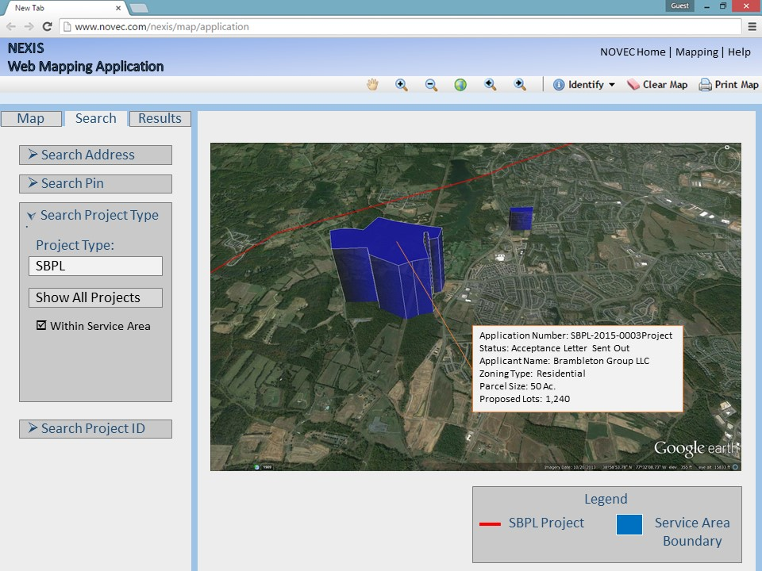
Future Work
Expansion of system to other counties within service area
Incorporate legacy data into forecasting models
Capability Phase II
  Forecast future electricity demands
  Plan asset deployment
Better user interfaces

Slide 36
Lessons Learned
Client engagement early and often
Communicate effectively using a variety of means
Pursue multiple paths

Slide 37
Acknowledgements
Project Sponsors: Bryan Barfield and Ally Shi
Loudoun County: Karen Lanham, Dept. of Economic Development and Diana Witek, Dept. of Information Technology
Faculty: Dr. Barry, Dr. Huang and Dr. Zaidi

Slide 38
Questions?

Slide 39
User Classes
General Users - Accesses the system with a user logon and permissions. The user can perform collections and queries.
Admininstrators - Accesses the system with an admin logon and permissions. The user can perform system level configurations items.
Analyst – Accesses the system with a privileged user logon and permissions. The analyst can perform collections and queries and update the database as needed.

Slide 40
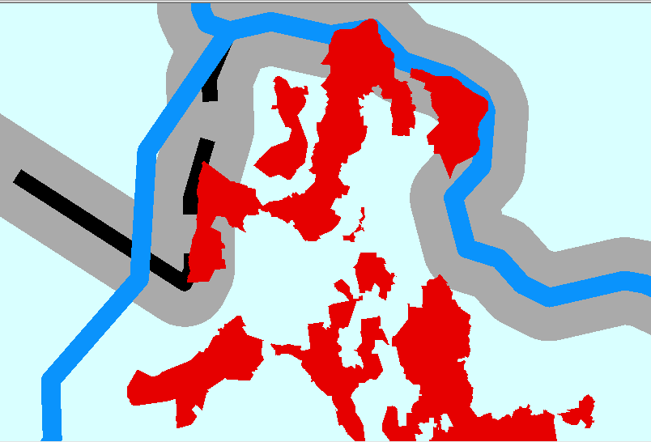
Ray Casting

Slide 41
Future Work (OV-1)

Slide 42
Schedule

Slide 43
Existing Interfaces
Records that populate the NOVEC models
  Land Applications
  Available Land
NOVEC Analyst accesses the LOLA web page and populates their models with records manually (human interface)
Update to interface with automation of data collection process

Slide 44
Web Scraper

Slide 45
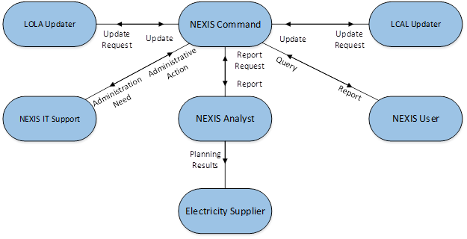
NEXIS Operation
OV-2 Operational
Resource
Flow Description

Slide 46
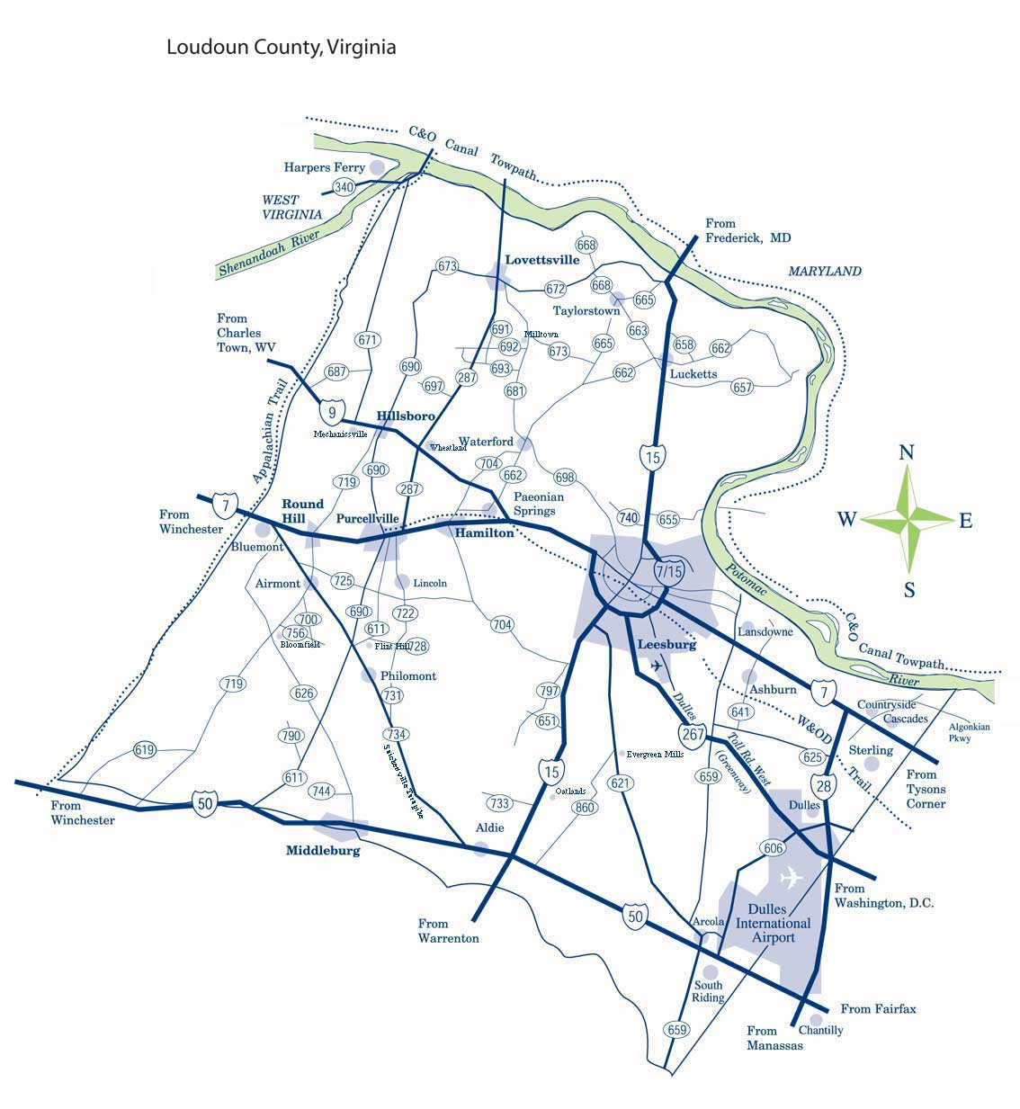
Loudoun County
Quick Stats
  Area: 521 mi²
  Population: 361,000
Economic Development
  Loudoun County Available Land (LCAL)
Planning and Zoning
  Loudoun County Land Application System (LOLA)
    Land Applications (ZMOD, SPEX, SBPL, etc)
    Subdivision Preliminary Plat (SBPL)
      PIN
      Description
      Filled / Acceptance Date
Notes:
Large area
Experiencing increasing growth
While a majority of the country was experiencing economic hardships during recession Loudoun County continued to grow
Define data sources

Slide 47
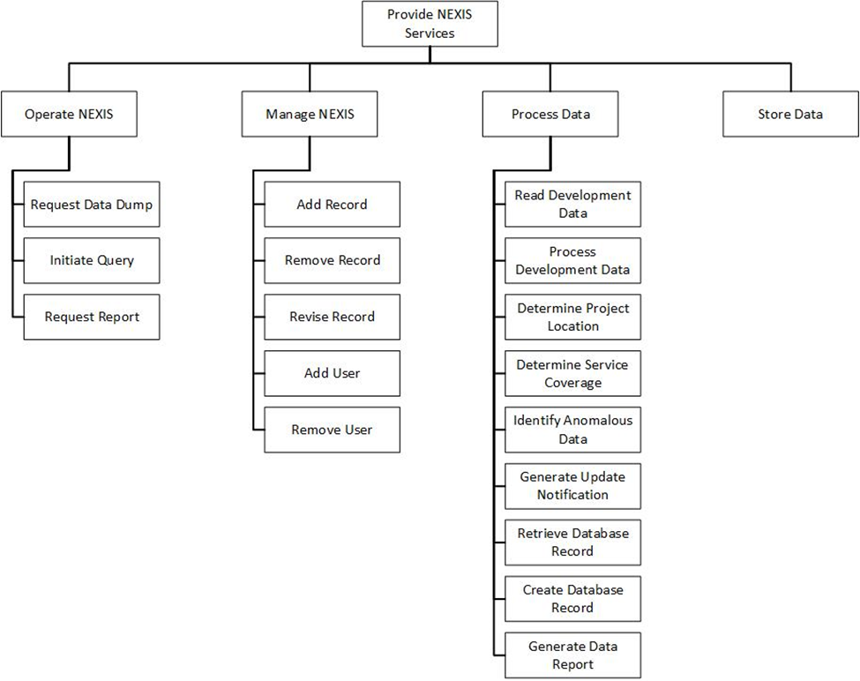
NEXIS Functions
OV-5a Operational
Activity Model

Slide 48
NEXIS Interfaces
SvcV-1
Services
Interface
Description

Slide 49
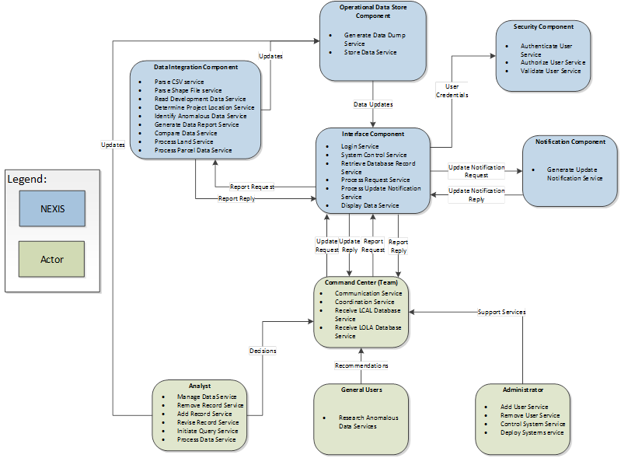
NEXIS Services
SvcV-2 Service Resource Flow Description

Slide 50
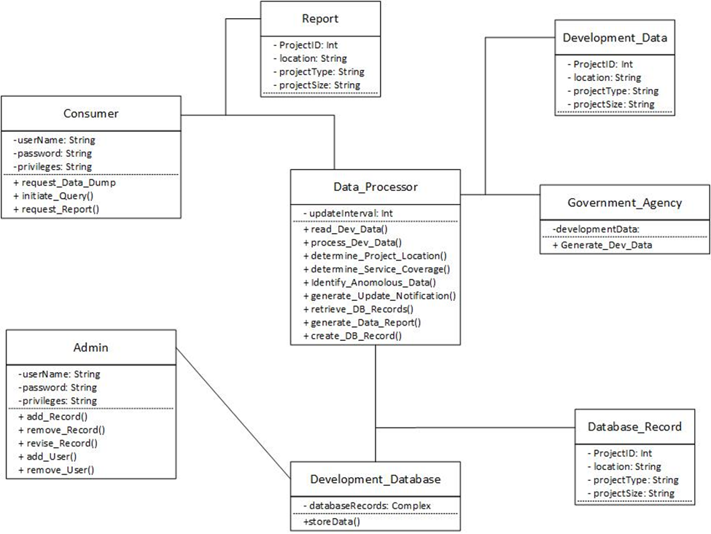
Class Diagram

