Slide 1
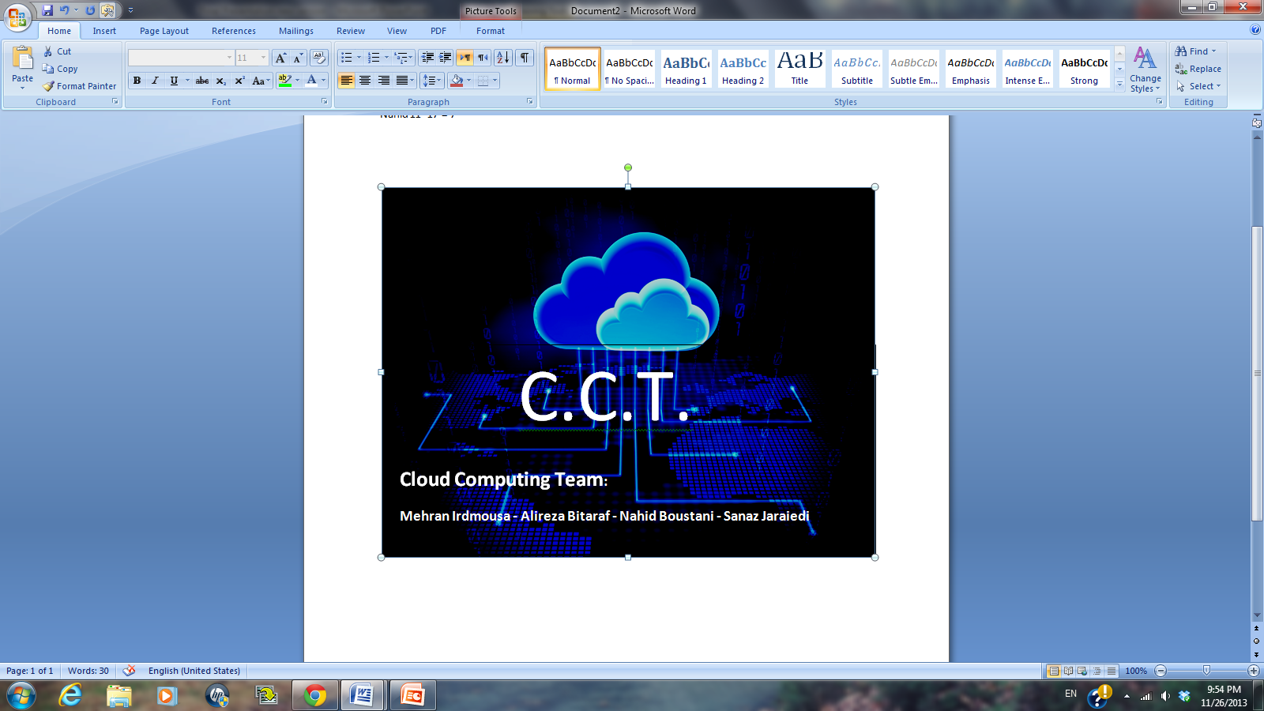



Assessment of Migrating NOVEC’s Core Applications to Cloud
Mehran Irdmousa
Alireza Bitaraf
Nahid Boustani
Sanaz Jaraiedi
Volgenau School of Information Technology and Engineering - Systems Engineering and Operations Research (SEOR)
George Mason University (GMU)
SYST699 – Fall 2013

Slide 2
Agenda
Problem Statement
Stakeholders’ Needs
Project Approach
Technical Research
Technical Analysis
Final Remarks
Questions & Answers

Slide 3



Problem Statement
Cumbersome software maintenance: can cloud provide a higher performance and more integrated solution?
Will moving to cloud reduce the cost?
NOVEC has a warm Disaster Recovery (DR) site. Will it be more effective to look at a cloud solution for DR?
Cyber-security: will cloud provide a secured environment?
Technical and financial perspectives

Slide 4
Statement of Work (SOW)
8 core applications
6 Areas of Focus (aka Major Considerations)
Stakeholders: NOVEC’s application users, LM IT staff, NOVEC’s customers, managers (decision makers)
Assumptions & Scope
  Core applications and major considerations only
  NOVEC’s internet bandwidth can handle proposed cloud solutions
  Impact on current IT staffing is out of scope
  Cloud implementation scheduling is out of scope

Slide 5
Stakeholders’ Needs
Analysis
Higher performance?
More integrated solution?
Cyber-security and DR?
Scalability and agility?
Cloud solution for each application
Application maintenance and patch updating?
Cloud vs. Status quo
Cost reduction in cloud?
Major Consideration-based analysis
Application-based analysis
Utility analysis
ROI Analysis
Notes:
Play the slide show

Slide 6
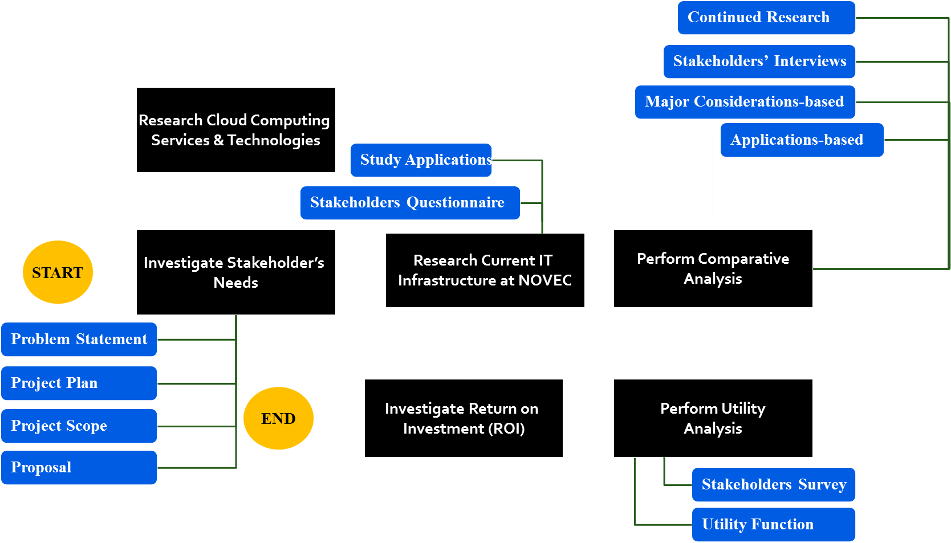
Project Approach

Slide 7

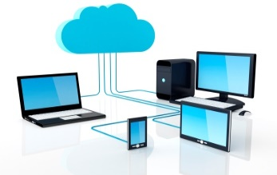

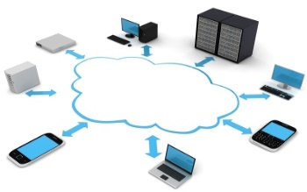
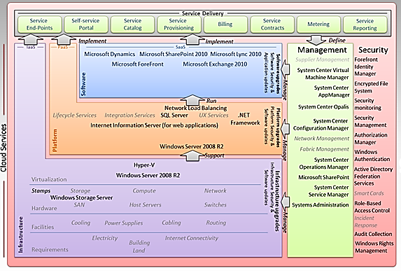
The Big Picture (Tip of the Iceberg Analogy)
Perception
Reality

Slide 8
Research Cloud Computing
Services & Technologies

Slide 9
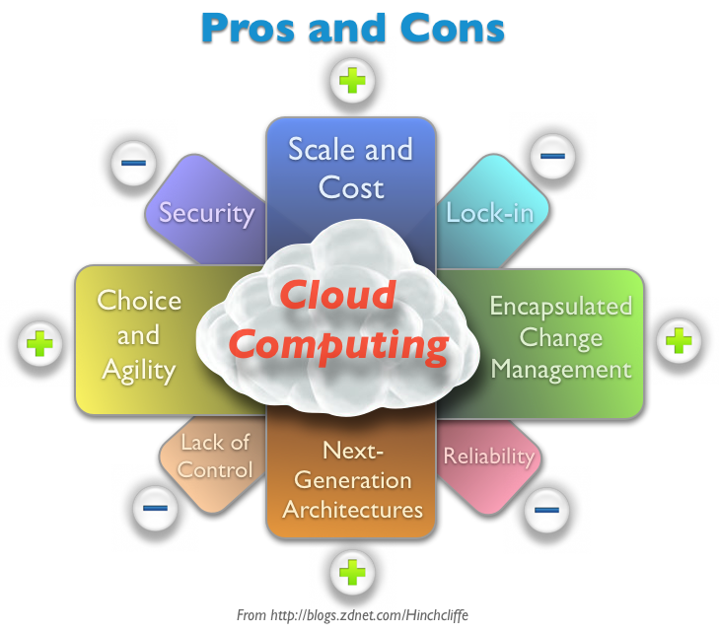
Understanding Cloud
The practice of using a network of remote servers hosted on the Internet to store, manage, and process data, rather than a local server or a personal computer.
Industry Adoption: Almost 80 percent of businesses already make some use of cloud services.
Notes:
http://www.technovalley.in/guest-post-4-disadvantages-of-cloud-computing-you-must-known-about/

Slide 10
Major Considerations & Characteristics
Cyber-security
Performance
Integration
Attack of Physical System
Maintenance Burden
Malicious Internet Content
Authentication Attack
Level of Integration
Application Response Time
Fault Tolerance Maneuverability
Technical Response
Denial of Service Attack
Time to Perform Backup
Speed & Business Agility
Recovery Point Objective (RPO)
Auto Scaling
“idea-to-cash”
Smarter Budget Allocation
Recovery Time Objective (RTO)
Scalability
Number of Users System Handles Simultaneously
Agility
Disaster Recovery (DR)
Distance between DR & Production Site
Real-time Scaling

Slide 11
Research Current IT
Infrastructure at NOVEC

Slide 12
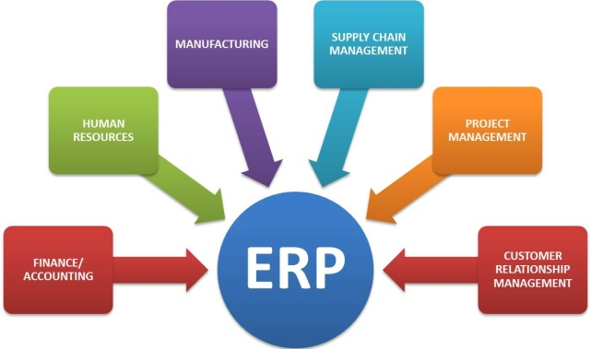
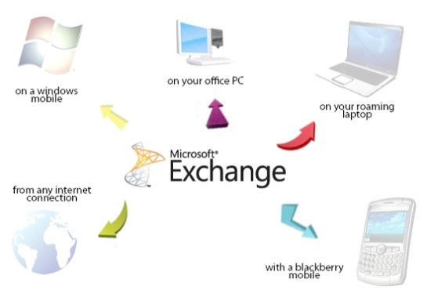

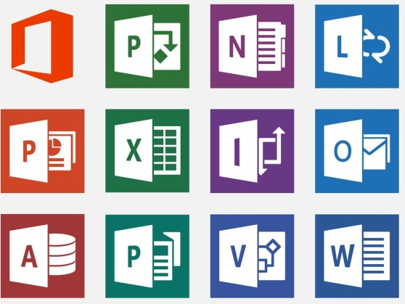
Core Applications
ERP: Enterprise Resource Planning (Lawson/Infor)
CIS: Customer Information System (Daffron)
GIS: Geographical Information System (ESRI)
WMIS: Work Management Information System (Logica/CGI)
NOVEC’s Web Site: www.novec.com
Document Imaging (Comsquared)
Email (Exchange)
Microsoft Office Suite

Slide 13
Research Current IT Infrastructure
Performed site visits, interviewed stakeholders, developed questionnaires to capture:
  Core applications
  Current interdependencies
  Current bottlenecks and issues
  Current hardware and network architecture (i.e. servers, databases, interfaces, etc.)
Contacted application vendors to get details on available cloud solutions

Slide 14
Perform Comparative Analysis
Methodology
Major Considerations-based Analysis
Applications-based Analysis
Findings

Slide 15
Comparative Analysis Methodology
Stakeholders’ Needs
Major Considerations-based
Analysis
(System-level)
Status Quo Pros & Cons
CSP Interviews
Cloud Pros & Cons
Utility
Analysis
Cloud Challenges
Vendor Interviews
Cloud Considerations
Site Visits
Industry Adoption
Applications-based
Analysis
Migration Complexity
Stakeholder Interviews
Cloud Solutions
ROI
Analysis
Cloud Consultants
Application Challenges
Scholarly Articles
Architectural Models
GMU Faculty
Technical Research
Comparative Analysis
CSP Cloud Options

Slide 16
Major Considerations-based Findings Snapshot
This was done for each of 6 major considerations & 18 characteristics
 |  | Status Quo |  | Cloud
Major Considerations | Characteristics | Pros | Cons | Pros | Cons | Important to Note
Performance | Technical Support | Support response time is easier to be negotiated based on the severity of the problem and the availability of the support staff. | There is heavy dependency on support staff expertise for resolving issues. | Access to free documented support manuals, best practice instructions, Q&A forums, and live chats in the virtual world. | There are limited tiers of support packages available. Response time is dependent on the tier of support. Quality of service is unknown. | Many support responsibilities will be handed over to cloud provider for the part of the system moved to their side, affecting performance of the system.

Slide 17
Applications-based Findings Snapshot
This was done for each of the 8 applications
Delivery Model
Deployment Model
Challenges
Complexity
Application |  |  | Rationale
WMIS (Work Management Information System) | IaaS Vendor (CGI) | Private | Benefits in terms of performance (software and hardware maintenance) and disaster recovery | Matching the current application response time is a challenge due to substantial changes in the network. NOVEC might have to increase its bandwidth in order to support simultaneous access to cloud. | High complexity

Slide 18
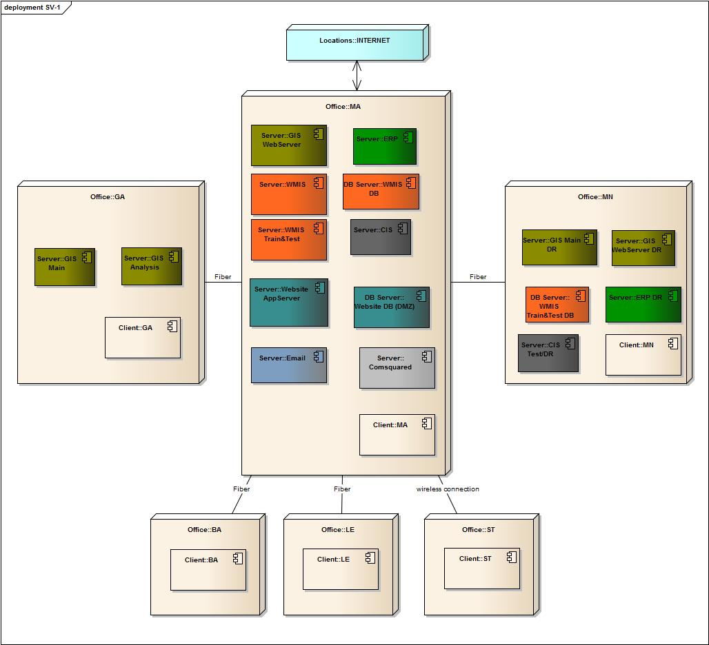
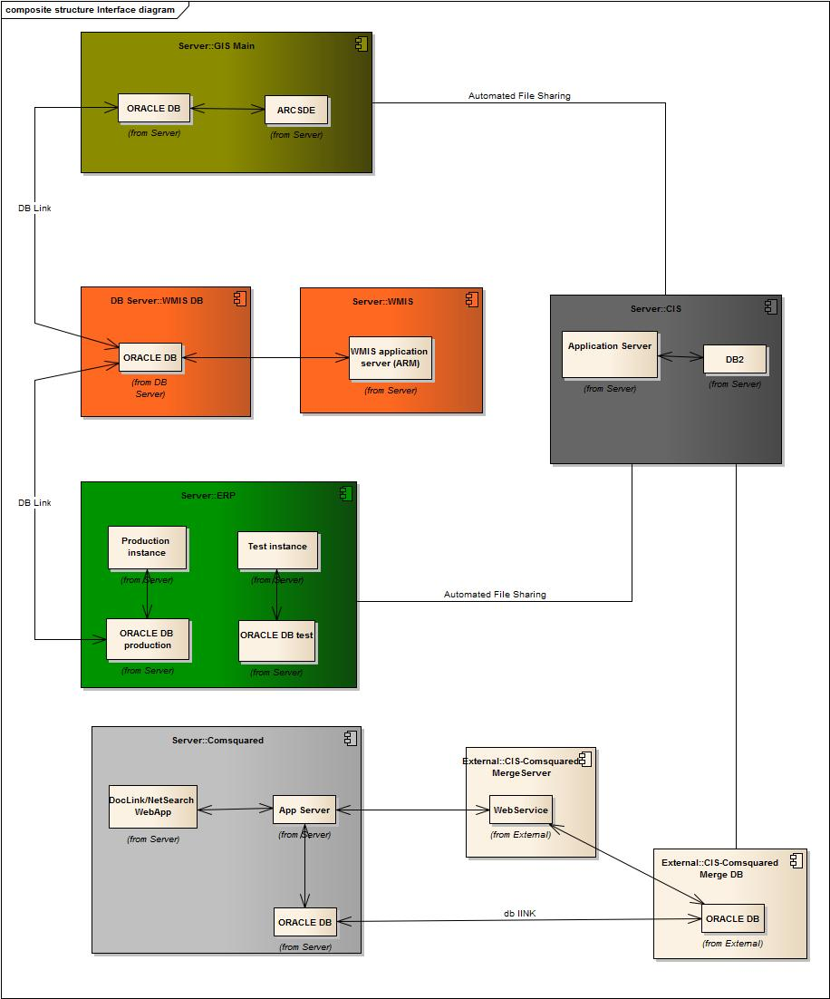
Architectural Models

Slide 19
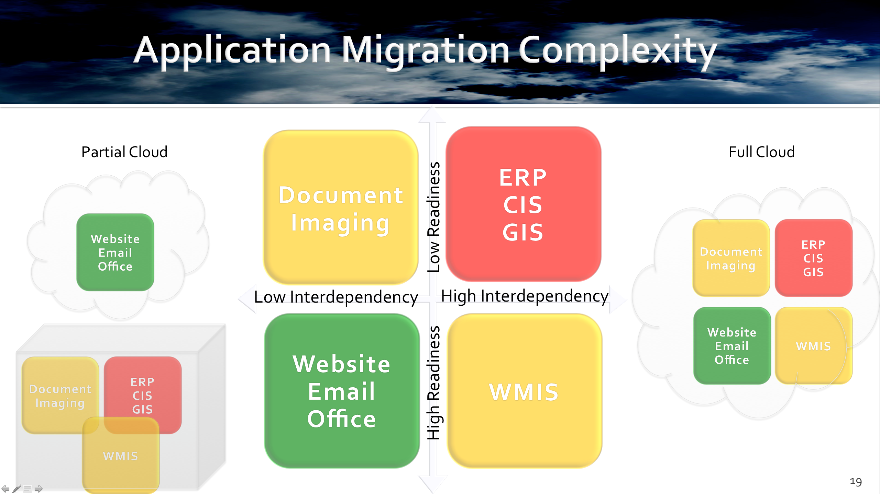
Application Migration Complexity
On-premise

Slide 20
Perform Utility Analysis
Methodology
Analysis
Findings

Slide 21
Utility Analysis
Purpose
  Compare cloud alternatives based on stakeholder values
Attributes
Utility
Weight
Alternatives
Attributes
  Cyber-Security
  Status Quo (SQ)
  Partial Cloud (PC)
  Full Cloud (FC)
  Performance
  Disaster Recovery
  Scalability
  Agility
  Integration

Slide 22
Utility Analysis
Value Hierarchy (VH)
Utility Function (UF)
U_{T} = U = 0.191U_{CS} + 0.178U_{P} + 0.162U_{DR} + 0.125U_{S} + 0.140U_{A} + 0.204U_{I}

Slide 23
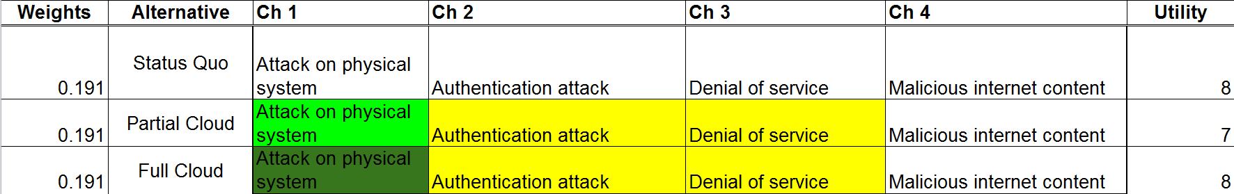
Utility Analysis Findings
Worst
Baseline (SQ)
Best
Scoring System:
0
1
2
3
4
Cyber-security Snapshot:
(This was done for each of the 6 attributes & 18 characteristics)
Characteristic 1
Characteristic 2
Characteristic 3
Characteristic 4
Final Results:
Status Quo: 6.45
Partial Cloud: 6.82
Full Cloud: 9.21

Slide 24
Sensitivity Analysis
Weight Sensitivity
Scenario 1: Swap the weights of the most important attributes
Scenario 2: Assign the same weights to most important attributes
Scenario 3: Assign the same weight to all attributes
Utility Sensitivity
Scenario 1: Increase integration for Status Quo
Scenario 2: Increase technical support for Status Quo Scenario 3: Increase integration and technical support for Status Quo

Slide 25
Investigate Return on Investment (ROI)
Methodology
Findings

Slide 26
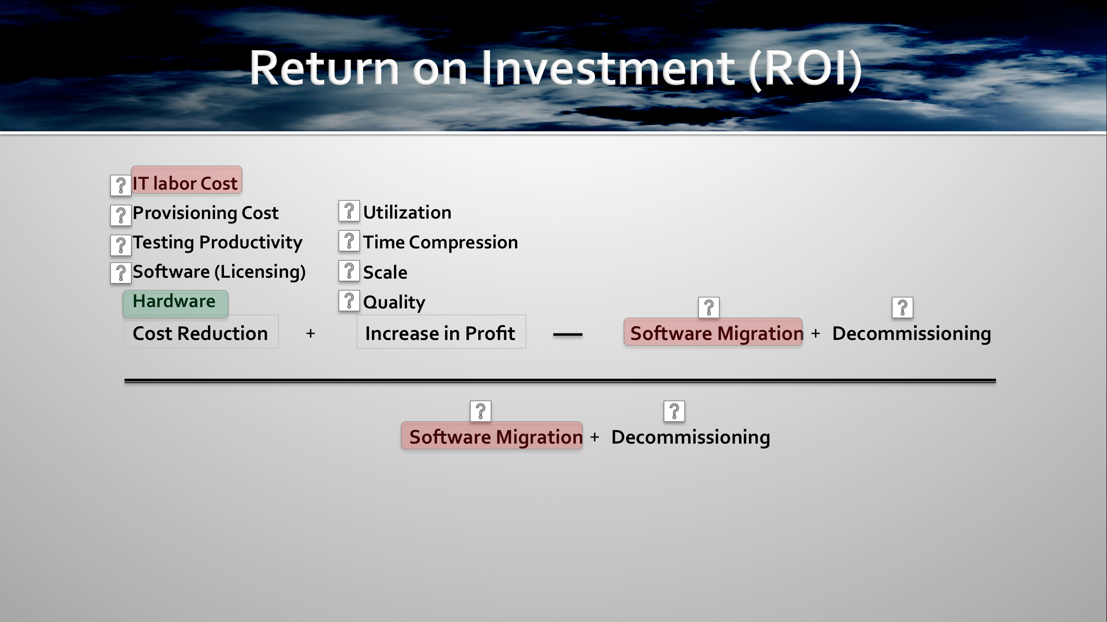
Return on Investment (ROI)

Slide 27
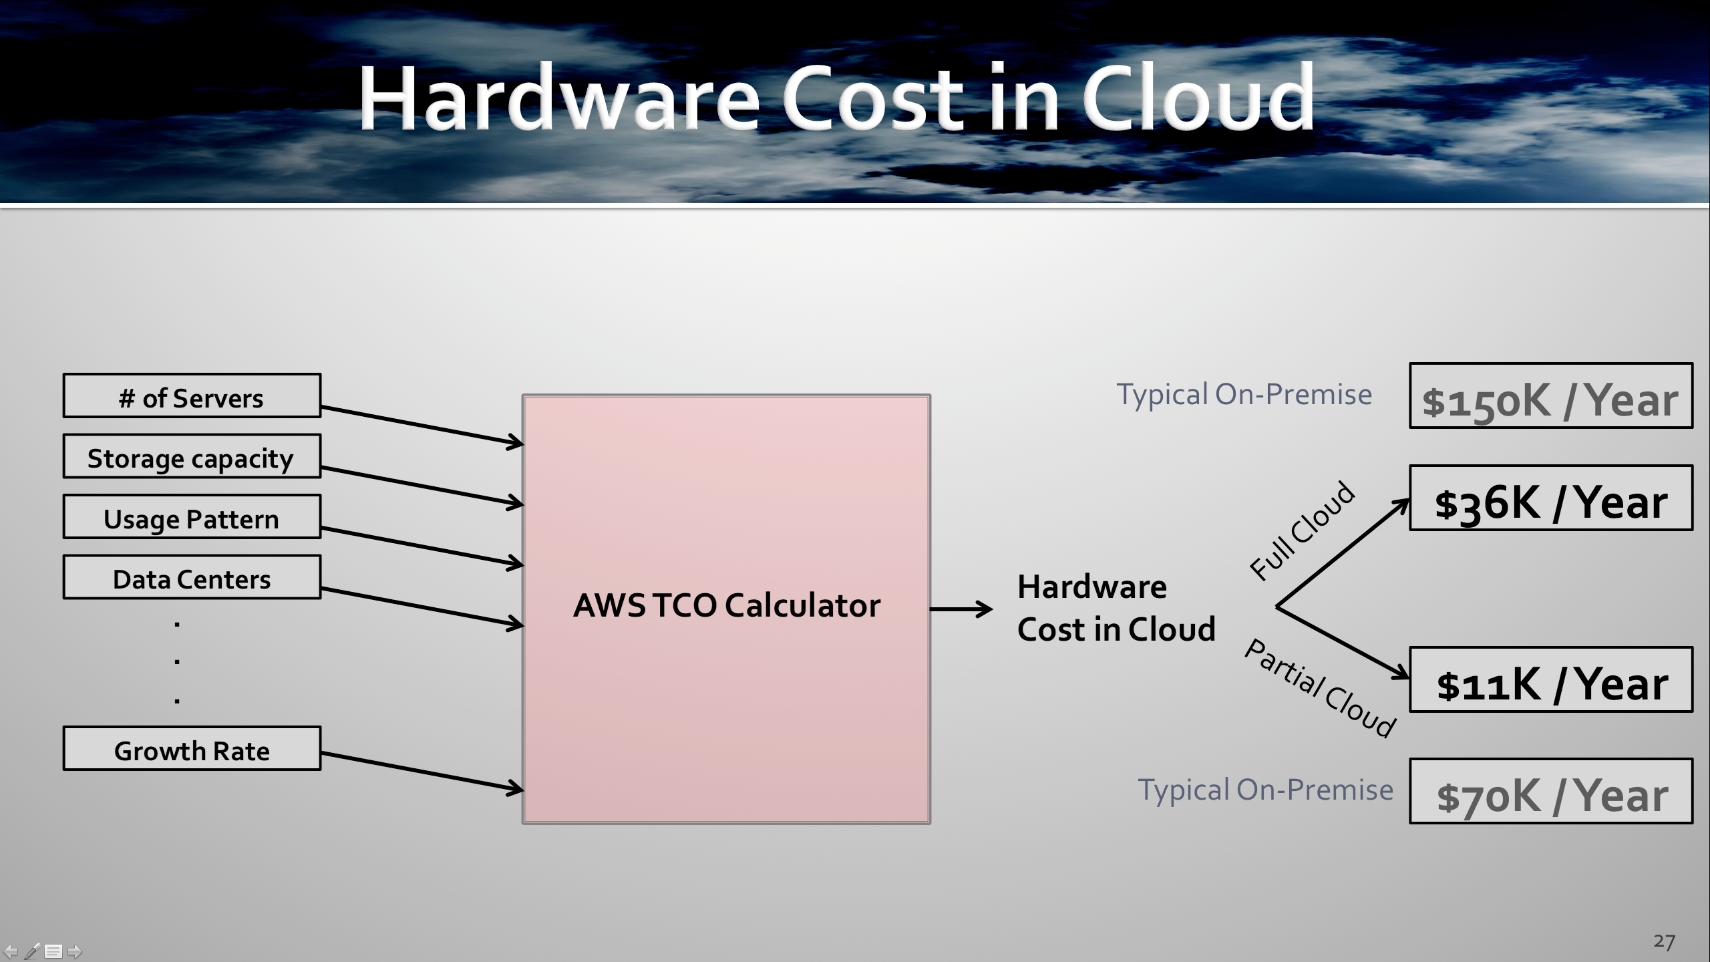
Hardware Cost in Cloud

Slide 28
Final Remarks
Findings Summary
Future Work
Lessons Learned
Resources

Slide 29
Findings Summary
Problem Statement
Findings
Cloud is a challenging environment with advantages and disadvantages
Comparative Analysis
Technical
&
Financial
Perspective
A phased strategy should be taken to move the least complex apps to cloud fist
Complexity Analysis
“Full Cloud” alternative maximizes the utility
Utility Analysis
Cost
IT labor cost & Migration cost are cost drivers
COST Analysis
Security
Disaster
Recovery
It is possible to improve software maintenance, disaster recovery process, and security by migration to cloud if the right solutions are chosen
Comparative Analysis
Software
Maintenance

Slide 30
Future Work
A project to assess complex applications
More in-depth analysis of integration
Analysis of bandwidth
A project to determine full ROI

Slide 31
Questions & Answers
Project Statistics
130 pages of report
6 NOVEC employees interviewed
11 CSPs & application vendors contacted
10 cloud consultants & experts contacted
7 professors contacted
126 articles, papers, books, and scholarly websites reviewed
Lessons Learned
Establish an up-front scope
Follow a technical approach and stick with it
If information is not available from primary sources, utilize secondary resources
The more open communication with the stakeholder, the better the final product

