Slide 1
SYST699 – Spec Innovations
Innoslate™ System Engineering Management Software Tool Test & Analysis

Slide 2
Agenda
Analysis Scope
Analysis Methodology
Analysis Results
Recommendations
Questions

Slide 3
Analysis Scope
Focus of the test is on the functionality, usability, performance, and documentation of/for the tool
Capabilities of the Innoslate have been scoped to:
Database View
Requirements Gathering
Document Analyzer
Report Generation
Notes:
Capabilities of the Innoslate have been scoped to:
Database View, includes storing assets, artifacts, etc
Requirements Gathering, including capturing requirements for the MEEPAS project
Document Analyzer, includes automated versus manual parsing of inputted documents
Report Generation, includes inputting objects into the database and generating a report

Slide 4
Analysis Methodology - Innoslate™ Evaluation Criteria (1)
Functionality
Database – create, edit, delete, import, sort, search, filter content entities
Reports
Requirements – create, edit, delete, sort, search, filter, validate, and map requirement statements
Collaboration – project sharing, shared user presence notification
Usability
Navigation
Coverage of and ability to develop selected SELC artifacts successfully
Intuitiveness and efficiency with regard to utilizing the tool functions
Data organization
Consistent user interface across browsers used for testing (Firefox and Chrome)
Context specific feedback related to user actions
Site map or tool functional hierarchy

Slide 5
Analysis Methodology - Innoslate™ Evaluation Criteria (2)
Performance
Responsiveness
Save/Update/Delete process time
Batch function process time (validation, deletion of multiple entities)
Documentation
Ease of understanding tools capabilities
Accuracy
Guidance for troubleshooting issues

Slide 6
Analysis Methodology - Scoring the Innoslate Capabilities
Evaluation Criteria
The team has defined a set of evaluation criteria for each capability of the tool that is undergoing evaluation
Scoring
A score will be assigned to each capability using a constructed scale where the function $u_{i}$($a_{i}$) is defined as:
$u_{i}$($a_{i}$) = 0 if a capability does not meet evaluation criteria $a_{i}$
$u_{i}$($a_{i}$) = 1 if a capability partially meets evaluation criteria $a_{i}$
$u_{i}$($a_{i}$) = 2 if a capability fully meets evaluation criteria $a_{i}$

Slide 7
Analysis Methodology - Computing Weights
Due to the size of the set of evaluation criteria, the team selected the Paired Comparison method to scoring evaluation criteria
Using the set of evaluation criteria, the team determined an ordering from highest importance to least importance (A thru K)
Developed a rubric to express a criterion’s importance in relation to other criteria (e.g., A = B+D, E = 2G)
Determined the value of each criterion using rubric and setting lowest-order criterion to 1
Used sum of values to normalize the values resulting in a series of weights that sum to 1

Slide 8
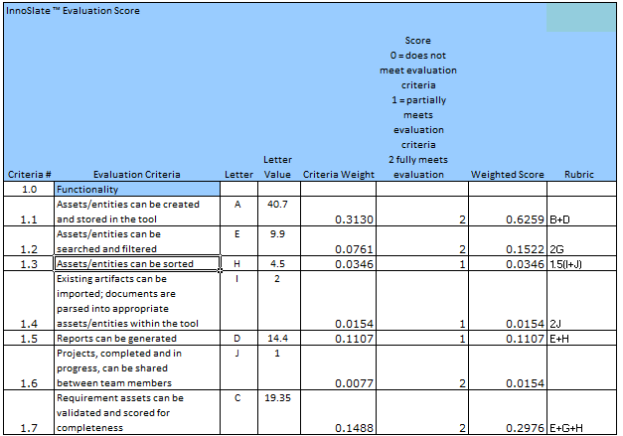
Analysis Methodology - Innoslate™ Scoring Template

Slide 9
Analysis Results – Database View (1)
Database Activities - Performed most database related activities with no issues: Creating, Saving, Viewing, and Searching class entities; Filtering and Sorting the database’s view; Exporting entities from the tool
Importing Documents - Importing documents associated with particular entities works, but seems to lack user-friendliness (user guide needed to perform this activity); to confirm document was uploaded, user has to download document from tool
Deleting Entities/Documents - Deleting already created entities or small artifacts works, however, deletion of large number of entities at the same time resulted in the tool hanging up

Slide 10
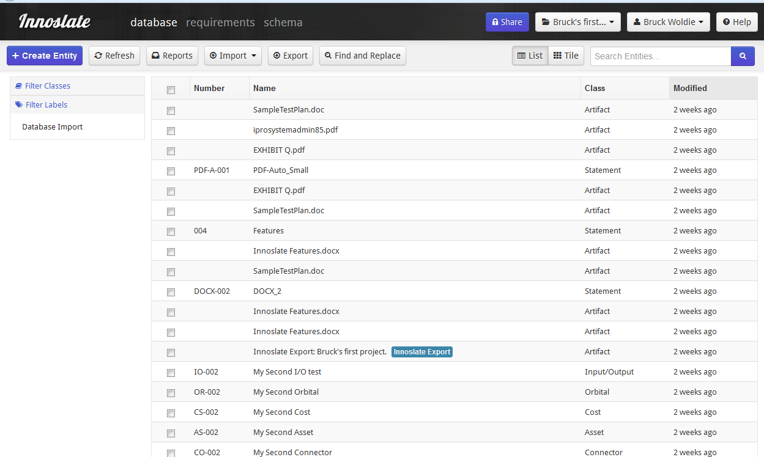
Analysis Results - Database View (2)

Slide 11
Analysis Results – Requirements Gathering (1)
Requirement Database Activities - Creating, viewing, editing, and deleting of requirements performed correctly in accordance with the user guide
Validating – Scoring is inconsistent (two requirements worded very similar, but received very different scores), validation process occasionally caused system to hang
Requirements Deletion - Deleting a large number of requirements at once took a long time; deleting large number of entries (more than 100) was not successful
Requirements Report Generation - Generating the requirements document initializes the document sections; however it is not intuitive how to actually get the specific entered requirements into the document itself

Slide 12
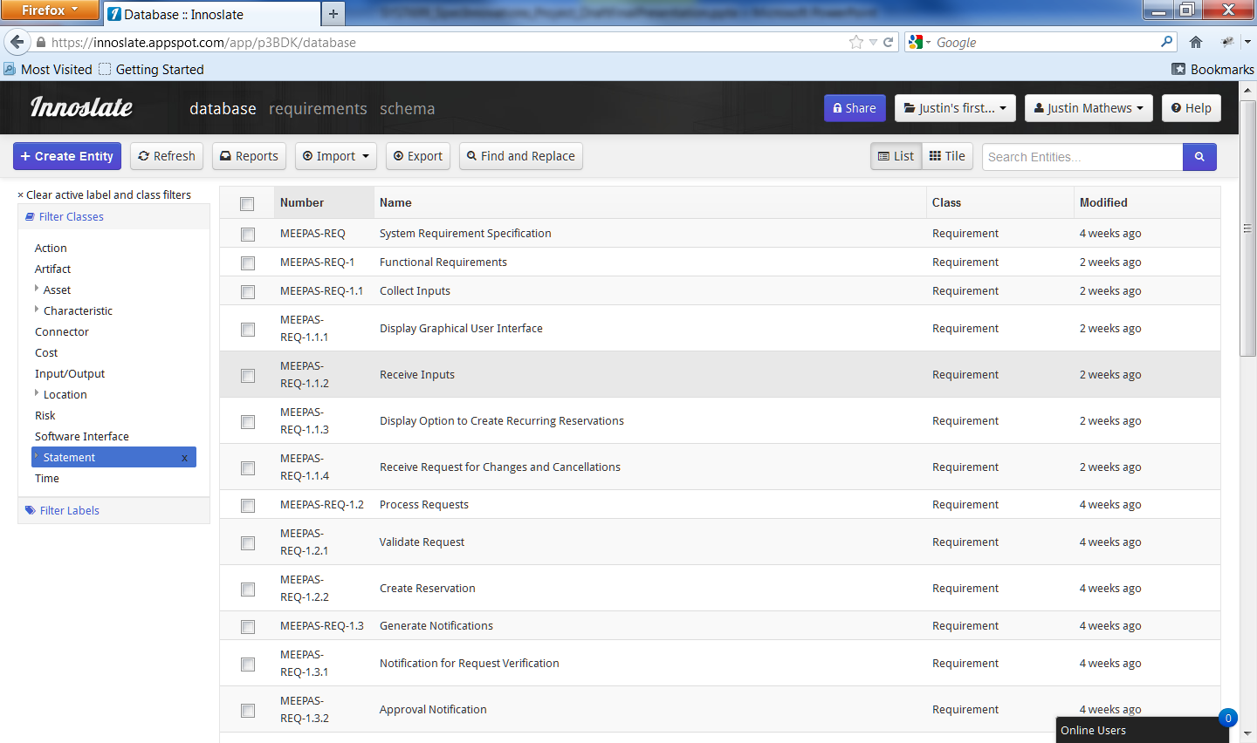
Findings – Requirements Gathering (cont’d)

Slide 13
Findings – Document Analyzer (1)
Importing Document – Uploaded both Word and PDF files; imports small to medium-sized files using the Analyzer with no issues; issues with importing large files (progress bar freezes, but document is imported successfully)
Analyzer – PDFs not parsed completely forcing user to manually enter remaining portions of the document; Word documents parsed successfully; results of parsing couldn’t be seen in database view due to a quota error and the tool freezes

Slide 14
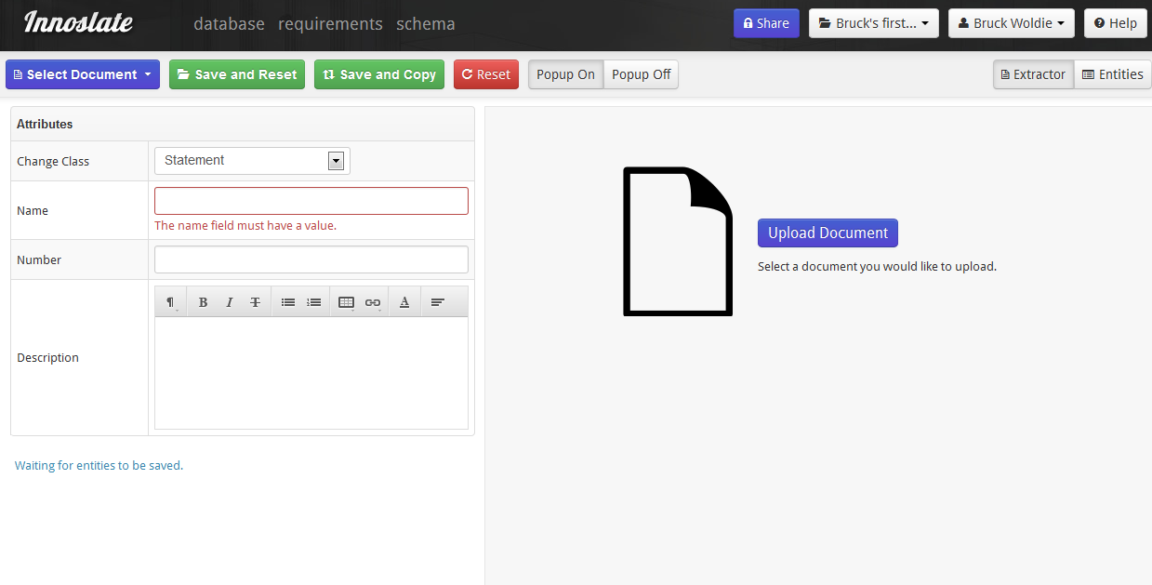
Analysis Results – Document Analyzer (2)

Slide 15
Analysis Results – Report Generation (1)
Class-Based Reports (e.g. requirements) – Tool generated class summary report successfully to display a list of artifact entities
CONOPs Report – User guide claimed CONOPs reports could be generated, but user was unable to locate the capability under General Reports using Google Chrome; Firefox users generated report without issues
DoDAF Reports - Failed to generate. DoDAF views are not yet implemented in the current version of Innoslate.
JCIDS Reports – Tool generated class summary report successfully to display a list of artifact entities

Slide 16
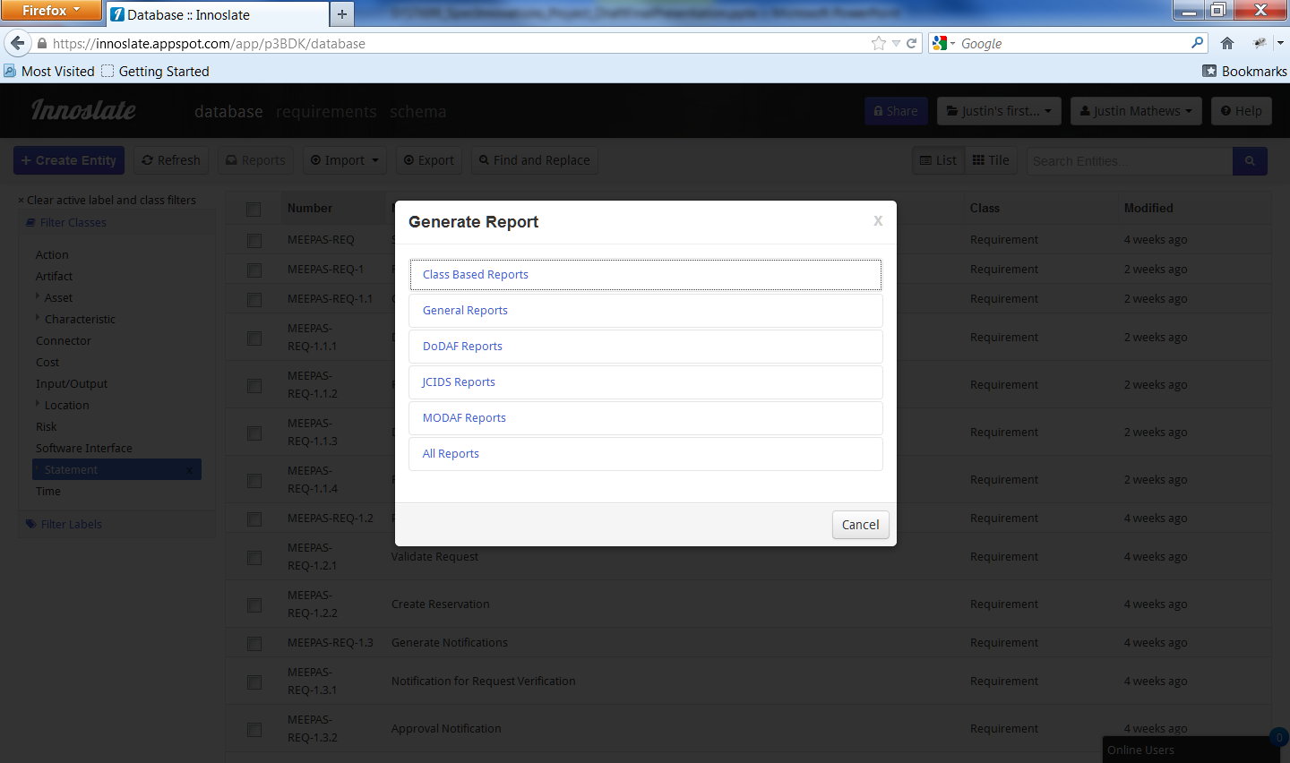
Analysis Results – Report Generation (2)

Slide 17
Analysis Results - Innoslate™ Scoring Results
Scoring broken into four groupings with a total score for the tool (0 - does not meet needs, 1 - partially meets needs, 2 – fully meets needs):
Functionality 1.7859
Usability 1.0557
Performance 1.7222
Documentation 1.35
Total 1.4784

Slide 18
Recommendations - Database View
Below are the salient points from our recommendations for improving the Database feature of Innoslate:
There need to be an alert to caution the user about data loss, when he/she tries to navigate away from an entity’s create/edit screen.
Need to have explicit message when uploading files into the system, prompting users the status and outcome of the upload. When going through entities having attached files in them, need to have a graphic display to indicate that the entity contains files.
Need to have the capability to delete already uploaded files.
Need to improve on the ability to sort the list of entities from the Database view; currently only can sort using only a subset of the available attributes.

Slide 19
Recommendations - Requirements Gathering
Below are the salient points from our recommendations for improving the Requirements feature of Innoslate:
A feature that enables a mechanism for automatic-numbering of requirements or perhaps a visual display noting the current numbering scheme would be helpful when entering requirements.
A status display or progress bar would be very helpful to the user when running the requirements validation function within the requirements view.
It would be desirable to have the capability to add multiple requirements at once without having to exit to the database view after creating each requirement.

Slide 20
Recommendations - Document Analyzer
Below are the salient points from our recommendations for improving the Analyzer feature of Innoslate:
When uploading files using the Analyzer, there exist 2 identical options for seemingly doing the same thing (i.e. upload files), namely “Upload Documents” and “Select Documents” options. Recommended to have only one of the options.
Similar to the importing feature of the database function mentioned previously, need to have explicit messages prompting user the status and outcome of file uploads.
When file fails to upload, need to provide more specific error messages rather than simply stating that the upload failed.

Slide 21
Recommendations - Report Generation
Below are the salient points from our recommendations for improving the Report Generation feature of Innoslate:
Since DoDAF views and reports are essential tools for a Systems Engineer, that capability need to be implemented soon.
It would be useful if the 'Report Completed' dialog had a 'View Report' button which would open the report just generated.

Slide 22
Next Steps
Continue integrating the analysis of the two teams
Refine recommendations to ensure final recommendations are sound and appropriate
Finalize report and presentation

Slide 23
Questions

