Slide 1
Ship Maintenance Costs
Brittany Basilone
Rudy Catahan
Paul Heroman
Jean-Ali Tavassoli

Slide 2
All Hands on Deck
Team
  Brittany Basilone, MS OR (Fall 2012)
  Rudy Catahan, MS SE (Fall 2013)
  Paul Heroman, MS OR (Fall 2012)
  Jean-Ali Tavassoli, MS OR (Fall 2012)
Sponsor
  NAVSEA Cost Community
    Naval Surface Warfare Center, Carderock Division (NSWCCD) Code 2110, Cost Effectiveness Branch
      Molly Mertz, Cost Team Lead
    NAVSEA 05C Cost Engineering and Industrial Analysis Group
      Technical Warrant Holder for Cost Analysis
    Naval Center for Cost Analysis (NCCA)
      Mike Carey, VAMOSC Program Manager
* Views expressed in this study are those of the authors and do not reflect views of the US Navy

Slide 3
Agenda
Introduction
  Problem Definition
  Types of Maintenance
  Data Sources
Analysis
  DDG-51 Flight 1 Historical (First half of life)
  DDG-51 Flight 1 Forecast (Second half of life)
Wrap-Up
  Other Analysis Performed
  Further Studies

Slide 4
Introduction

Slide 5
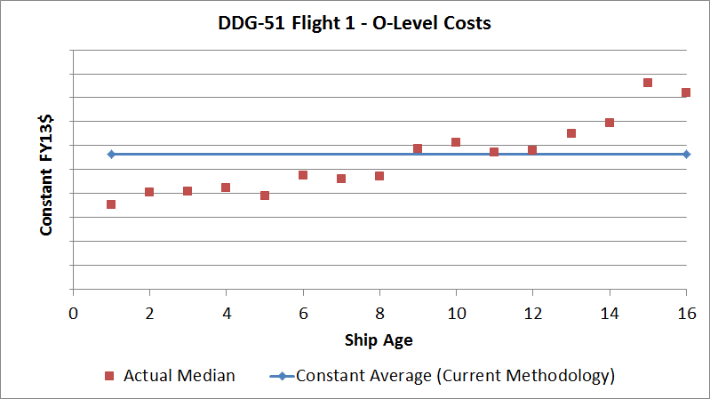
Problem Definition
Theoretical Modeling
  Estimating ship maintenance is currently very static (historical average applied to every year of estimate)
  Although aging impacts are inherent in the average, estimates are not as dynamic as desired
Reality
  Maintenance costs are not the same every year
  Goal is to adjust cost estimating models to better reflect reality

Slide 6

Purpose
Importance of cost estimating is at an all-time high
  Increased scrutiny of defense budgets/Fiscal constraints
  Navy must be better equipped to anticipate costs
Lifecycle cost estimating includes 4 phases:
  Research & Development
  Procurement
  Operations & Sustainment (O&S) – tends to be most expensive
  Disposal
$
*Image from Defense Acquisition University, www.dau.mil
$
Procurement
O&S
R&D
Disposal
Maintenance
Years

Slide 7
Deliverables
Sponsor has requested the following:
  Age curve/factor for DDG-51class at appropriate levels of maintenance
  Forecasted factors for future DDG-51 maintenance costs
  Guidance/documentation on analysis & application

Slide 8

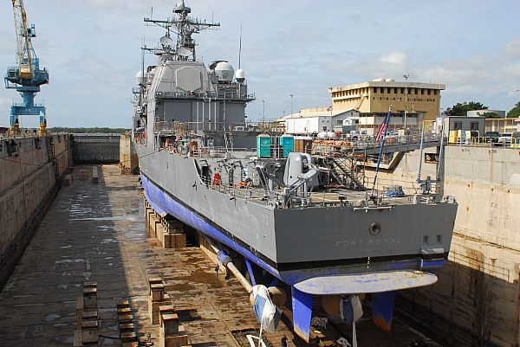
Types of Maintenance
Organizational Level
Performed by ship’s crew
Includes only material costs
Intermediate Level
Includes tasks that are outside crew’s capabilities
    Can be performed pier side, underway, or at an I-level facility
Depot Level
Typically performed at a shipyard, in dry dock or pier side to accomplish more intense maintenance tasks
Determined by Chief of Naval Operations (CNO)
* Funding source has large impact on maintenance categorization

Slide 9
Data
Visibility and Management of Operating and Support Costs (VAMOSC)
  Congressionally mandated database that collects/houses O&S costs for the entire Navy
  Use in analysis:
    O-Level: material costs & manhours
    I-Level: labor/material costs & manhours
    D-Level: scheduled maintenance costs
OPNAVNOTE 4700 (dated August 2011)
  Annual budgeting/scheduling document from the Chief of Naval Operations (CNO) that lists the maintenance timeline necessary for a ship class to reach its Expected Service Life
  Use in analysis: D-Level planned maintenance
Naval Vessel Register
  Official Inventory of US Naval Ships and Service Craft
  Use in analysis: technical summary of each ship class

Slide 10
Analysis:
DDG-51 Flight 1
Historical

Slide 11
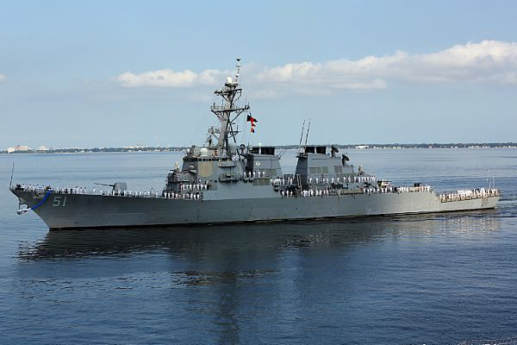
DDG-51 Flight 1
Class Name: Arleigh Burke
Ship Type: Guided Missile Destroyer
NVR Reference Hull: DDG-51
Overall Length: 505 ft
Extreme Beam: 66 ft
Maximum Nav. Draft: 31 ft
Light Displacement: 6,691 LT
Full Displacement: 8,960 LT
Hull Material: Steel Hull, Steel Superstructure
Number of Propellers: 2
Propulsion Type: Gas Turbines
Officers: 26
Enlisted: 330
DDG 51 Flight 1 will be the focus of our analysis

Slide 12
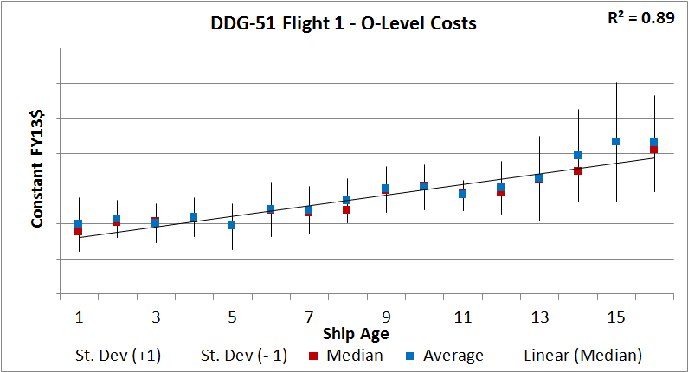
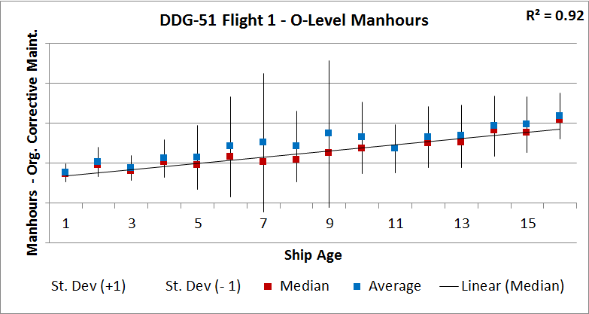
O-Level Maintenance
O-Level costs include material only (performed by ship’s crew)
O-Level median costs generally increase with age
O-Level median manhours show similar trend
  Manhours show greater variability across age levels than total cost
  Variability driven by few ship years that reflect high manhours that do not translate into high costs
    Suggests that these maintenance actions are not material-intensive
    Future research required to gain more insight into these outliers

Slide 13
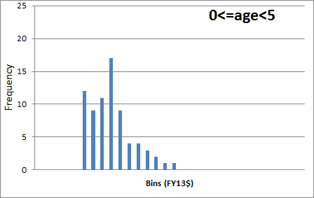
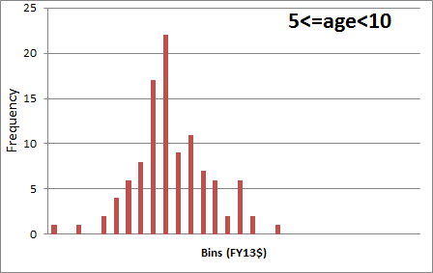
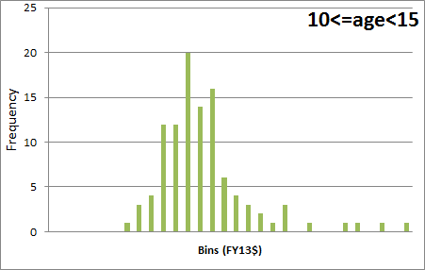
Age Progression
0-5 years
Throughout the first 15 years of life, O-level maintenance costs increase
Distributions show different shapes, along with increasing means
5-10 years
10-15 years

Slide 14
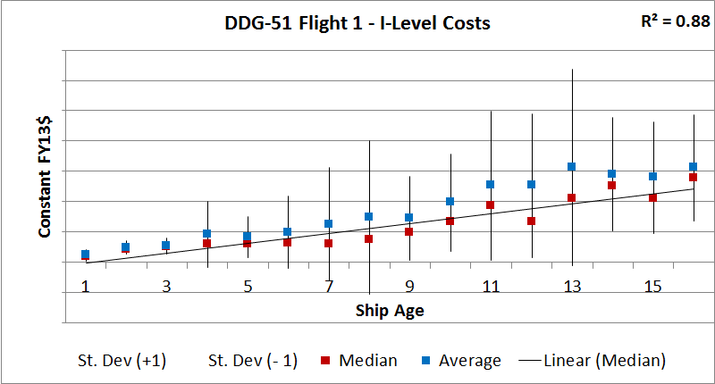
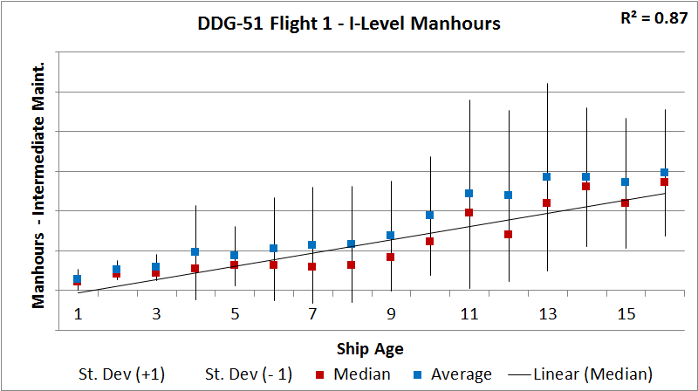
I-Level Maintenance
I-Level costs include Labor and Material
  Labor is the main cost driver (~85% of I-Level costs)
  Material costs are generally consistent across ages
Median costs and manhours generally increase with age
  Variability tends to increase with age

Slide 15
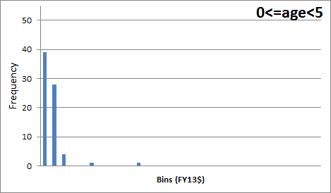
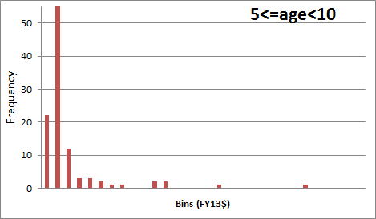
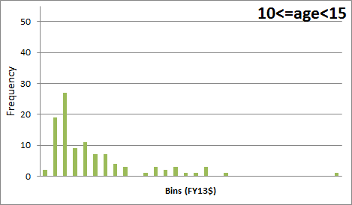
Age Progression
0-5 years
5-10 years
Bin count and size are thrown off by outliers in years 5-15
Although costs appear to increase with age, histogram view is not appropriate
10-15 years

Slide 16
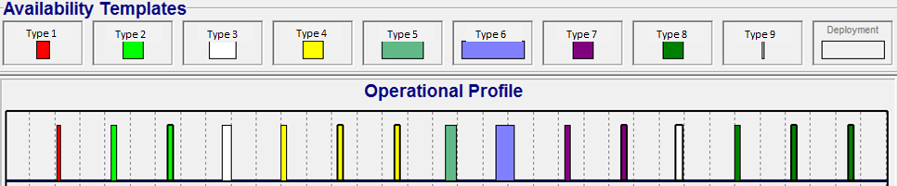
D-Level Maintenance
D-Level maintenance is planned discretely by CNO
  Methodology for O/I-Level analysis cannot be applied to D-Level
D-Level maintenance periods scheduled by OPNAVNOTE 4700
Schedule above represents a notional profile
  Guidance changes every year
Month

Slide 17
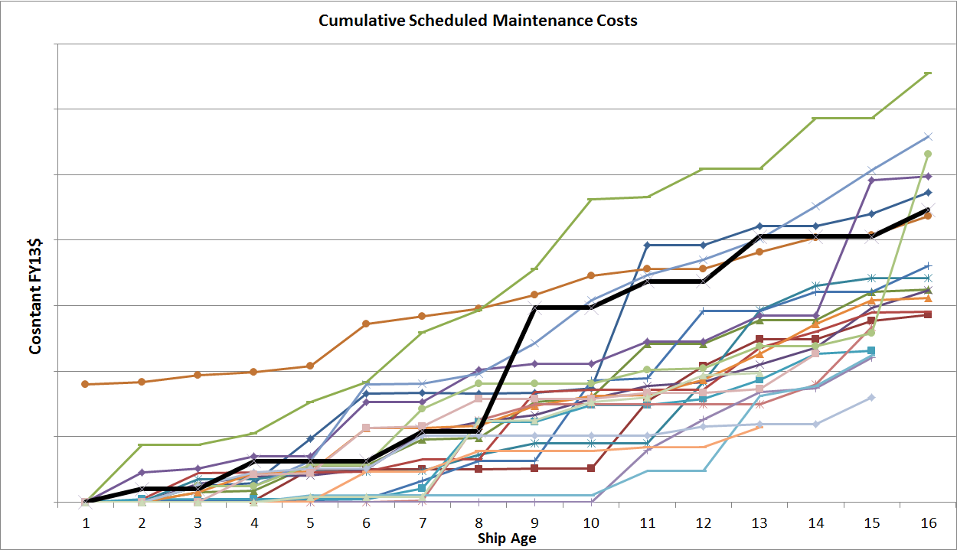
D-Level Maintenance
Compared actual cost returns with OPNAVNOTE 4700 guidance
  Converted manday guidance to notional FY13$ for comparison (labor and material)
Most hulls have lower cumulative costs than planned
  Actual costs reflect multiple iterations of OPNAVNOTE 4700 guidance
    Notional line represents latest guidance
  Possibility that ships are not being maintained to the extent required (unable to confirm)
  Possibility that work is being completed at another level of maintenance (unable to confirm)
OPNAVNOTE 4700 FY13$

Slide 18
Analysis:
DDG-51 Flight 1
Forecast

Slide 19
Forecast Analysis
Methodology
  Normalized general aging trends to compare multiple combatant classes
    Quantified aging impacts that can be applied to future ship platforms
  Forecasted future maintenance costs of DDG-51 Flight 1
Notes:
Same label issues

Slide 20
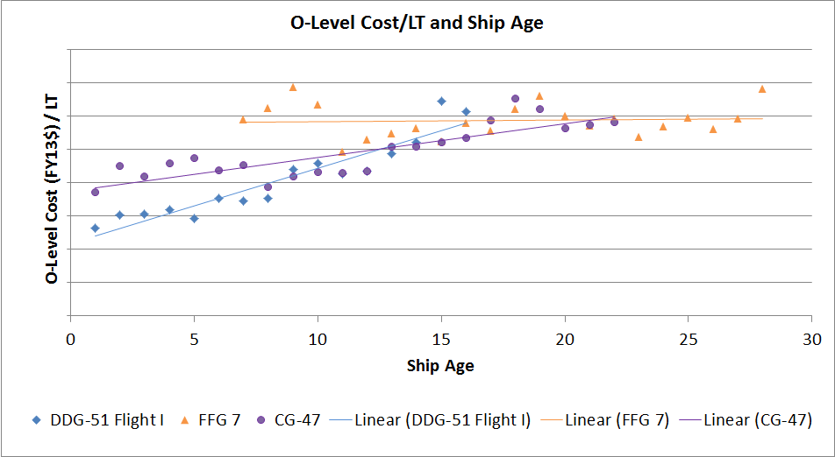
O-Level Cost Aging Factors
FFG-7 shows an increasing trend in terms of manhours, but not in terms of costs.

Slide 21
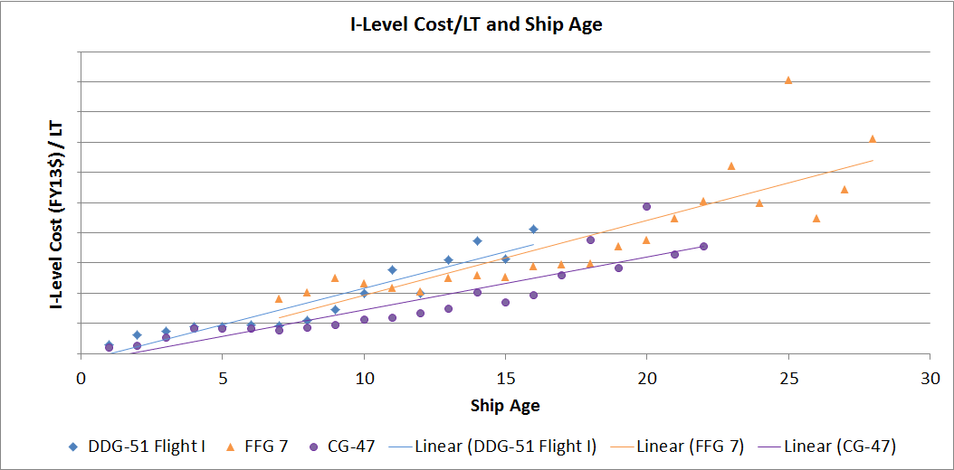
I-Level Cost Aging Factors
Classes generally show similar aging factors
Notes:
same

Slide 22
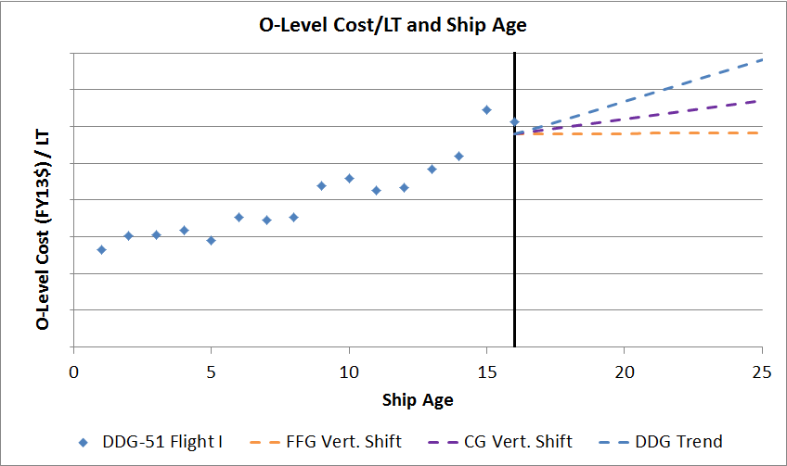
O-Level DDG-51 Forecast
DDG-51 Flight 1 data available through age 16
Leveraged other historical combatant trends to extrapolate future of DDG-51 maintenance costs
Range of forecasts can be used to develop risk ranges
Possible future trends based on other historical combatants

Slide 23
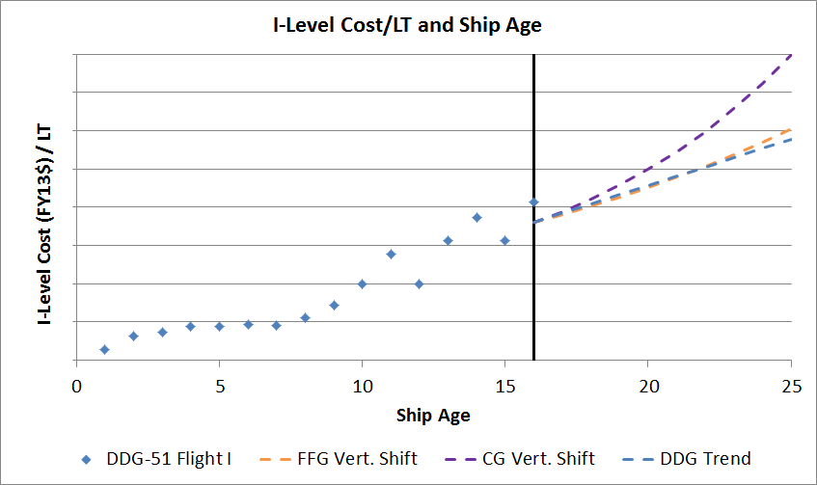
I-Level DDG-51 Forecast
DDG-51 Flight 1 data available through age 16
Leveraged other historical combatant trends to extrapolate future of DDG-51 maintenance costs
Range of forecasts can be used to develop risk ranges
Possible future trends based on other historical combatants

Slide 24
Wrap-Up

Slide 25
Other Analysis Performed
Investigated non-cost element effects on trends
  Operational Tempo: Steaming Hours Underway/Not Underway
  Enlisted Personnel count
Considered stochastic approach
  Visually inspected distributions of cost by age using histograms
  Found best fit probability density function
Started initial analysis on Amphibious vessels
  O/I-Level analysis performed
  Further data understanding necessary
Researched existing studies
  Service Life Extension Plan (SLEP) Study for Amphibious vessel
  Technical Foundation Paper for Amphibious vessel

Slide 26
Further Studies
Refine current approach
  Gain additional data understanding
    Research cause of outliers
    Consider why planned maintenance costs do not match actual costs expended
  Compare actual costs with budgeted costs
    Explore VAMOSC Depot Universe to obtain actual start and end dates of maintenance periods
    Overlay annual O&MN allocations to compare actuals costs with budgets
  Examine if trends hold across multiple ship types
    Submarines
    Air Craft Carriers
    Amphibious Vessels

Slide 27
Deliverables
Sponsor has requested the following:
  Age curve/factor for DDG-51class at appropriate levels of maintenance
    DDG-51 Flight 1 aging factors for O-Level and I-Level maintenance costs
  Forecasted factors for future DDG-51 maintenance costs
    DDG-51 Flight 1 forecasted aging factors based on FFG-7 and CG-47 classes
  Guidance/documentation on analysis & application
    Guidance/Documentation of analysis and application included in package to sponsor
Aging Impact analysis will be incorporated into estimates produced by the, NAVSEA 05C, Navy’s technical warrant holder for cost.

Slide 28
Thank you, you were an ORSE-ome audience ☺
Questions?

Slide 29
Bibliography
http://www.navy.mil/view_image.asp?id=130721
http://www.navy.mil/view_image.asp?id=68934
http://www.navy.mil/view_image.asp?id=137844
https://www.dau.mil/

