Slide 1
Project #3: Production Cost Savings at Washington Post
SYST 798/OR 680
Project Proposal
February 17, 2011
Thomas Kuklinski
Timothy Smith
Ling Wu
Vladimir Zivkovic

Slide 2
Overview
Clients
Problem Description
Preliminary Requirements
Technical Approach
Expected Results
Project Plan
Questions

Slide 3
Clients
Kent Renk, Materials Handling Foreman, Washington Post, renkk@washpost.com,
703-916-2471 (office), 703-916-2471(cell)
Kim Hammett, Assistant Superintendent for Materials Handling, hammettk@washpost.com,
703-916-2447 (office), 703-869-2463 (cell)

Slide 4
Problem Description
Background
Fall of 2010 GMU students did initial static analysis of the Washington Post’s Shipping and Receiving Department in Springfield, VA
They conducted a process evaluation, an analysis of labor, and an analysis of routes which resulted in three recommendations:
Labor cuts (implemented)
Route simplifications
Improved data tracking
Problem Statement
Our objective will be to maximize the efficiency of the Washington Post’s materials handling system at their four work centers in an effort to generate cost savings to the overall operation
We would like to bring to life and build upon the static analysis done by previous group in a dynamic simulation model of the helper component of the work centers
Stakeholders
Materials Handling Foreman (Kent Renk)

Slide 5
Preliminary Requirements
Project Requirements
The project requirements fall into three main categories:
Initial requirements collection and concept of operations
Straw man modeling and model alternative evaluation
Model construction, testing & evaluation, and output analysis
Functional Requirements
The functional requirements fall into three main categories:
Input parameter acceptance and data flexibility
Model process logic and visual animation representation
Output analysis and reporting
Performance Requirements
Performance requirements deal primarily with ensuring that the labor constraints are satisfied (e.g. max of 5 shifts per week for each helper)

Slide 6
Technical Approach
Process Analysis
Build upon last group’s work done on process evaluation
Develop a complete and detailed qualitative understanding of how the Shipping and Receiving Department operates
Data Collection and Analysis
Collect data from both the materials tracking system (i.e. MTC) and subject matter experts
Obtain descriptive statistics on each component of the system
Model Selection and Construction
Evaluate model alternatives based on quantitative/qualitative data and client needs
Construct and test model (e.g. turn system processes into Arena modules)
Output Analysis
Evaluate output in terms of cost and throughput
Iterate

Slide 7
Expected Results
Simulation Model
Reflect the Washington Post’s Shipping and Receiving Department accurately
Backend process logic should be complex, but sound
Provide adjustable input parameters and understandable output results
Graphical User Interface
Allow easy manipulation of input parameters for the client
Display useful animation of the system that adds another layer of understanding for the client
Provides output analysis and reports that enable the client to make informed decisions on how to improve the cost efficiency at the Washington Post (e.g. labor cuts)

Slide 8
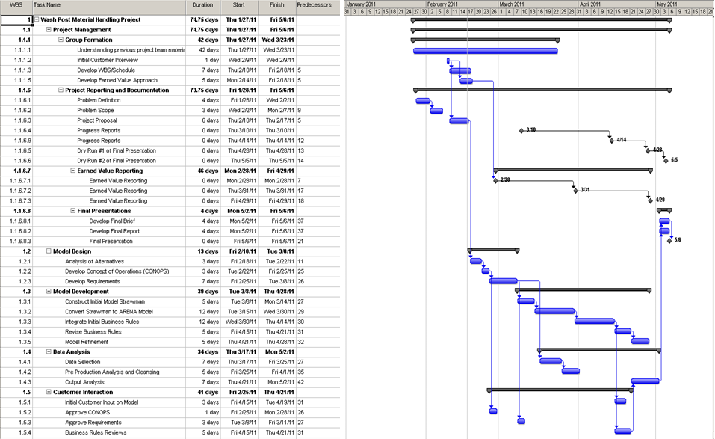
Project Plan
Deliverable | Date
Problem Definition | 3-Feb
Problem Definition & Scope | 17-Feb
Project Proposal | 24-Feb
Progress Report (1) | 10-Mar
Progress Report (2) | 14-Apr
Final Presentation Run (1) | 28-Apr
Final Written Report | 2-May
Final Presentation Run (2) | 5-May
Final Website | 5-May
Final Presentation | 6-May

Slide 9
Questions?

