Slide 1
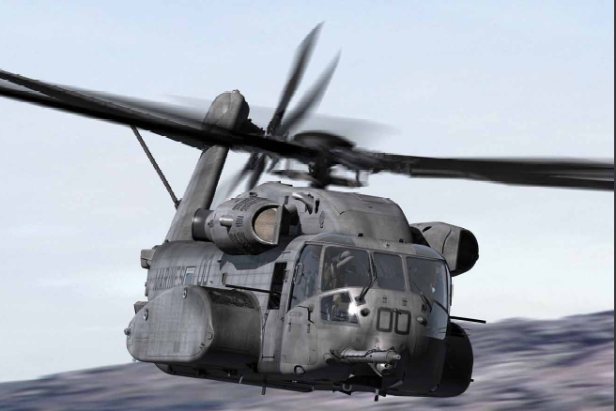
Implications of Liquid Fuel in Future Warfare
Jess Kaizar, Hong Tran, Tariq Islam

Slide 2
Agenda
  Problem Statement
    Objectives and Scope
    Methodology
  Technical Approach
  Scenarios
  Model Development
  Cost Estimation
  Technologies
  Results & Sensitivity Analysis
  Evaluation
  Insights and Recommendations
  Future Work
  Acknowledgements

Slide 3
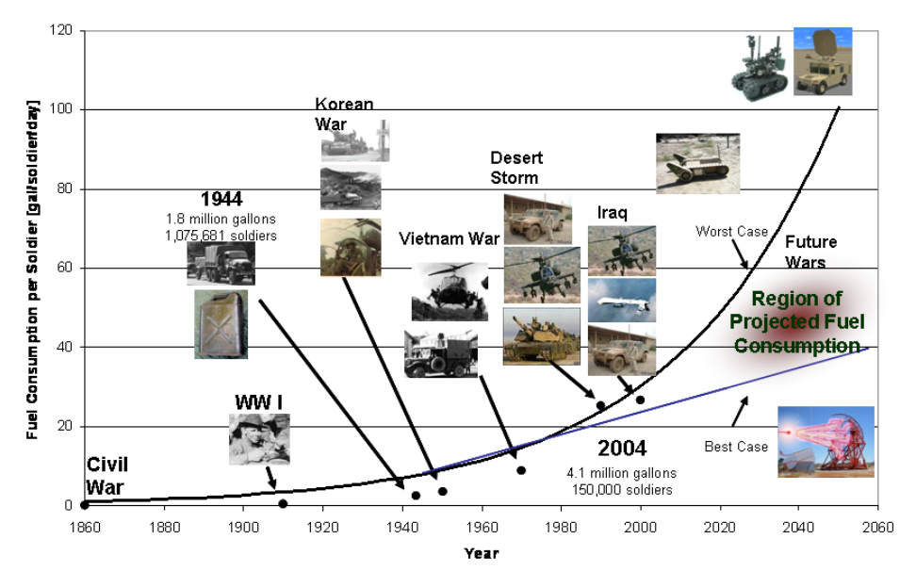
Problem Statement
U.S. Army Past and Projected Fuel Consumption
Source: Roche, Robert 2008, Fuel Consumption Modeling And Simulation (M&S) to Support Military Systems Acquisition and Planning
Questions to address:
How will helicopters be leveraged and used in future scenarios?
Fuel efficiency
Tactical perspective
Design perspective
Notes:
The Army generates this chart to provide a historical perspective and forecast of US military fuel consumption trends. It provides a Soldier daily fuel consumption estimates from the Civil War to Operation Iraqi Freedom (OIF). The bottom-line is that Army fuel consumption usage has increased significantly over time primarily due to the increases in power demand for both moving and non-moving operation.
Background and Need:
The US military has been spending increasing amounts of its budget towards liquid fuel. In the coming decades, the DoD will need to focus on more fuel efficient technologies and find ways to reduce the expenditures associated with liquid fuel use in its vehicles.
Problem Statement:
This project will serve to provide a background study on past wars in terms of their fuel usage, and compare them to the metrics of modern day warfare. What is needed, and what will be answered here subsequently is that given various future warfare scenarios, how will helicopters be leveraged and used in those scenarios? The largest issue being fuel efficiency, the efficiency of helicopters from a tactical perspective as well as a design perspective will need to be applied to each of the future scenarios to provide feasibility guidance in the next 10 to 20 years of helicopter production by vendors, specifically Sikorsky.

Slide 4
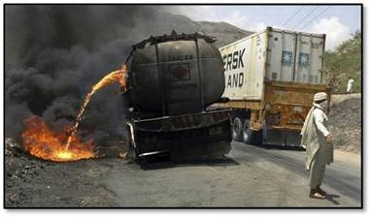
Objectives and Scope
  Determine impact of fuel consumption in past and modern warfare
  Determine baseline scenarios and evaluate applied technologies
  Recommend approaches based upon technology maturity data and sensitivity analyses

Slide 5
Methodology
Conduct background research
  Past vs. Modern warfare
Determine relevant baseline metrics
Determine input and output variables for model
  What do we want to show?
Research available and upcoming technologies
Develop baseline scenario model
Apply cost estimation techniques
Apply technologies to model
Project cost of fuel
Project scenarios for 2021 and 2031
Evaluate results

Slide 6
Technical Approach
  Survey energy usage in warfare throughout history and develop energy consumption metrics
  Identify a range of representative scenarios
    Primary missions
    Army, Navy, Marine Corps, Air Force
  Identify technologies for inspection and characterization
  Conduct estimation of fuel prices in 2021 and 2031
  Model Scenarios
  Analyze Scenarios
    Vary fuel price
    Apply technologies
    Conduct excursions for potential changes in future warfare
  Provide insight and recommendation for the impact of fuel efficiencies on rotary aircraft
Notes:
The problem statement defines “what we are doing” and the technical approach outlines “how we going to do it”.
The ILF team will conduct a survey and past and present warfare fuel consumption. This research will be used to inform and develop metrics to characterize fuel consumption and to establish a present day baseline for fuel consumption in a modern war such as Operation Iraqi Freedom (OIF).
Next the team will focus on identifying a representative range of baseline scenarios for rotary aircraft. The range will include each of the forces, the primary missions of helicopters in warfare and will be focused on at least a medium and heavy lift. Force variations on the BLACKHAWK will be used for the medium lift and CH-53D or E as the heavy lift. Missions include:
Attack/Assault
Intelligence, surveillance, reconnaissance (ISR) or Command and Control (C2)
Anti-submarine warfare (ASW)
Heavy cargo lift
Combat search and rescue (CSAR) / Medical evacuation (MEDEVAC)

Slide 7
Assumptions and Limitations
Primary focus is to study fuel consumption, the impact of fuel efficiency, and an examination of possible fuel usage in the future
An emphasis is placed upon rotary aircraft means, methods, and efficiency to evaluate the benefit of building more fuel efficient aircraft
Potential future energy costs are used for each timeframe based on historical trends to provide an initial cost reference point
Average unburdened fuel prices are used
The baseline consists of present day military aircraft composition
  Force composition changes are applied for the 2021 and 2031 timeframes
Average fuel burn is used to simulate fuel expenditures
Technologies are applied to overall fuel expenditure
Political implications are not considered
Notes:
Not a logistics study: The study team will not be optimizing logistic routes
Not a literature survey: The research done into the background of fuel usage is to develop an understanding of fuel in conflicts and will be used to gain insight and draw conclusion

Slide 8
Identify Representative Scenarios
  Note: Excursion assessing rotational ISR mission was also evaluated
Notes:
Scenarios cover forces and missions and may be modified with respect to force inventories and allocation between mission types.
US Army (USA)
UH-60s Airborne assault
Desert Shield/101st
OIF
Required
Number of helos
Flights Schedules
Expected drivers
Cost due to the large number of aircraft required
Additional Potential Excursions/Scenarios
Potential scenario: Close-in air support (CAS)
Potential excursion: Increasing vehicle weight

Slide 9
Model Development
  Excel based model
  Average fuel consumption for individual rotary aircraft at cruise speed and sea level
    Total fuel capacity / Maximum Endurance = Burn Rate
  Missions based on real flight profiles
  Determines total expenditures per day for each scenario
  Variables
  Model Inputs:
    Aircraft available
    Burn rate
    Reserve (10%)
    Available flight time
    Fuel cost per gallon
    Aircraft weight
    Lift capacity
    Cruise speed
  Model Outputs:
    Total expended
    Total cost of fuel expended
    Scenario Metric
      Time on station
      Lift capacity
      Total Mission Time
Notes:
Each scenario’s fuel consumption is modeled in excel. The variables can be altered as the user would like. A number of assumptions are included in the scenario modeling.
Assumptions:
Fuel weights 6.75 lbs/gal
Fuel is not assumed to be consumed during hot pump
Fuel is assumed to be consumed during aerial refueling
A 10% reserve was assumed

Slide 10

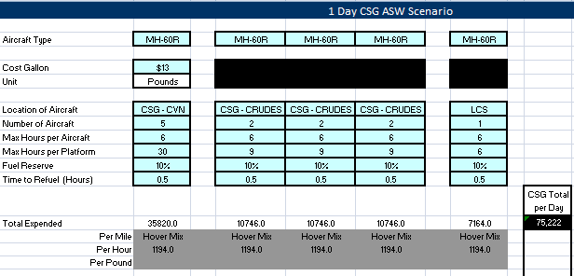

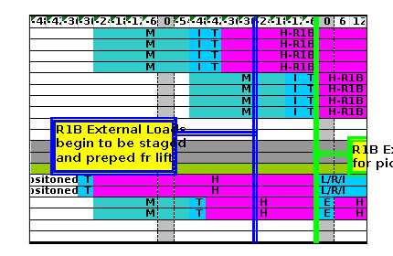

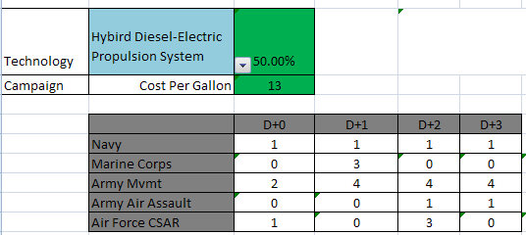
Model
1. Inputs
Flight Schedules, Airframe Characteristics & Scenarios
2. Variables
Fuel Price & Technologies
3. Outputs
Scenario & Integrated Results
Notes:
This is an example of the U.S. Navy CSG ASW model. Flight schedules were turned into hours for each helicopter/platform combination. Variables were set and fuel expenditure was found. The graph calculates it over 5 days and allows for consumption excursions based upon parametrics or technologies.

Slide 11
Aviation Fuel Cost Estimation
2031
Cost = 1.4 + 0.001 * X^2.76
Aggressive
Source Data: Energy Information Administration and Bureau of Labor Statistics
Represented: Annual average U.S. Aviation Fuel Sales by Refiners
Inflation: FY$10 based upon CPI-U
2021
Conservative
2011
Nominal 3% Inflation Rate
Note: These are the one and two sigma (±SE) error bands
  General error regression model used to fit line with multiplicative error and zero bias constraints
  Dramatic trend compared to a nominal 3% inflation rate
  Estimate is considered conservative as historical cost of fuel is not the only predictor in the future cost of fuel
Year | Low (-2σ) | Estimated | High (+2σ)
2011 |  | Actual $3.27
2021 | $6 | $8 | $10
2031 | $13 | $17 | $20
Notes:
Growth in consumption in major countries such as India and China for such a supply constrained resource

Slide 12
Cost Results
  Fuel expenditures by rotary aircraft is only expected to have modest increases over the next 20 years
    2021-2031 a new BLACKHAWK and the CH-53K Marine Corps heavy lift phase in with higher fuel consumption than their predecessors
  Price of fuel is a major driver in the future cost of warfare
  Potential 10 fold increase in the cost of rotary aircraft mission over the next 20 years between cost uncertainty and airframe fuel consumption
Projected
Projected
Notes:
More UAVs will be used for time-on-station intensive mission such ISR. For an example, the Predator drone which is an armed unmanned aircraft has been approved to use for military campaign in Libya.
Combination of Technologies yields the most bang for the bucks.
Helicopters must be designed with fuel-efficiency in mind. Navy created energy accountability as their new acquisition requirement.
Helicopter Remain Vital to DoD operations as conventional military campaign or humanitarian effort will still be performed in different areas of the world.
We expect limited role for helicopter for cyber warfare as this war requires different warfighting techniques.

Slide 13
Cost Results
2031
2σ Standard Deviation Shown
2021
2011
3% Inflation over 20 Years
2011
  Dramatic increase in the cost of fuel over the next 20 years outpaces inflation
  DoD is already taking cost and energy savings initiatives to begin tackling this problem
    Acquisition process beginning to incorporate the need for fuel savings
    Including burdened cost of fuel in Analysis of Alternatives (AoA)
Notes:
More UAVs will be used for time-on-station intensive mission such ISR. For an example, the Predator drone which is an armed unmanned aircraft has been approved to use for military campaign in Libya.
Combination of Technologies yields the most bang for the bucks.
Helicopters must be designed with fuel-efficiency in mind. Navy created energy accountability as their new acquisition requirement.
Helicopter Remain Vital to DoD operations as conventional military campaign or humanitarian effort will still be performed in different areas of the world.
We expect limited role for helicopter for cyber warfare as this war requires different warfighting techniques.

Slide 14
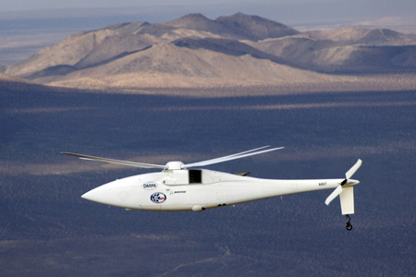
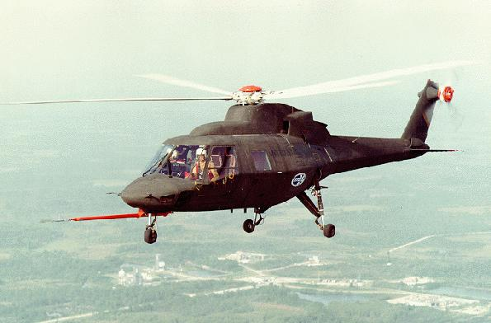
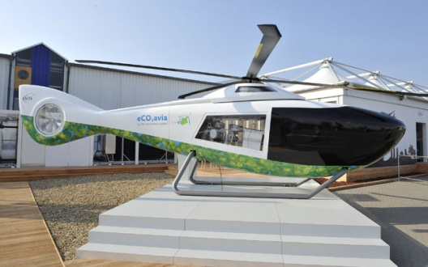
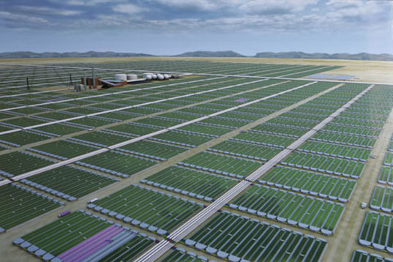
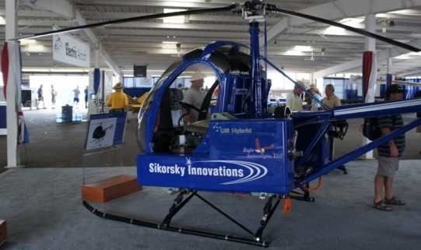

Alternate Technologies and Designs
Optimum Rotor Speed Improves rotor efficiency Available today Boeing proprietary | Light Materials Lower airframe and engine weight Available today Sikorsky | Hybrid Diesel-Electric Propulsion System Utilization of different sources 2020 EADS
Algal Biofuel Direct replacement for JP-8 military fuel 2015 | Electricity Facilitates driveshaft removal 2025 Sikorsky | Hydrogen Fuel Cells Significant power output to weight ratio 2030+ United Technologies Corp.
Design
Alternate Technologies
Notes:
This chart highlights six examples of the alternate technologies we have reviewed. I would like to point out the reasons why they were selected.
These six technologies are classified into two groups—the helicopter and alternate energy technologies.
The helicopter technologies aim to make improvements on different areas of the helicopter so less fuel is consumed. The hybrid propulsion system combines diesel and electric energies to give a very fuel efficient system and is proposed EADs to be used for helicopters. The optimum rotor speed technology maximizes the rotor efficiency and light materials is currently applied in the Boeing A160T Hummingbird or composites reduce the airframe weight was employed on the Sikorsky S-75 helicopter.
The alternate energy technologies provide alternate energy sources to become less dependent on fossil fuel. Algal biofuel also offers saving in fuel consumption with estimate production yield of 10000 gallons per acre. This biofuel has both military and commercial applications in aviation and automobile. Hydrogen fuel cell yields a high power to weight ratio and was used by United Technologies Corporation to build the first remote controlled helicopter.

Slide 15
% Savings in Fuel Consumption
Alternate Technologies
Large uncertainty / unknown efficiency data
Notes:
The alternate technologies are integrated into the model using a fuel saving factor in percentage. This chart shows the minimum and maximum value of fuel saving factor for each of the six technologies described earlier. For an example, using the hybrid propulsion system could save the fuel consumption between 30-50%. The fuel saving percentages are gathered from companies’ analyses, flight test data or we derive the number from data available over the Internet. The algal biofuel, optimum rotor speed exhibit moderate fuel saving while the hybrid propulsion system displays significant fuel saving.

Slide 16
Technology Maximum Sensitivity
Notes:
This slide and the next focus on the results of fuel saving when the alternate technologies—optimum speed rotor, hybrid propulsion system, algal biofuel and composite are applied to the different baseline mission scenarios discussed earlier by Jess.
The red column represents the baseline without no technology incorporation. Since the objective is to reduce the fuel consumption, please note the Marine Corp fuel consumption reduces drastically when the hybrid propulsion system’s maximum fuel saving percentage of 50 is applied (orange column).

Slide 17
Technology Minimum Sensitivity
Notes:
This is an illustration of fuel saving when the four technologies are applied to the baseline scenarios using the minimum range of fuel saving percentage. In this scenario, the Marine Corp fuel consumption reduces by 30% with the application of the hybrid propulsion system.
The fuel saving for the optimum rotor speed technology is fixed in either scenario because it is a fully developed technology.

Slide 18
Insights
  There will be impacts to military operations in the next 20 years due to the rising cost of fuel
  Sikorsky must have emphasis on increased rotorcraft fuel efficiency
    Consider combinations of alternate technologies
    Understand that application of any technology is time-consuming, cost-intensive

Slide 19
Investment-Worthy Technology
Today
Optimum Rotor Speed
Today
Composite Material
2020
Diesel-Electric Hybrid Propulsion
2025
Electric battery
Lithium air battery
2015
Algal Biofuel
2700% increase in propulsion efficiency
Removable driveshaft (+.5% per 700lbs.)
Constant, stable fuel price
Large fuel efficiency percentage
Retro-fitting will be extremely costly
7 – 10 %
.07 – 1.5 %
5 – 10 %
30 – 50 %
Timeline of Technologies

Slide 20
Immature Technologies
Technologies that may be ready after 2030 for consideration
  Hydrogen Fuel Cells
    Not mature enough
    The technology is not as promising for large scale, power intensive applications

Slide 21
Future Work
Assist Sikorsky Business Case Development
  Update Scenarios (Future Warfare Tactics as they become known)
    Incorporation of UAV/fixed wing trade-space in missions
    Cyber Warfare Tactics
      Clean and dirty environments
    Consider trade-space for operational and tactical advantages
  Further Alternate Technology Research
    Applicable to ILF model
    Updated efficiency numbers through further prototyping / research
    Research more data on the following technologies for near-future application:
      Hybrid-Diesel Electric engine (proprietary)
      Algal biofuel
      Lithium Air batteries (Sikorsky Firefly)
    Find realistic cost of application
      Break-Even Point
Notes:
.

Slide 22
Acknowledgements
  Thank You to Dr. Laskey for Your Guidance In Managing & Focusing the ILF Project
  Thank You to David Kingsbury & John Burton for their extensive help, time and effort on a weekly basis.
  A special thank you to Chris VanBuiten and Monica Gil for their invaluable support throughout the project effort.

Slide 23
BACK-UP

Slide 24
Background / Problem Statement
Background and Need:
The US military has been spending increasing amounts of its budget towards liquid fuel. In the coming decades, the DoD will need to focus on more fuel efficient technologies and find ways to reduce the expenditures associated with liquid fuel use in its vehicles.
Problem Statement:
This project will serve to provide a background study on past wars in terms of their fuel usage, and compare them to the metrics of modern day warfare. What is needed, and what will be answered here subsequently is that given various future warfare scenarios, how will helicopters be leveraged and used in those scenarios? The largest issue being fuel efficiency, the efficiency of helicopters from a tactical perspective as well as a design perspective will need to be applied to each of the future scenarios to provide feasibility guidance in the next 10 to 20 years of helicopter production by vendors, specifically Sikorsky.
Notes:
How will helicopters be leveraged and used in those scenarios?
- This is one of Sikorsky's main questions
- Considering the speculation involved in future warfare scenarios, what are the implications of...
Fuel efficiency?
- This is Sikorsky's main parameter
- From this, all of our metrics will be derived and expanded upon
- All decisions for future scenarios depend, rely, and affect fuel efficiency
Tactical and Design perspectives
- Both perspectives weigh heavily on fuel efficiency
- These two perspectives will further define our metrics and parameters into our model

Slide 25
Background Research
  175% Increase in Gallon of Fuel Consumed per Soldier per Day since Vietnam War
  Fuel Consumption of 22 Gallons/Soldier/Day in Iraq/Afghanistan War w/ a Projected Burn Rate of 1.5%/Year through 2017
Notes:
Open Data of Previous Wars in terms of war tactics, fuel consumption or metrics are Not Available (difficult to obtain). These statistics come from Deloitte’s Nov 2010 report which tracks US military energy use from WWII to current Iraq and Afghanistan conflicts

Slide 26
Background Research
  Defense Energy Support Center (US Military's Primary Fuel Broker) has contracts with the International Oil Trading Company; Kuwait Petroleum Corporation and Turkish Petrol Ofisi, Golteks and Tefirom. Contracts with these companies range from $1.99 a gallon to $5.30 a gallon.
  DESC sets fuel rates paid by military units.
  $3.51 a gallon for diesel
  $3.15 for gasoline
  $3.04 for jet fuel
  Avgas -- a high-octane fuel used mostly in unmanned aerial
  vehicles -- is sold for $13.61 a gallon
  Fuel Protection (from Ground & Air)
  Accidents/Pilferage/Weather
  IEDs
  Inventory/Storage Due to Many Types of Fuel
  Final Delivery Cost of $45 -$400/gallon to Remote Afghanistan (lack of infrastructure, challenging geography, increased roadside attacks)
Notes:
This chart shows the fuel consumption cost is also affected by transportation, protection, accident, storage and etc. Raw fuel cost begins at about $3/gallon. At delivery, the fuel cost could be as high as $400/gallon for use in Afghanistan due to lack of infrastructure, challenging geography and frequent roadside attacks.

Slide 27
Background Research
  2001 DSB Report Recommends the Inclusion of fuel efficiency in requirements and acquisition processes.
  Target fuel efficiency improvements through investments in Science and
  Technology and systems design
  The Principal Deputy Under Secretary of
  Defense signed a memo stating “…include fuel efficiency as a Key Performance Parameter (KPP) in all Operational Requirements Documents and Capstone Requirements Documents.”
Notes:
DOD recognizes the critical need to work the energy/liquid fuel issue. In 2001, the department created a task force to analyze the problem and provide recommendation. One recommendation to include fuel efficiency in the requirement. The principal deputy under secretary of defense requires the services to include fuel efficiency as KPP in the ORDs and CRDs.

Slide 28
Past War Research

Slide 29
Scenarios

Slide 30
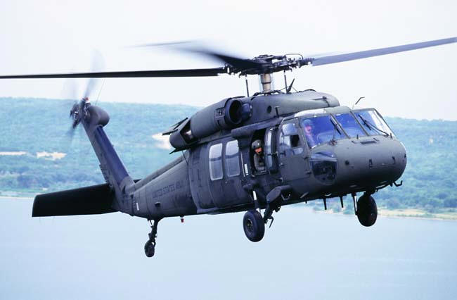
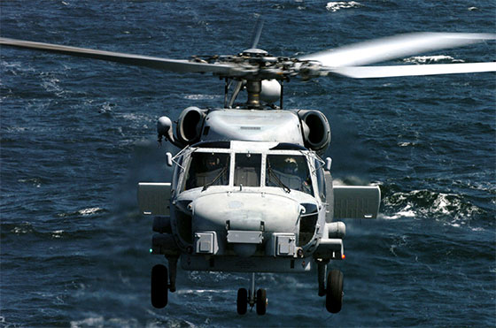
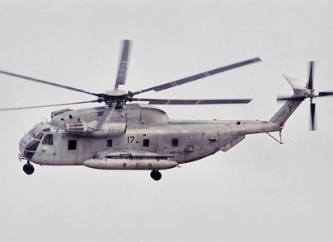
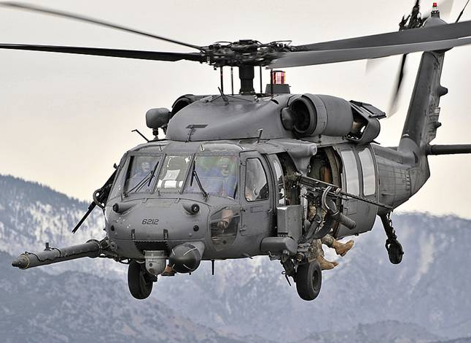
US Army [backup]
Force
US Army
US Navy
US Marine Corps
US Air Force
Helo
UH-60
Airborne Assault
MH-60
ASW
(Anti-Submarine Warfare)
CH-53E
Heavy Lift
Shore Assault
HH-60
CSAR
(Combat Search and Rescue)
Mission
Total Mission Time
Time on Station
Lift Capacity
Time on Station
Metric

Slide 31
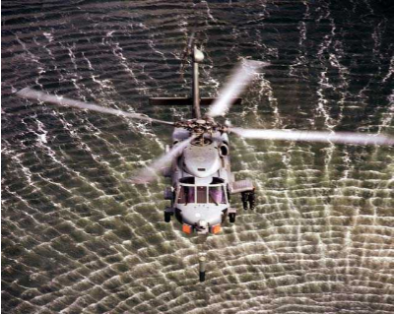
U.S. Navy [backup]
  Scenario over 1 Day of Navy ASW Operations
  1 CSG
  12 MH-60R per strike group (11 squadron + 1 on LCS)
    5 on CVN
    6 on CRUDES 2 per platform
    1 independent deployer on LCS
  Total of 63 flight hours per day
    4.5 hours spent refueling
Notes:
The U.S. Navy scenario consists of a single day of ASW (anti-submarine warfare) operations. A squadron of MH-60R is embarked upon the CVN as part of the carrier air wing. It consists of 11 MH-60R, 5 of those remain on the CVN, while 6 go in pairs on 3 CRUDES (cruiser destroyer) escorts. The LCS has a single MH-60R embarked as an independent deployer.
A number of assumptions were made to characterize flight operations and fuel burn for the MH-60R.
Flight Assumptions:
Flight time is assumed to be on station time
5 MH-60R’s on CVN fly 6 hours per day
2 MH-60R’s on 3 CRUDES total 9 flight hours per day per platform
1 MH-60R on LCS flies 6 hours per day
Fuel Expenditure Assumptions:
ASW missions require a mix of hovering, slow prosecution, and cruising
Sikorsky provided a standard fuel expenditure rate for ASW mission of 1194 lbs/hr

Slide 32
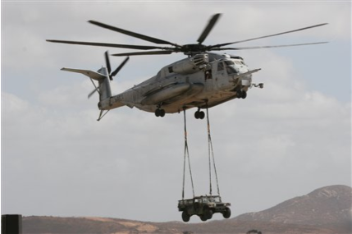
US Marine Corps [backup]
  Lift scenario over 15hours of delivering power from sea to shore
    3 waves of vehicles
    4 refueling sorties
  2 Squadron of CH-53E launched from sea
    14 CH-53E per sqaudron
      10 ready to fly
      1 back-up
      3 in maintenance
  20 CH-53E Heavy Lift
    13 Single external vehicle lift (65%)
    7 Double external vehicle lift (35%)
  4 CH-53E Refueling
    Internal fuel bladders
Notes:
The U.S. Marine Corps scenario is a heavy lift occurring over a 15 hour period. There are 2 squadrons of CH-53E embarked from 2 large deck amphibious assault ships, LHA/LHA(R), embarked with16 aircraft each. The majority of the mission is heavy lift for vehicles such as the High Mobility Multipurpose Wheeled Vehicle, HMMWV or Humvee. The lift occurs in 3 waves. Each wave consists of 20 vehicle lifts and 4 CH-53E assisting with refueling. It is assumed that 2 remain as back-up and 6 are in maintenance.
Flight Assumptions:
65% of vehicle lifts were single HMMWV
35% of vehicle lifts were tandem HMMWV
Fuel Expenditure Assumptions:
Flight to landing zone burns based on external lift weight
Returning flight burns average cruise expenditure
Insertion range of 225nm
Vehicles weight 13,000 lbs each

Slide 33
U.S. Air Force [backup]

Slide 34
Cost Estimation

Slide 35
Cost Estimation Assumptions
  To the left is the historical spot price of barrels of fuel in the U.S.
  To the right is the historical cost of aviation fuel sold by refiners
  Data set used for projection is aviation fuel
Source Data: Energy Information Administration and Bureau of Labor Statistics
Represented: Annual average U.S. Aviation Fuel Sales by Refiners
Inflation: FY$10 based upon CPI-U
Notes:
More UAVs will be used for time-on-station intensive mission such ISR. For an example, the Predator drone which is an armed unmanned aircraft has been approved to use for military campaign in Libya.
Combination of Technologies yields the most bang for the bucks.
Helicopters must be designed with fuel-efficiency in mind. Navy created energy accountability as their new acquisition requirement.
Helicopter Remain Vital to DoD operations as conventional military campaign or humanitarian effort will still be performed in different areas of the world.
We expect limited role for helicopter for cyber warfare as this war requires different warfighting techniques.

Slide 36
Cost Estimation Assumptions
  Aviation follows a consistent relationship to gasoline sales in the U.S.
  The flat projection due to values in the 1980’s indicate that historical oil prices may not be the best predictor of future oil prices
  To have a notional starting value for the price of aviation fuel values beginning in 1991 and onward are used to create a projection
Source Data: Energy Information Administration and Bureau of Labor Statistics
Represented: Annual average U.S. Aviation Fuel Sales by Refiners
Inflation: FY$10 based upon CPI-U
Notes:
More UAVs will be used for time-on-station intensive mission such ISR. For an example, the Predator drone which is an armed unmanned aircraft has been approved to use for military campaign in Libya.
Combination of Technologies yields the most bang for the bucks.
Helicopters must be designed with fuel-efficiency in mind. Navy created energy accountability as their new acquisition requirement.
Helicopter Remain Vital to DoD operations as conventional military campaign or humanitarian effort will still be performed in different areas of the world.
We expect limited role for helicopter for cyber warfare as this war requires different warfighting techniques.

Slide 37
Technologies

Slide 38
Algae Biofuel [backup]
  Algae Characteristics
    Freshwater Algae
    Grows Rapidly in Open “Raceway Pond”
    Generates Oil which Becomes Biofuel/Biogas/Biohydrogen/Hydrocarbon/Bioethanol
    Uses Liquid Waste from Wastewater Treatment Plants or other Nontoxic Liquid Waste sources
    Requires CO₂
  Testing & Production Progress Status
    Solazyme signed Contract w/ DOD to Provide 150,000 Gallons of Algae Biofuel (September 2010) for Testing and Certification Purposes
    Continental Airline Airplane Flew Two Hours Using 50 % Blend of Fuel Made from Algae and Jatropha (Jan 2008) (Test Data Indicated 4% Increase in Energy Density).
    DARPA Led Contract to Identify Highly Efficient System to Produce Low-Cost Algal Oil Production and Conversion to JP-8 (2010). One Contract Metric is <$3/gallon production cost of JP-8 based on capacity of 50 Million gallons/yr
    Diamond Aircraft Powered by Pure Algae Biofuel Developed by EADS (Fuel Consumed 1.5L/hr Less than Conventional J-A1in 2010)
Notes:
The technologies that we chose to inspect consist of alternative energies and alternative designs associated w/ the helicopter. Alternative energies deal w/ identification of different sources of energy to be independent from foreign oil sources. One possible fuel source is algae.
This type of algae grows naturally in every freshwater creek, river or pond . It grows easily and can double one to three times a day in water. Algae can take wastewater and other nontoxic liquid waste. Algae also need CO2 which can be piped in froT nearby power plants.
algae can also be used to produce other renewable energy products, such as biohydrogen, hydrocarbons, bioethanol and biogas.
http://www.actionbioscience.org/biotech/smith.html
USAF A-10 Thunderbolt II Flew w/ Combination of JP-8 Jet Fuel and Fuel Derived from Camelina Oil; C17 also Flew w/ 50% Blend of Biofuel & JP-8;US Navy F/A-18 Super Hornet Flew on 50% Blend
Zenk said the test flight showed that algae fuel gets better mileage than petroleum-based jet fuel. "We noticed a 4 percent increase in energy density in the fuels because of the lower-burning temperatures in the engine itself, which resulted in greater fuel mileage," he said. http://www.scientificamerican.com/article.cfm?id=algae-biofuel-of-future

Slide 39
Solar & Battery Power [backup]
  Characteristics
    Solar Cell and Composite Integrated into the Airframe & Rotor Structures
    Lithium Batteries to Fly at Dusk
    UAV applications
  Adapted from Single-Seater Sunseeker II Technology
    Integrate Solar Cells into Wing Structure
    Use Battery Power to Take Off (Four Packs of Lithium Polymer Batteries in Wings
    Electric Motor of 5kW. Two have been built.
    A Design of Two-man Seat is in Work (20kW Electric Motor)
  Adapted from QinetiQ’s Zephyr UAV Technology
    High Altitude (70kft) Long Endurance (14n days) UAV
    Flies by Day and Night Powered by Solar Energy.
    Lithium-Sulphur batteries are Recharged during Day Using Solar Power (Paper thin United Solar Ovonic Solar Arrays Fixed to Transparent Mylar-Sheet Wing)
    Silent Flight
    Seven UAVs have been Produced
    Contract w/ DOD to Perform In-Theatre Evaluation and possible Low Rate Production
    Potential Applications in Defense, Security and Civil Requirements
    Electric Motor of 1.5KW
Notes:
We’d like to propose the usage of solar energy to power the helicopter. The usage of composite to make the airframe light supplements the solar power usage. Solar energy will be used during the day and charged lithium batteries enables night-time flying.
This idea is based on the application of Sunseeker ii. This is the only manned solar-powered aircraft currently. Solar panels are incorporated into the wing structure. Sunseeker II uses battery power to take off and flies only during day light. It has a 5kW electric motor. Two have been built. A design for a two-man seat aircraft is in work. This design uses a 20kW electric motor.
Another application of Solar and Battery energy is the QinetiQ’s Zephyr UAV technology. Solar energy is used to fly the aircraft during the day. At night, lithium charged battery by solar power allows night-time flying. Paper-thin solar arrays are bonded over the transparent Mylar wing. The flight is silent to escape enemy detection. The UAV can go up in 70K altitude and it can be flying for 14 days. Seven have been produced. QinetiQ has current contract w/ DOD for in-theatre evaluation and possible low rate production. Zephyr UAV uses 1.5KW electric motor.
http://www.gizmag.com/solar-powered-hybrid-aircraft-sunseeker-ii/11121/
http://www.gizmag.com/sunseeker-solar-powered-aircraft-in-paris/15512/
http://www.airforce-technology.com/projects/zephyr/
http://www.strategypage.com/dls/articles/Three-Of-Seven-8-20-2010.asp

Slide 40
Electric Power [backup]
  Conventional Lithium Ion Battery
  Lithium Air Battery
    Rechargeable?
  Most ideal for shorter flight times
  Not ideal for heavy lift / long flight missions
    Still very relevant and applicable
    Greatest benefit
  Ideal for ISR scenarios / craft
  Drive-trains…?
Notes:
Lithium Ion Batteries are most popular today
Not enough to power vehicles, much less military operational vehicles
Sikorsky Firefly prototype runs through hundreds of these in 20 minutes or less
At only 2000 pounds.
Conventional military rotary aircraft weigh upwards of 25K lbs.
Lithium Air batteries
More than triple the energy density
Not currently rechargeable, but that’s coming
Shorter flight times, light lift is best for even lithium air
Or at least predictable flight patterns
This is particularly true for ISR scenarios
Success of lithium air batteries removes need for conventional drive trains.
This is a significant weight on the craft
Fewer moving parts
Vastly increased efficiency for main rotary engine
Drive-train component design
Remove turbine engines and main gearbox transmission, replace with electric motor and batteries
Remove main gearbox transmission and attach a single electric motor. (Remember the gearbox transmission has 2 functions, combine power from multiple engines and reduce the output shaft speed – turbine engines run ~20,000 RPM, rotors run ~760 RPM)
Remove tail rotor shaft and intermediate transmissions and replace with tail rotor electric motor and wiring.

Slide 41
Hydrogen Fuel Cells [backup]
  Polymer Electrolyte Membrane (PEM)
  Need more efficient fuel cell stacks
    Or allow for large quantities of stacks onboard
      Very lightweight, no moving parts, can be isolated.
  Can be used in conjunction with electric powered motors and battery support
  Very dependent upon future power outputs and fuel cell designs
  Not viable for sole power resource for operational helos
Notes:
PEMs are still relatively immature
PEM applications are small and isolated
Would need to be researched to be retrofit in large quantities on military craft
Would require room for storage, but at very low weight cost
This is ideal for supplemental/backup use
Alongside conventional liquid fuel motors, or electric motors
Current power outputs are relatively small due to current applications.
Research needs to be done on large scale applications / high power yield
In the next 20 years, will most likely serve only as supplemental energy source to save fuel
Ideal for powering onboard computers / electronics

Slide 42
EADS Diesel-Electric Hybrid [backup]
  Engine Components
    Two Diesel-Electric Motor-Generator Units
    A Pair of Batteries
    Power Electronics Unit
  Propulsion System Characteristics
    Safe
      Four Independent Sources of Energy Provide System Redundancy
    Fuel Efficient via:
        Less Aerodynamic Drag in Cruise Due to the Tilting
        Main Rotor and Its Electrical Drive
        Modern, Weight-Optimized Electrical Motors Driving
        Rotors Whose Speeds Can Be Adjusted & Controlled Individually
        Taking Off and Landing Utilize only Electrical Power
        OPOC Engines Operates at Most Fuel Efficient Operating Point
    Offer Fuel Economy Improvement of Up To 30% as Compared to Current Helicopter Turbine Engines
Notes:
OPOC (Opposed Piston, Opposed Cylinder) Engine Power Output Fitted w/ Weight-Optimized Generators to Deliver Electrical
Current to Power Electronics Unit. Power Electronics Unit Controls Main/Tail Rotors, Distributes Electricity to/from Batteries & Other Electrical Systems on Helicopter. EcoMotors Designs OPOC Engine
Electrical Motors Driving Main & Tail Rotors Eliminate the Need for Transmission Gear Boxes of Conventional Helicopter Power Trains & Allow for More Flexible and Power-Optimized Rotor Speed Settings. Thus Lower Fuel Consumption
Tail Rotor Can be Turned Off at Higher Speeds as It has no Mechanical Linkage to Main Rotor
Helicopter’s Tail Fin and Rudder Control/Stabilize/Balance Rotor Torque
Take-offs and Landings are possible on Electrical Power Alone (OPOC Engine Runs Idle During these Phases).
Other Combustion Engine Could Integrate Into this Hybrid System
The Most Fuel-Efficient Operating Point is during cruise phase
ila2010.eads.com/.../8b9e957abedfb3c67dddb2c0c2c37fdbb5db88c0bdcc98cec7a677bdc8cc63

Slide 43
Optimum Speed Rotor (OSR) [backup]
  Characteristics
    Rotor Speed (Revolution per Minute) Can Be Adjusted Depending on External Condition (Altitude, Gross Weight & Cruise Speed) to Yield Optimum Rotation. This Technology Saves Fuel Consumption and Maximize Time Aloft
    RPM Could Be Reduced to More Than Half its Maximum (140-350 RPM) in Low-Speed and Low-Weight Flight Which In Turn Reduces Fuel Efficiency
    Composite Airframe (Metal in Nose Frame, Bulkheads & ISR Payload Struss Structure)
      Keep Structure Frequency Outside of Rotor Frequency
    Rotors Blades Design Complements the OSR System
      Varying Stiffness and Cross Section along the Length
      Rigid, Low-Loading & Hingeless Design
  Adapted from Boeing A160 Hummingbird UAV
    Intelligence Gathering
    Dropping Supplies (2500lbs) to Frontline Troops
    Engine Power of 426.7kW (572shp)
    Fuel Efficient—1.5 Hrs of Fuel Remain After 18.7 Flying Hrs w/ 300lbs Payload
Notes:
Conventional rotor systems tend to have a fixed rotor RPM which is set for worst case flight condition such as take off at maximum weight regardless of altitude. The key to the Hummingbird’s performance is the ability to adjust the 36-ft/11m diameter rotor’s rotational speed at different altitudes and cruising speeds.
Outside the engine and places where there is typically metal components, the airframe is all composites to help keep the frequency ranges of the structure outside the frequency ranges of the rotor as it changes its speeds
Physically, the rotor blades are tapered, and each blade’s cross section and stiffness varies from root to tip.
The ability to shift to another gear has given the A160 the record for endurance in its class - 18.7h. "And we still landed with an hour and a half of fuel," Wattam says. "And that was carrying a 300-and-something pound payload."
http://www.vtol.org/vertiflite/hummingbird.pdf
http://www.defenseindustrydaily.com/50m-for-a160-hummingbird-uav-concept-demonstrators-01013/
http://www.gizmag.com/boeing-a160t-hummingbird-uav/14548/
http://www.globalsecurity.org/intell/systems/a160.htm
http://www.flightglobal.com/articles/2010/07/12/344075/farnborough-cutaway.html

Slide 44
Sensitivity Analysis

Slide 45
[backup] % Saving In Fuel Consumption
Combination of Alternate Technologies w/ Electric Tail Rotor Motor (bigger is better)
Helicopter Configuration
Notes:
The fuel saving percentages reflecting the combination of alternate technologies to include the incorporation of the electrical motor for each helicopter configuration are shown in this chart. The % saving in fuel consumption is greatest when combining technologies and applying them across the services.

Slide 46
Model Development

Slide 47
Metrics [backup]
Metrics capture how fuel is expended and any benefits of increased fuel efficiency
  Time to complete mission
    Reduced mission time by removing the need to refuel eliminating delays
    Lighter aircraft may move faster
  Lift capacity
    Carrying less fuel or building a lighter aircraft may allow additional lift capacity (up to the structural limitations of the aircraft)
  Time on station (TOS)
    Move efficient fuel/aircraft may extend legs or increase TOS
  Cost
    Less fuel burned = lower cost
    Alternate fuel = lower price?
    All metrics will be translated into cost as well
      $/mile
      $/lb lift
      $/flight hour
Notes:
Metrics are meant to capture the performance and effectiveness in the scenarios. The measures of performance or MoP are the time to complete the mission, lift capacity, and time on station. Each of these will be turned into fuel consumed and cost to determine the effectiveness of fuel efficiencies at saving the consumer money.

Slide 48
Analysis

Slide 49
[backup] Evaluation and Analysis
Baseline Scenarios
Notes:
The model has several built-in metrics. They are fuel consumption expended, cost of fuel expended, time on station, refueling time, # of pounds lifted. The metrics are used to gain the model ‘s fuel consumption insight.
The left chart represents the scenarios w/ most refueling effort which are the Army Assault, Army Troop Movement, the Marine Corps Heavy Lift and the Navy Anti-Submarine Warfare;
The right chart shows the scenarios w/ most pounds of fuel expended, the Marine Corps Heavy Lift.

Slide 50
Results

Slide 51


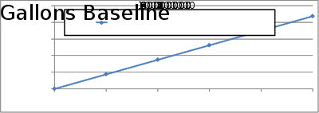




Results
  Baseline results
  Assess technological alternatives to find the trade-space in lowering fuel expenditure:
    Potential cost savings
    Additional time on station
    Additional lift capacity
    Decreased mission time
Decrease Cost
Lower/Replace Fuel Consumption
Baseline
Increase Performance
Additional Lift , TOS, or Mission Completion
Operational Advantages
Decrease refueling needs
Trade-offs
Notes:
For the results we will characterize the potential benefits of fuel efficiencies by cost, performance, and operational advantages.
How much money does each technology present in savings over the course of a campaign?
What additional levels of mission performance may be attained? More lift? More time on station? Less time to complete mission?
What operational advantages can be found through the technologies? Less refueling delays? Reduced need for refueling stations/aircraft?

