Slide 1
Optimal Option Investment Strategy
Sponsor: Dr. K.C. Chang
Tony Chen
Ehsan Esmaeilzadeh
Ali Jarvandi
Ning Lin
Ryan O’Neil
Spring 2010

Slide 2
Outline
Background
Problem Statement
Statement of Need
Project Scope
Requirements
Assumptions
Approach
Optimal Fraction Analysis
Simulation and Results
Work Breakdown Structure
Tasks Status Summary
Project Schedule
Earned Value Management

Slide 3
Background

Slide 4
Background
ECON 101:
Futures contract – An mutual agreement to trade a commodity in the future between two traders
Expiration date – The date the futures contract is effective
Strike price – Price at which the commodities are traded (usually market price for standard futures contract)
Positions – Long (buyer) and short (seller)

Slide 5
Background
Option – A conditional futures contract with a pre specified strike price. Option buyer gets right to exercise contract
American
European
Premium – Price option buyer pays to have right to exercise
Two general types: call (right to buy) and put (right to sell)
“In the money” – An option would have positive return if exercised at this instant

Slide 6
Background
Long Position (buyer) – Theoretically limitless
Call: Commodity price greater than strike price
Put: Commodity price less than strike price
Short Position (seller) – Maximum is the premium from selling option. Gets full amount if option is not exercised
Stop Loss – Maximum amount seller is willing to lose. Executed by buying back the same option

Slide 7
Background
Short Strangle Strategy:
Simultaneously selling a call and a put with the same expiration date
Strike prices for each option can be different
Typically call strike price is greater than commodity price and put strike price is less than commodity price (at options writing)
Greatest payoff when commodity price at expiration date is between strike prices
Best used on a commodity with low rate of volatility

Slide 8
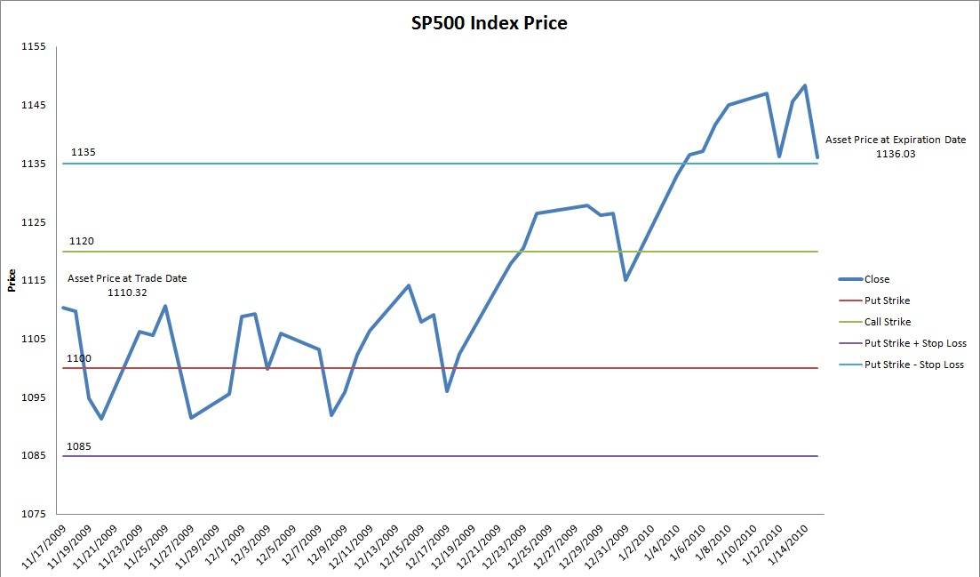
Background

Slide 9
Optimal Option Investment Strategy Team
Our goal is:
to provide policy recommendations for the option sellers to maximize profit and minimize risk of loss
to determine the optimal fraction for investment
to develop graphical user interface to plot equity curves of the selected strategies
We help the option seller to know when and at what price to trade the option
6 years of real historical data on option prices, instead of estimated prices

Slide 10
Problem Statement
Investors can potentially earn huge profits by trading assets
Options allow investors to leverage current assets to trade in greater quantities
Most investors trade on speculation and attempt to predict the market
It is difficult to find an optimal investment strategy that balances high returns on investment with low risk of catastrophic loss

Slide 11
Statement of Need
There is a need for a solid well-documented analysis to provide investment strategies for investors with different characteristics and help them in selecting the best strategy for a maximum benefit
There is also a need for a computer based application analyzing historical market data and providing feedback to users

Slide 12
Concept of Operations

Slide 13
Project Scope
Range of data: 2004-2009
Underlying asset is S&P 500 future index
Short strangle strategies only
Strike prices ±$50 from asset price at increments of 5
Stop loss from 5 to 45 at increments of 5

Slide 14
Assumptions
Assumptions:
American options only
Use of calendar days instead of trading days
Strategies, missing data points more than 50% are ignored
Only make trades at the end of a trading day
Do not consider interest rate
Do not simulate trading commission or slippage
Use SP500 index prices rather than SP500 futures as the underlying asset
Estimate difference of strike prices and asset price by $5 increments, not scaled to index prices.

Slide 15
Requirements
The analysis shall provide recommendations on investment policies
Consider expected return on investment and risk of ruin in providing recommendations
Provide different sets of recommendations based on the level of risk acceptable by an investor

Slide 16
Requirements
The software system shall provide the expected return and risk for any given strategy
Take input from users using a graphic user interface
Present the return on investment (equity curve) as a function of time

Slide 17
Approach
Research on the topic
Relevant papers
Previous team’s work
Parse the historical data
Develop the simulation model
Validate & analyze results
Revise the model as needed
Determine optimal strategies and optimal fraction for investment
Develop Graphical User Interface

Slide 18
Methodology

Slide 19
Optimal f Allocation
Definition
f is a fraction of equity that is invested at options writing date
We write options contracts such that the margin requirement equals f percent of equity.

Slide 20
Optimal f Allocation
1. Setup initial amount C = $1,000,000;
2. Let f = the fraction of money we invest in the market;
3. Let L = abs (the biggest point loss in our trades);
4. Let Margin = $5,000
5. Let P = the points we earn or lose
For Strategy 1 to Strategy n
For f = 0.05:0.05:1 (this is MATLAB format which means 0.05 0.10 0.15...0.95 1)
NewMoney = C;
For Trade 1 to Trade 60
B = NewMoney *f ;
NumberOfContract = B/max (L*50, Margin);
NewMoney = NumberOfContract*P*50+NewMoney;
TWR = NewMoney/C (TWR should be displayed)
End
End
End

Slide 21
Risk of Ruin
Definition: Ruin is a state losing a significant portion (often set at 50%) of your original equity.
Computation methods:
Vince formula
Monte Carlo simulation
Futures formula

Slide 22
Risk of Ruin
Algorithm:
R = e^((-2*a/d)*(ln(1-z)/ln(1-d)))
Where a = mean rate of return
d = standard deviation of the rate
z = how we define ruin. Here is 50%.
Sharpe ratio = a / d
Risk of Ruin Example

Slide 23
Simulation and Results

Slide 24
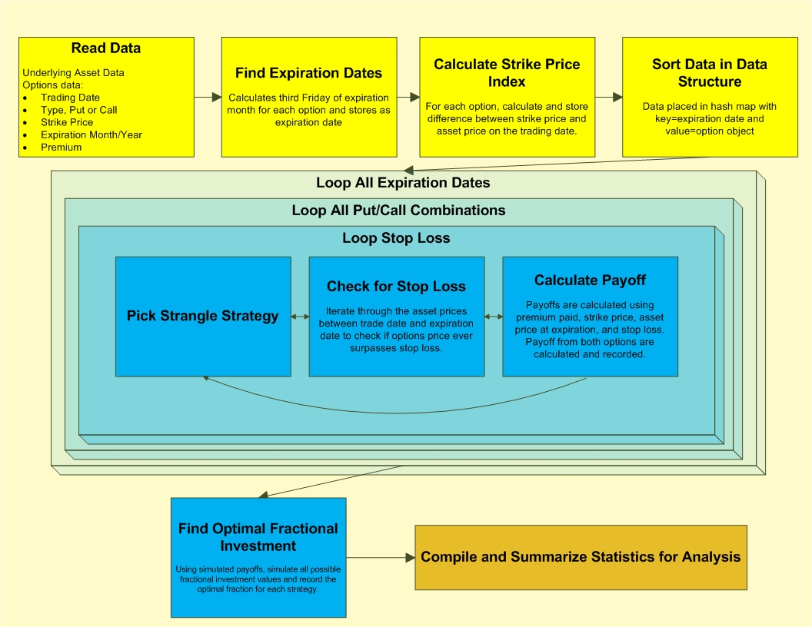
Simulation

Slide 25
Results
Determination of most profitable investment strategy with the following attributes:
Strike price
Put & call prices
Premium
Monthly profit over the investment period
Stop loss
Optimal f
Final TWR
Minimum TWR

Slide 26
Tasks & Schedule

Slide 27
Work Breakdown Structure (WBS)

Slide 28
Project Schedule (GANTT)

Slide 29
Earned Value Management (EVM)

Slide 30
Cost & Schedule Performance Index

Slide 31
Questions

Slide 32
Background for Optimal f Allocation
Kelly formula:
f = (b*p – q)/b
f* is the fraction of the current bankroll to wager
b is the net odds received on the wager (that is, odds are usually quoted as "b to 1")
p is the probability of winning
q is the probability of losing, which is 1 − p

Slide 33
Validation
Two assumptions of this formula:
1. Winning and losing per bet is constant
2. Total bet is large enough
in our case
1. the return from each trade is different
2. total trade is limited
So, we cannot this formula

Slide 34
How to make investment
Introduced by Vince in his book The New Money Management, we should use:
f$ = abs (biggest losing trade)/optimal f
Where f$ means how much a contract worth

Slide 35
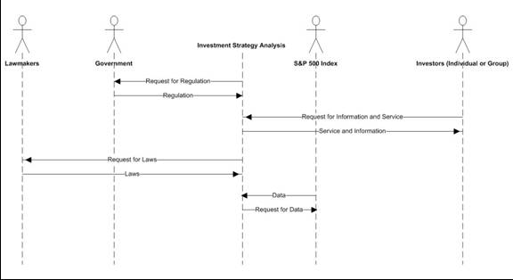
Operational Scenario

Slide 36
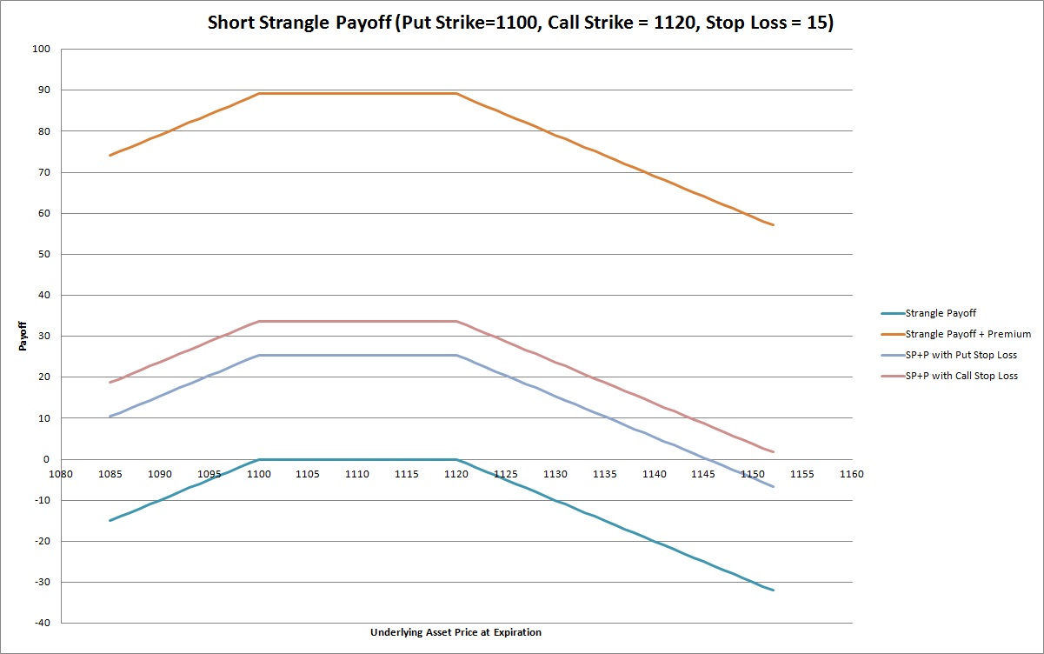
Option Payoff

Slide 37
References
Kolb, Robert (1995), Understanding Options. New York, John Wiley & Sons, Inc.

