Slide 1
Optimal Option Investment Strategy
Sponsor: Dr. K.C. Chang
Tony Chen
Ehsan Esmaeilzadeh
Ali Jarvandi
Ning Lin
Ryan O’Neil
Spring 2010

Slide 2
Outline
Background
Optimal Option Investment Strategy Team
Problem Statement
Statement of Need
Project Scope
Requirements
Operational Scenario
Planned Approach
Assumptions & Constraints
Team Progress
Optimal Fraction Analysis
Preliminary Results
Expected Results
Result Validation
Work Breakdown Structure
Tasks Status Summary
Project Schedule
Earned Value Management

Slide 3
Background

Slide 4
Background
ECON 101:
Futures contract – An mutual agreement to trade a commodity in the future between two traders
Expiration date – The date the futures contract is effective
Strike price – Price at which the commodities are traded (usually market price for standard futures contract)
Positions – Long (buyer) and short (seller)

Slide 5
Background
Option – A conditional futures contract with a pre specified strike price. Option buyer gets right to exercise contract
American
European
Premium – Price option buyer pays to have right to exercise
Two general types: call (right to buy) and put (right to sell)
“In the money” – An option would have positive return if exercised at this instant

Slide 6
Background
Long Position (buyer) – Theoretically limitless
Call: Commodity price greater than strike price
Put: Commodity price less than strike price
Short Position (seller) – Maximum is the premium from selling option. Gets full amount if option is not exercised
Stop Loss – Maximum amount seller is willing to lose. Executed by buying back the same option

Slide 7
Background
Short Strangle Strategy:
Simultaneously selling a call and a put with the same expiration date
Strike prices for each option can be different
Typically call strike price is greater than commodity price and put strike price is less than commodity price (at options writing)
Greatest payoff when commodity price at expiration date is between strike prices
Best used on a commodity with low rate of volatility

Slide 8
Optimal Option Investment Strategy Team
Our goal is:
to provide policy recommendations for the option sellers to maximize profit and minimize risk of loss
to determine the optimal fraction for investment
to develop graphical user interface to plot equity curves of the selected strategies
We help the option seller to know when and at what price to trade the option
Continuation of Fall 2009 project
13 years of real historical data on option prices, instead of estimated prices

Slide 9
Problem Statement
Investors can potentially earn huge profits by trading assets
Options allow investors to leverage current assets to trade in greater quantities
Most investors trade on speculation and attempt to predict the market
It is difficult to find an optimal investment strategy that balances high returns on investment with low risk of catastrophic loss

Slide 10
Statement of Need
There is a need for a solid well-documented analysis to provide investment strategies for investors with different characteristics and help them in selecting the best strategy for a maximum benefit
There is also a need for a computer based application analyzing historical market data and providing feedback to users

Slide 11
Concept of Operations

Slide 12
Project Scope
Range of data: 1997-2009
Underlying asset is S&P 500 future index
Short strangle strategies only
Strike prices ±$50 from asset price at increments of 5
Stop loss from 5 to 45 at increments of 5

Slide 13
Requirements
The analysis shall provide recommendations on investment policies
The analysis shall consider expected return on investment and risk of ruin in providing recommendations
The analysis shall provide different sets of recommendations based on the level of risk acceptable by an investor

Slide 14
Requirements
The software system shall provide the expected return and risk for any given strategy
The system shall take input from users using a graphic user interface
The system shall present the return on investment (equity curve) as a function of time

Slide 15
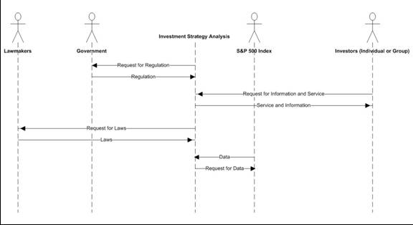
Operational Scenario

Slide 16
Methodology

Slide 17
Planned Approach
Research on the topic
Relevant papers suggest by the sponsor
Previous team’s work
Parse the historical data
Develop model & simulation
Validate & analyze results
Revise the model as needed
Determine optimal strategies and optimal fraction for investment
Develop Graphical User Interface

Slide 18
Assumptions & Constraints
Assumptions:
American options only
Use of calendar days instead of trading days
Strategies, missing date points more than 50% are ignored
Only sell one strangle (put and call combination) for each contract expiration date
Only make trades at then end of a trading day
Interpolate missing data using Black Scholes Formula, required for equity curves and stop loss

Slide 19
Assumptions & Constraints
Do not consider interest rate
Do not simulate trading commission or slippage
Use SP500 index prices rather than SP500 futures as the underlying asset
Estimate difference of strike prices and asset price by $5 increments, not scaled to index prices.
Constraints:
Missing data points

Slide 20
Team Progress
We have completed:
JAVA code including all necessary factors for the first simulation run
Development of a meaningful format for output files
Study of literature on optimal fraction for investment
Simulation of first run for 2004-2009 data without stop loss

Slide 21
Team Progress
Still working on:
Producing the second set of results based on data from years 2004-2008 with stop loss included
Identifying a clear strategy for earlier years with less available data points
Performing statistical analysis based on the simulation results
Performing risk & sensitivity analysis

Slide 22
Maximizing returns using optimal fixed fraction asset allocation

Slide 23
Background for this technique
Kelly formula:
f = (b*p – q)/b
f* is the fraction of the current bankroll to wager
b is the net odds received on the wager (that is, odds are usually quoted as "b to 1")
p is the probability of winning
q is the probability of losing, which is 1 − p

Slide 24
Validation
Two assumptions of this formula:
1. Winning and losing per bet is constant
2. Total bet is large enough
in our case
1. the return from each trade is different
2. total trade is limited
So, we cannot this formula

Slide 25
How to find optimal f
By doing simulation
Example :Single investment strategy test
In our project, we have more than 4000 strategies. Therefore, eventually there will be a 3-D graph which can illustrate different strategies and their corresponding optimal fs and final outcomes

Slide 26
How to make investment
Introduced by Vince in his book The New Money Management, we should use:
f$ = abs (biggest losing trade)/optimal f
Where f$ means how much a contract worth

Slide 27
What’s next?
By utilizing optimal f technique, we now know:
How much should we invest?
How should we invest?
What is our possible expectation?
Risk of Ruin?
In the next two weeks, I will concentrate on chapter 5 of Portfolio Management Formulas written by Vince

Slide 28
Results

Slide 29
Preliminary Results
Determination of most profitable investment strategy for each day in 45 day period based on simulation from 2004-2009 historical data with the following attributes:
Strike price
Put & call prices
Premium
Graphs of monthly profit over the investment period
Stop loss has not been implemented in the model yet

Slide 30
Expected Results
Policy Recommendations – Find optimal strategies and optimal fraction for investment
Analytical Model – Application to run simulation and provide results
Software Application – GUI for user to input strategies and display equity curves

Slide 31
Result Validation
Confirm our sponsor’s initial hypothesis:
The best strategies will most likely occur between day 20 and 30
Overall, strategies will yield lower profits near the beginning and end of the trading period

Slide 32
Tasks & Schedule

Slide 33
Work Breakdown Structure (WBS)

Slide 34
Tasks Status Summary
Research
CONOPS
Requirements
Data Parsing
Modeling & Simulation
Testing & Validation
Analysis
Optimal policies
Optimal fraction
Risk & sensitivity analysis
GUI Application
Report & Presentation

Slide 35
Project Schedule (GANTT)

Slide 36
Earned Value Management (EVM)

Slide 37
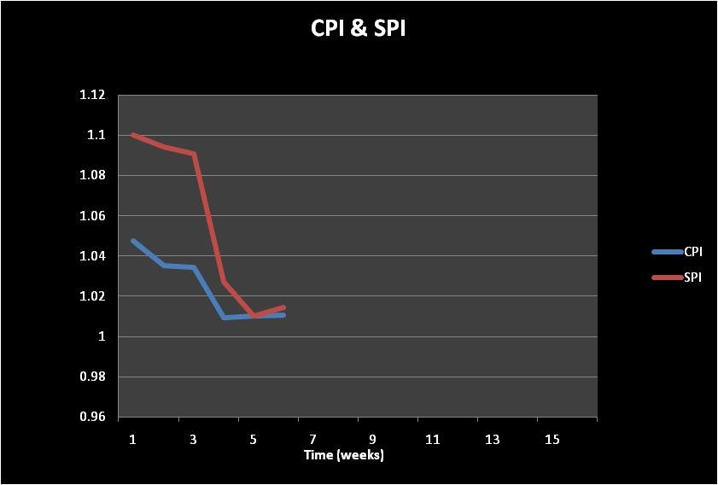
Cost & Schedule Performance Index

Slide 38
References
Kolb, Robert (1995), Understanding Options. New York, John Wiley & Sons, Inc.

Slide 39
Questions

