Slide 1
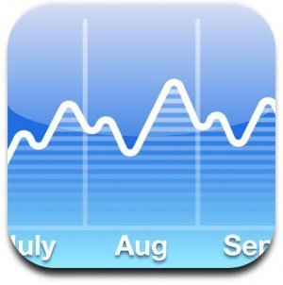
Optimal Option Investment Strategy
Sponsor: Dr. K.C. Chang
Tony Chen
Ehsan Esmaeilzadeh
Ali Jarvandi
Ning Lin
Ryan O’Neil
Spring 2010

Slide 2
Outline
Background & Problem Statement
Project Scope
Requirements
Assumptions
Approach
Methodology
Modeling
Analysis
Evaluation & Recommendations
Conclusion & Future Work

Slide 3
Background
Investors can potentially earn huge profits by trading assets
Many investors trade on speculation and attempt to predict the market
Options allow investors to trade with greater leverage

Slide 4
Definitions
Option Contract – A conditional futures contract to trade an asset at a given price and date. Option buyer gets right to exercise contract.
Positions – Long (buyer) and short (seller)
Expiration date –date underlying assets are traded
Strike price – Price the commodities are traded
Premium – Option price
Notes:
Futures Contract-an agreement between two parties to enter a contractual agreement to trade an underlying asset at some specified date in the future at some specified price. An options contract is a subset of futures contract, where the contract buyer gets to choose if the contract will be exercised at expiration in exchange for a premium paid to the contract seller. Options are standardized by strike price and expiration date to facilitate trading as finding a willing partner would otherwise be difficult.
Position – describes the parties entering the contract. The long position is the options buyer and the short position is the options seller/writer. It is important to distinguish position since buyers and sellers have different options payoffs.
Expiration Date – date at which the options buyer decides whether or not to exercise the option.
Strike Price – price that the underlying asset is traded at the expiration date. Options buyer’s payoffs are determined by differences between the underlying asset price at expiration and the strike price.
Options Premium – price the options buyer pays to the options seller in exchange for the right to exercise an option. Since the options contract is a tradable asset like stocks, it changes depending on market conditions and price of the underlying asset, in comparison to strike prices.

Slide 5
Definitions
Two general types: call (right to buy) and put (right to sell)
American and European
Short Strangle Strategy:
Simultaneously selling a call and a put with the same expiration date
Typically call strike price > commodity price and put strike price is < commodity price
Notes:
Options Type – two common types of options, put and call. a) the put option grants the options buyer the right to sell the underlying asset at the strike price. b) the call option grants the options buyer the right to buy the underlying asset at the strike price.
“In the money” – An option would have positive return if exercised at this instant

Slide 6
Background – Short Strangle

Slide 7
Background – Strangle Payoffs
Call: Commodity price less than strike price
Put: Commodity price greater than strike price
Notes:
Long Position (buyer) – Payoff is theoretically limitless
Call: Commodity price greater than strike price
Put: Commodity price less than strike price
Short Position (seller) – Maximum is the premium from selling option. Gets full amount if option is not exercised

Slide 8
Background – Stop Loss
Stop Loss – Maximum amount seller is willing to lose. Executed by buying back the same option
Notes:
Stop Loss – Maximum amount seller is willing to lose. Executed by buying back the same option

Slide 9
Volatility Smile
Volatility smile results from variation in implied volatility among options that vary only on premium value.

Slide 10
Previous Team
This project is a continuation of Fall 2009 project
Estimated premiums using Black-Scholes model
Estimated return using strike prices, stop-loss, and days before expiration as input

Slide 11
Problem Statement
Previous group used fixed implied volatility. Due to volatility smile, this results in inaccurate premiums.
Tradeoffs between profits and risk of ruin need to be balanced using a equity allocation and risk management methods.
No easily accessible tools to quickly assess strangle strategy performance.

Slide 12
Optimal Option Investment Strategy Project Goals
To provide policy recommendations for the option sellers to balance profit and risk of loss using historical data
To determine the optimal fraction for investment with associated risk of ruin
To develop a graphical user interface to provide useful information investors can act on.

Slide 13
Business Case
Our model and tools can aid fund managers to quickly assimilate information about the current options market conditions
We provide a software tool to display equity curves over a specified period of time. Our tool also shows payoffs from fractional investment allocations to match returns and risk of ruin to customer demand

Slide 14
Outline
Background & Problem Statement
Project Scope
Requirements
Assumptions
Approach
Methodology
Modeling
Analysis
Evaluation & Recommendations
Conclusion & Future Work

Slide 15
Project Scope
Range of data: 2004-2009
Underlying asset is S&P 500 future index
Short strangle strategies only
Call strike prices +5 to +50
Put strike prices -5 to -50
Stop loss from 5 to 45 and without limit
Maximum acceptable volatility at 30, 40, 50 and without limit

Slide 16
Assumptions
Strategies missing more than 50% of data points (months) are ignored
Only have closing price data so trade after market
Our trades do not affect the market
Do not simulate trading slippage (always a willing trade partner)
Do not consider interest rate or inflation (time value of money)

Slide 17
Requirements [1 of 2]
Provide recommendations on investment strategies
recommendations are based on expected return on investment and risk of ruin
Provide a range of optimal strategies that trade off risk and return according to investors’ risk tolerances

Slide 18
Requirements [2 of 2]
Develop a Graphical User Interface (GUI) to display results, statistics, and visual representation of selected strategies
Take filtering criteria from users in the model interface
Plot the return (equity curve) for various fractional allocations of capital

Slide 19
Approach
Research relevant papers and previous work
Parse and organize the historical data
Develop the trading model
Validate model & analyze results
Determine optimal strategies
Develop graphical user interface

Slide 20
Outline
Background & Problem Statement
Project Scope
Requirements
Assumptions
Approach
Methodology
Modeling
Analysis
Evaluation & Recommendations
Conclusion & Future Work

Slide 21
Optimal Fraction Allocation
Fractional Investment: choosing investment size by fraction of equity
Optimal f: fractional investment which brings the highest return
Relevant research:
Kelly Formula
Vince Formula

Slide 22
Fractional Investment Algorithm
Initialization
Evaluate all strategies and fractions
Calculate the investment amount for next trade
Decide the number of contracts
Select the best TWR and the corresponding fraction in the array
Decide the investment amount

Slide 23
Risk of Ruin
Definition: Ruin is the state of losing a significant portion (often set at 50%) of your original equity
Futures Formula:
Where
a = mean rate of return
d = standard deviation of the rate
z = how we define ruin. Here is 50%.

Slide 24
Methodology Verification

Slide 25
Outline
Background & Problem Statement
Project Scope
Requirements
Assumptions
Approach
Methodology
Modeling
Analysis
Evaluation & Recommendations
Conclusion & Future Work

Slide 26
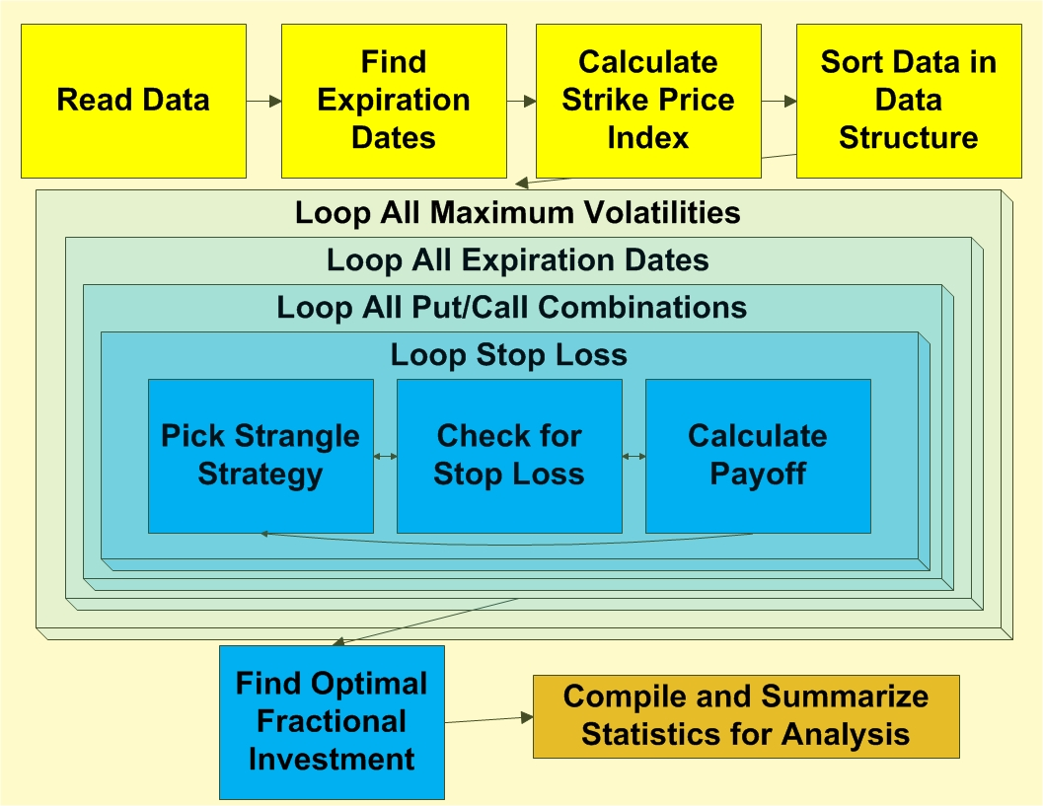
Modeling

Slide 27
Modeling
Days before expiration
Put & Call strike prices
Stop loss
Maximum volatility
Optimization Model
Average return
Final TWR
Maximum Draw-Down
Optimal Fraction
Risk of Ruin
GUI Application

Slide 28
Outline
Background & Problem Statement
Project Scope
Requirements
Assumptions
Approach
Methodology
Modeling
Analysis
Evaluation & Recommendations
Conclusion & Future Work

Slide 29
Evaluation Metrics
Terminal Wealth Relative (TWR) – $\frac{Final Account}{Initial Account}$
Average percent return – mean of monthly returns
Maximum drawdown – greatest negative difference between two dates over a time period

Slide 30
Days Before Expiration 2007-2009

Slide 31
Days Before Expiration – Individual Years

Slide 32
Stop-Loss 2007-2009

Slide 33
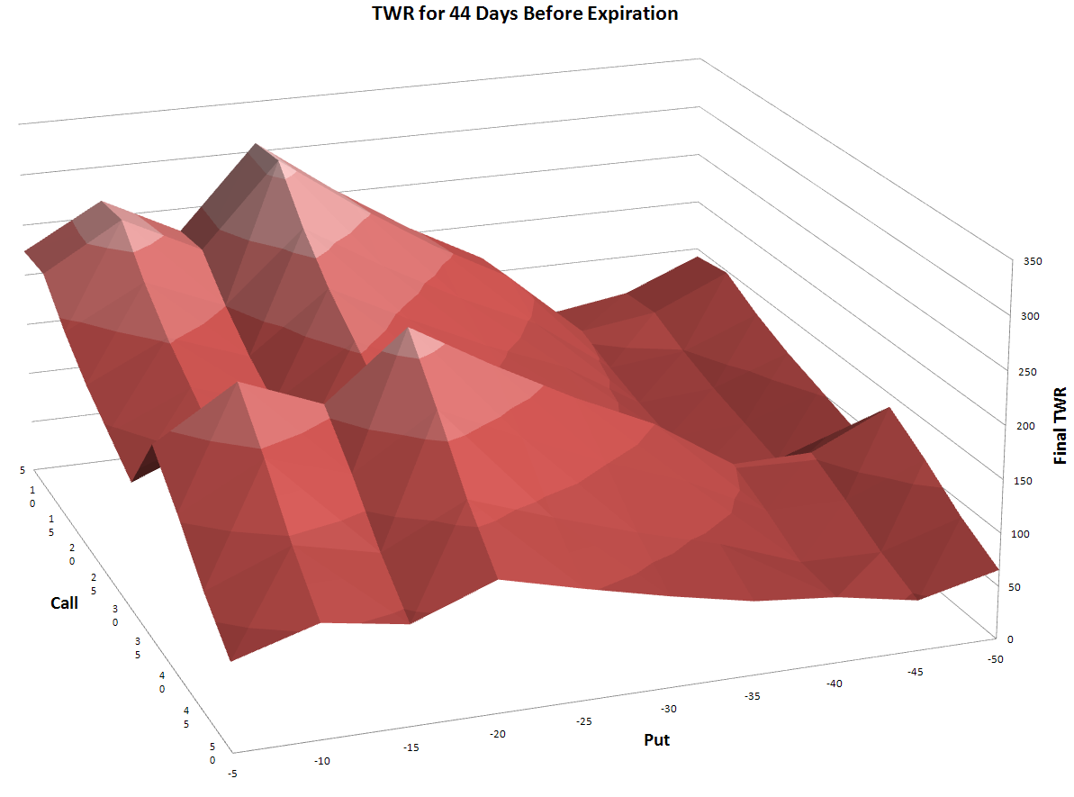
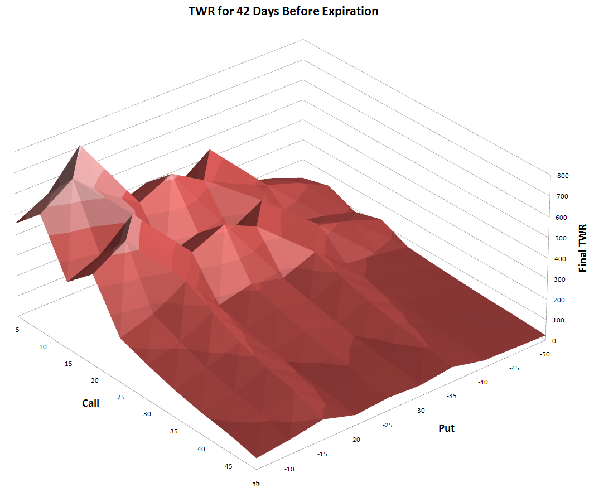
Strike Prices 2007-2009
Day 44 Before Expiration
Day 42 Before Expiration
Better strategies lie around call = +5 and put = -15

Slide 34
Volatility Index
Number of Strategies
Max. Vix = 30
Total number
of Strategies = 33320
Max. Vix = 50
Total number
Of Strategies = 34000
No Max. Vix
Total Number
Of Strategies = 34000

Slide 35
Sensitivity Analysis
Methodology:
Vary parameters of the optimal strategy one at a time
Optimal Strategy:
Call Price = +5
Put Price = -15
Stop-loss = 20
Days before expiration = 42
Fraction allocation = 100%
Strategy Output:
Final TWR = 711
Risk of ruin = 0%
Average monthly return = 16%
Percent winning trades = 88%
Maximum draw-down = 15%

Slide 36
Sensitivity Analysis

Slide 37
Sensitivity Analysis

Slide 38
Outline
Background & Problem Statement
Project Scope
Requirements
Assumptions
Approach
Methodology
Modeling
Analysis
Evaluation & Recommendations
Conclusion & Future Work

Slide 39
Evaluation
Days 39-44 provide the highest return
Stop-loss amounts of 15-25 were most common in the top strategies
Continuing to trade in high volatility market resulted in higher final return

Slide 40
Recommendations
Manageable higher stop-loss values should be chosen rather than low stop-loss values which can be difficult to implement in a volatile market.
Fractional investment allocation should also be less than 100% to avoid ruin because the market is constantly moving and therefore the future is still uncertain.

Slide 41
Conclusion
It would not be necessarily accurate to use our exact optimal strategies in the future since it may only remain optimal for a short period of time
A continuously weighted forecasting model with current data should be used to update optimal strategies

Slide 42
Future Work
Expansion of scope to analyze more complex strategies to yield higher profits
Obtaining a more complete and suitable data set especially for earlier years to find better patterns for forecasting the future
Addition of adaptive logic so that optimal strategies are calculated using only a portion of data
Notes:
Due to the limited project time and scope, many factors were left out that could be relevant in reality therefore there are areas for future work to produce better results.
Obtaining a more complete and suitable data set especially for earlier years, would allows us to find better patterns for forecasting the future. 1997 to 2003 were too sparse to find meaningful optimal strategies and even in the later years, we had to remove certain strategies where more than half of the premiums were missing. We managed missing premiums by skipping trading which significantly impacted final TWR. We also used S&P500 index data because we do not have S&P 500 futures data, introducing errors when calculating difference in strike price from the underlying asset.
The model can be improved by adding adaptive logic so that optimal strategies are calculated using only a portion of data. We expect that more recent data is more indicative of current market conditions, so a forecasting algorithm can be implemented to assign higher weight to more recent data. The expected result would be a more accurate estimation of current optimal strategies.

Slide 43
Questions

