Slide 1
PROGNOS
Integration Strategy for PROGNOS
Knowledge Exchange Module Interface
(ISP-KEMI)
FINAL PRESENTATION
May 7, 2010
Richard Rockweiler (rrockwei@gmu.edu)
Nhan Nguyen (nnguyel@gmu.edu)
Cheol Young Park (cparkf@gmu.edu)
Lisa Kim (lkim3@gmu.edu)

Slide 2
Agenda
  Introduction
  Problem Statement
  Objectives and Scope
  Assumptions
  Ontology Introduction
  Methodology & Approach
  Future Way Ahead
  Conclusion
  Acknowledgement

Slide 3
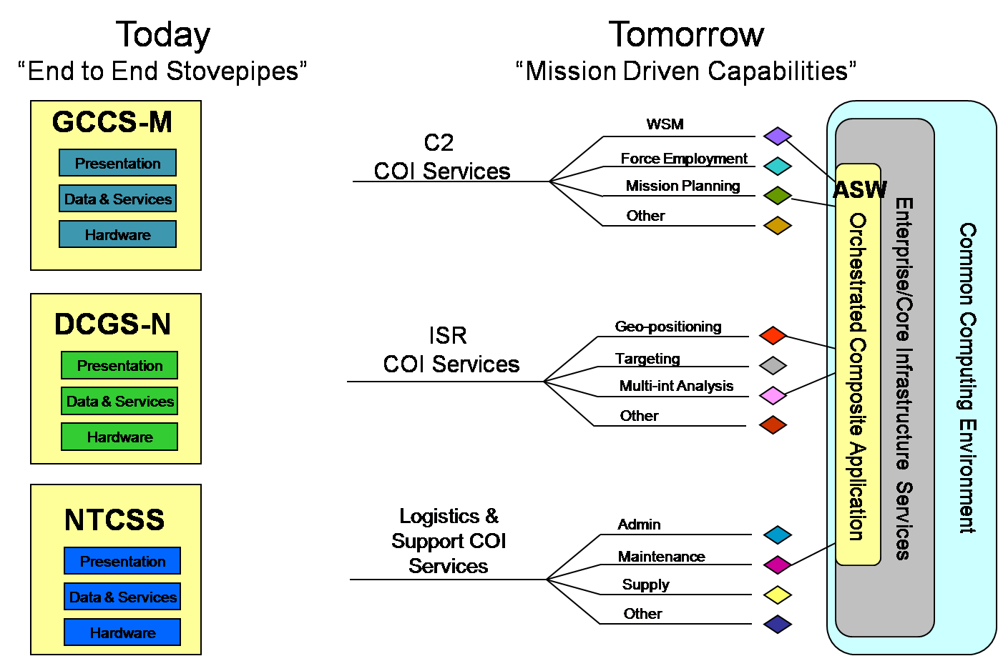
What is the Problem?
New “fog of war”
Lack of information sharing among systems
  “Stove piped” systems developed by separate government PMs with little incentive for data sharing
  Incompatible protocols
  Incompatible formats
  Disparate security levels
Information overload
  Too much information
  Need automated system
  to distill knowledge
  from the megabytes
  to gigabytes of data
  Lack of metadata
Navy FORCEnet C2, ISR, and Logistics Systems
**Miller, Chris, “PEO C4I Overview and Way Ahead for AFCEA NOVA”, 5 April 2007, slide 13.

Slide 4
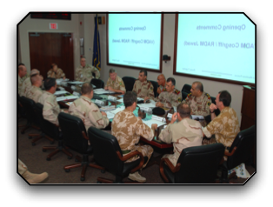
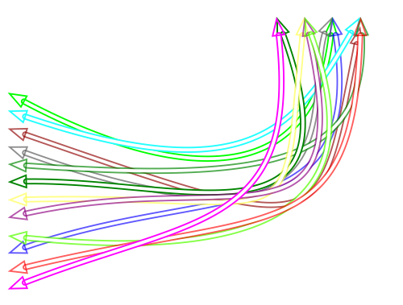



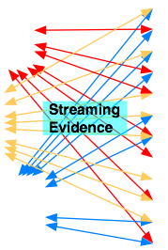

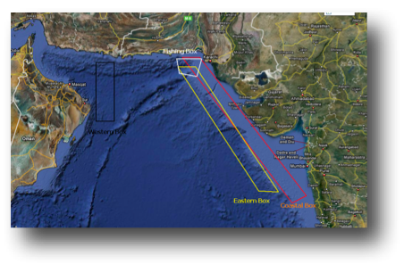
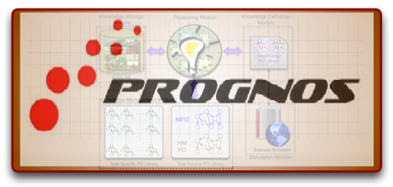



What is PROGNOS?
Predictive naval situation awareness system that will:
  Support decision makers by providing actionable, decision relevant information
  Provide reliable high level data fusion and situation awareness
  Bridge gap by providing knowledge interchange from data interchange
  Prevent information overload allowing optimal decision making
  Integrate with Navy lower level multi-sensors data network fusion, FORCEnet
?
?
?
?
?
?
?
Predictions &
Impact Assessments
Queries
Low level fusion + Stovepiped systems + Fog of War = Cognitive Overload
Notes:
PROGNOS takes in stopepiped systems data and translate data into knowledge.

Slide 5
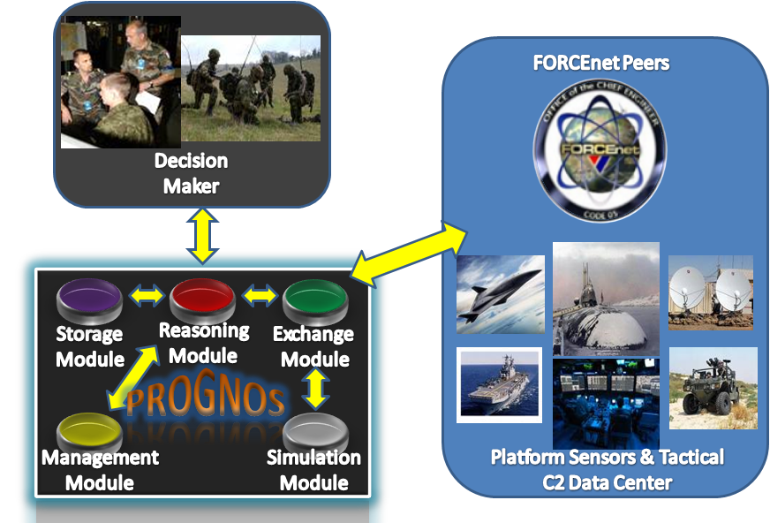
System Context Diagram

Slide 6
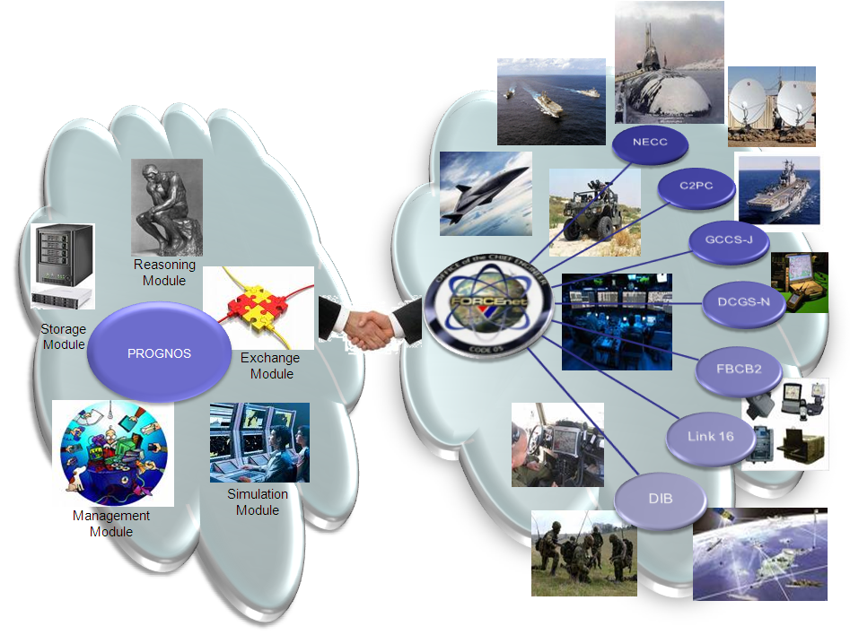
Problem Statement
Systems engineering approach needed to integrate PROGNOS with FORCEnet systems due to:
  Interface with multiple Naval platforms and C2 and ISR systems
  Interoperate with multiple systems each with different formats and standards
Notes:
Need to describe what FORCEnet is.

Slide 7
Objectives & Scope
Objectives:
  Provide an approach that will integrate PROGNOS with FORCEnet
  Define external interfaces for the PROGNOS Knowledge Exchange Module
Scope:
  Provide an integration approach to integrate PROGNOS with DCGS-N and NECC
  Provide an interface definition for PROGNOS with XML communication based C2 & ISR systems
Notes:
SCOPE:
In – FORCEnet (DCGS-N, NECC)
Out – non-DoD Systems
In - XML communication based C2 and ISR systems
Out – Non-XML systems and ontology-based communication systems

Slide 8
Assumptions & Limitations
Assumptions
DCGS-N will support XML/SOAP based communication
NECC will be implemented and will transition to an ontology-based approach
External interface is focused only on FORCEnet systems
Limitations
DCGS-N and NECC is still in development
PROGNOS ontology is still under development

Slide 9
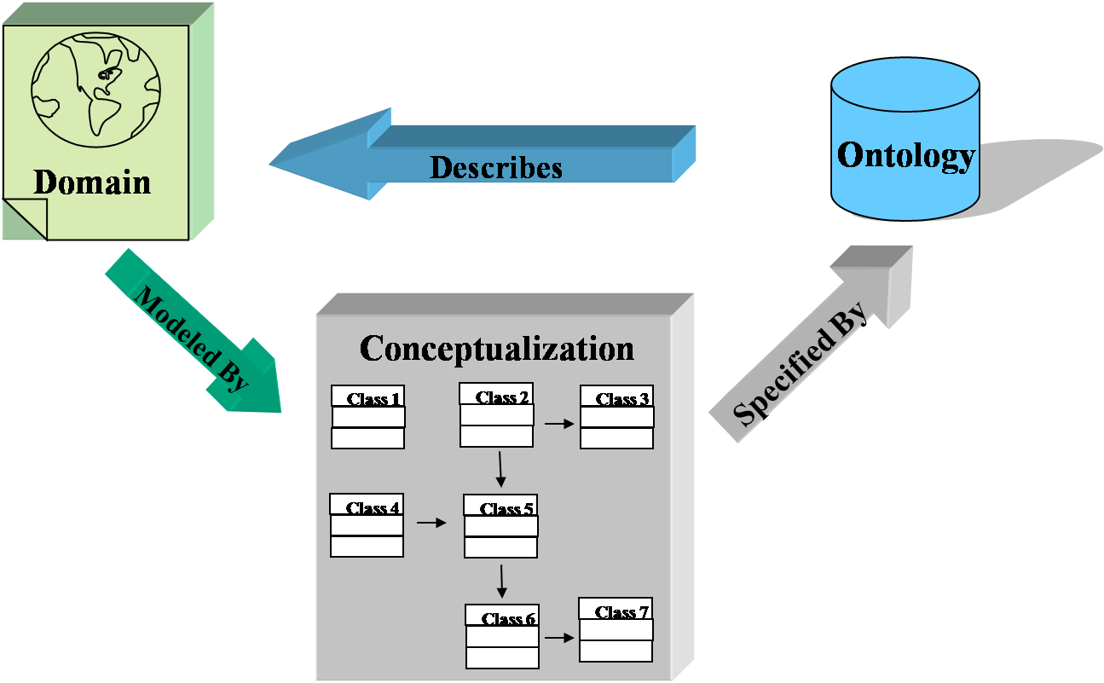
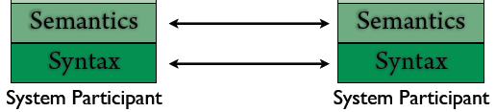
Ontology
A formal representation of the knowledge by a set of concepts within a domain and the relationships between those concepts.
  Used to reason about the properties of the domain
  Used to describe the domain
    A domain is conceptualized by using
      Classes (or sets)
      Attributes (or properties)
      Relationships (or relations among class
      members)
Enables Semantic interoperability among
disparate systems
  Linguistic Level of Information Exchange
  Integrate heterogeneous databases
  Specify interfaces to independent, knowledge-based services
Semantic: Understanding of meaning of message.
Syntatic: Common rules governing composition
and transmitting of message
Notes:
Updated by Lisa Kim on Thurs, Apr 22 2010:
Definition:
an ontology is a formal representation of the knowledge by a set of concepts within a domain and the relationships between those concepts. It is used to reason about the properties of that domain, and may be used to describe the domain.
Ontology can describe a domain of knowledge using three logic components: class, attribute, and relationship.
Why ontology? (semantic vs. syntactic):
In the scope of knowledge exchange, there are two types of exchange (linguistic) levels – syntax and semantic level.
First, in the syntax level, the sender and receiver system can have same rules or constructing and transmitting message.
Second, in the semantic level, both sender and receiver system assign and share the same meaning.
Therefore, they derive the same inferences from the same information.
(According to Dr. Coasta recent research work,) Ontology captures semantic domains by upper ontology in loosely coupled manner, which enables interoperability.

Slide 10
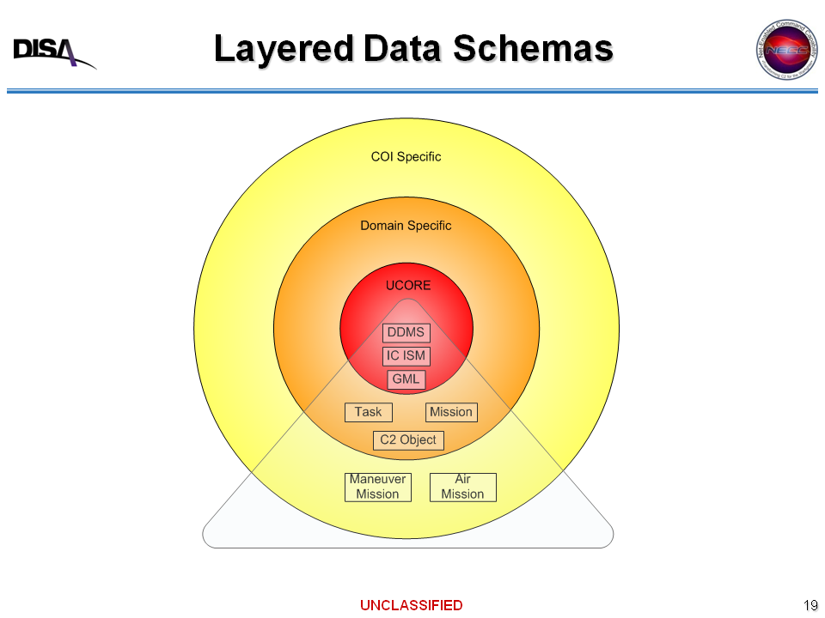
DoD Web Semantic Layered Approach
NECC/NCES Program Interaction, Defense Information Systems Agency, 14 APR 2008,
Notes:
DoD is using a layer approach to their Service Oriented Architecture Semantic Web implementation. The core of the approach is Ucore. Universal Core (UCore) is a federal information sharing initiative that supports the National Information Sharing Strategy and all associated Departmental / Agency strategies. UCore enables information sharing by defining an implementable specification (XML Schema) containing agreed upon representations for the most commonly shared and universally understood concepts of who, what, when, and where.
Ucore is based on three primary standards – the DoD Discovery Metadata Specification, the Intelligence Community Information Security Marking (IC-ISM), and the Geographical Markup Language (GML). DDMS provides enterprise level data discover. The IC ISM provides security related metadata for trusted net-centric accessibility. Geography Markup Language (GML) is the XML grammar defined by the Open Geospatial Consortium (OGC) to express geographical features. GML serves as a modeling language for geographic systems as well as an open interchange format for geographic transactions on the Internet.
The Task, Mission, and C2 Object are domain and military specific and is defined my military doctrine such as the Universal Joint Task List (UJTL) and MIL-STD-2525 which defines military symbology.
The outer most layer is Community of Interest (COI) specific. The repository for the COI XML schema is the DoD Metadata Registry. There are multiple COI schemas – blue force tracking, ISR, air mission, and more.

Slide 11
Methodology & Approach
Results
Sponsor
Needs
Validate
Needs
Develop & Analyze
Requirements
Requirements
Verification
Definition & Decomposition
Verification & Validation Testing
Develop
System Architecture
Architecture
Verification
Develop
System Specification
Specification
Verification
Time
Notes:
The team decided to follow the V model approach because it allows the team to breakdown a complex system one layer at a time so it is more manageable.
1st step is gather as much detail from sponsor in order to fully understand what is required for the team to accomplished.
From there we established originating requirements and derived system requirements
We then start developing architecture to better understand the scope and boundary of sponsor needs and requirements. We developed context, Operational & system diagrams for better understanding and system realization.
Once architecture is built, we developed system specifications (ICD) that would be provide more details into interface requirements for the chosen external systems (DCGS-N and NECC)
Due to our limitations, the right side verification and Validation will be accomplished via a detailed scenario walkthrough and simulation that will verify specifications, architecture, and requirements and validate sponsor’s needs.
Requirements
Developed an initial set of requirements
Will refine as architecture, ICD is development and further data obtained
System Architecture
Developing system architecture via SysML
Using DOD Architecture Framework (DODAF)
Developing System
Developing an Interface Control Document (ICD) to define the interface from the PROGNOS Knowledge Exchange module to Navy C4ISR systems
Verification and Validation
Scenario based approach
PROGNOS interaction with simulated Navy C4ISR systems

Slide 12
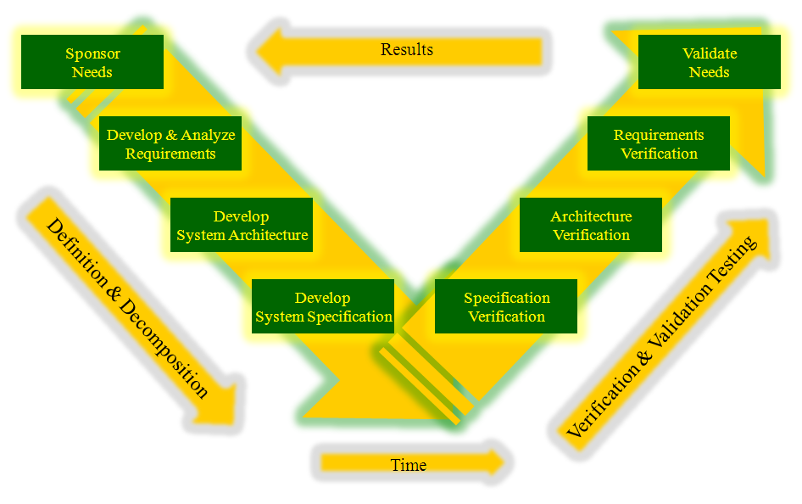
Sponsor Needs
Define external interfaces to the PROGNOS Knowledge Exchange module
  Provide an integration approach that will ensure successful integration of PROGNOS and FORCEnet

Slide 13
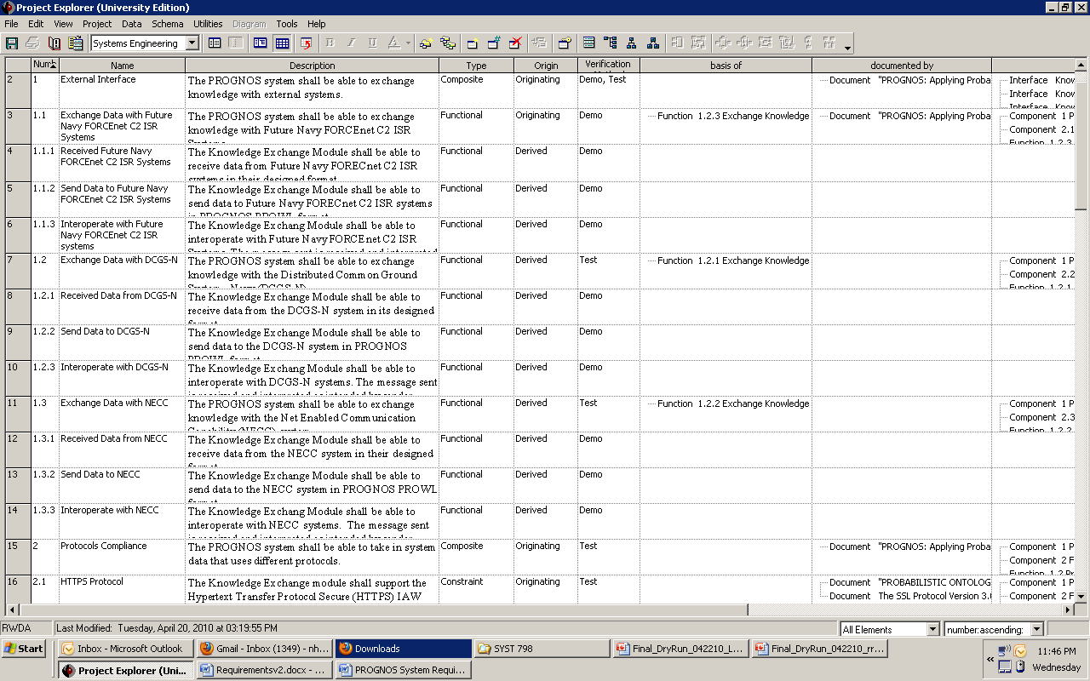

Requirements
Total of 60 requirements
13 Originating requirements
47 Derived requirements
5 Composite requirements
37 Constraint requirements
15 Functional requirements
3 Performance requirements

Slide 14
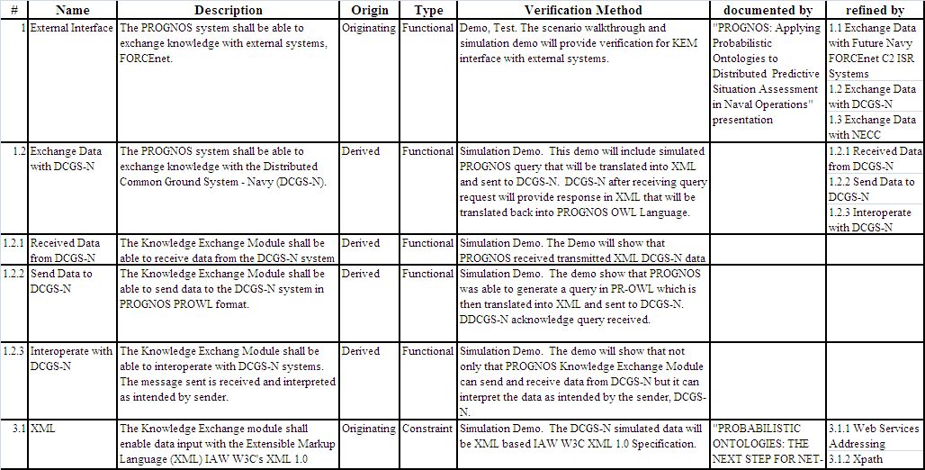
Requirements Traceability

Slide 15
System Architecture
NECC
NECC

Slide 16
Knowledge Exchange Message Translation
Notes:
Block definition diagram represents the five types of systems that PROGNOS must interface with. Systems are delineated based on message type. There are five primary message types.
Ontology based systems – This represents future systems that will send messages via a XML, RDF, and OWL formatted messages. Using an OWL based communications assumes some common ontological structure between OWL and some other ISR or C2 system. Lower layer transport mechanisms will be IP/TCP/HTTPS/SOAP.
XML based systems – Messages will be formatted in accordance with DDMS and COIs defined in the DoD Metadata Registry. Lower layer transport mechanisms will be IP/TCP/HTTPS/SOAP.
VMF (Variable Message Format) based systems – To support connectivity with Army and USMC ground force Blue Force Tracking systems, PROGNOS will need to interact with VMF based systems. VMF is a binary encoded format defined by MIL-STD-6017. VMF is used by FBCB2 and AFATDS among other systems.
USMTF (United States Message Text Format) based systems – Formal reports and guidance in DoD are published in the USMTF format. USMTF is a text format defined by MIL-STD-6040. To receive intel analysis reports, PROGNOS must support USMTF.
TDL (Tactical Data Link) – TDL refers to a series of standards primarily used by aircraft for Position Location Information tracking and sometimes communication. The most common one currently in use is Link-16/TADIL-J. TADIL-J is used for aircraft tracking; however, it can support much more than aircraft tracking.
PROGNOS Knowledge Exchange Module is focused primarily on Ontology and XML based systems.

Slide 17
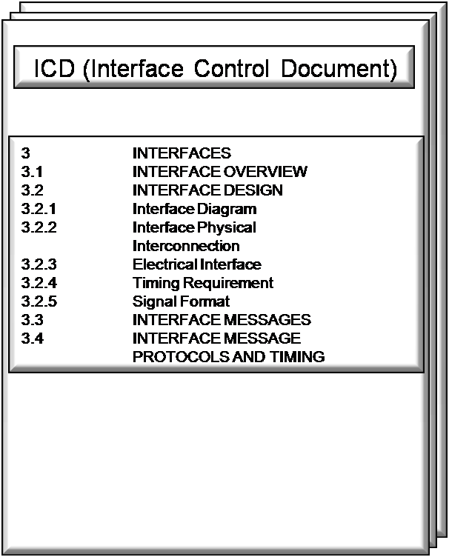
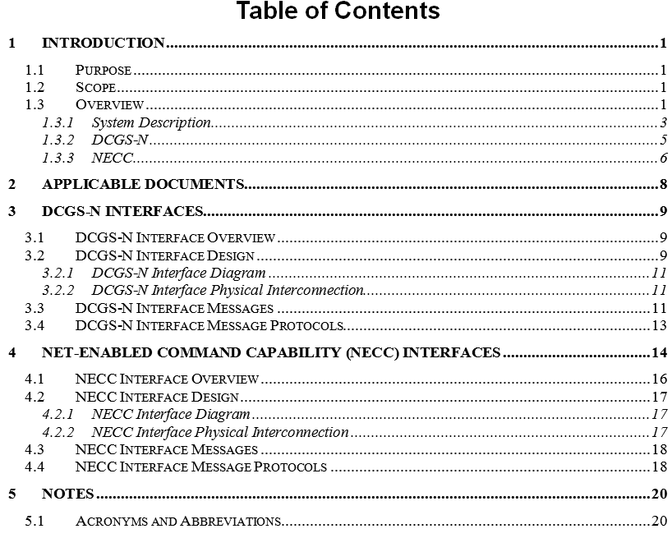
System Interface Control Document
Interface Control Document (ICD) is a critical document for systems engineering
ICD describes the systems that the KEM must interface with
ICD defines the interfaces that KEM must support to interface with external systems
DCGS-N & NECC

Slide 18
Verification and Validation
Two approaches
Scenario
  Demonstrate a detailed walkthrough of the scenario
  Provides partial requirements & architecture verification and validation
Simulation
  Demonstrate Knowledge Exchange Module system interchange with another external XML based system
  Message exchange between PROGNOS Knowledge Exchange module and DCGS-N provides verification and validation of some system requirements
  Interface verification provided via verbatim instantiation of the DCGS system

Slide 19
KEM Scenario
Human Intelligence (HUMINT) report received about possible Weapons of Mass Destruction (WMD) in Oman. Information received via DCGS-N and originates from CIA. Anticipate message format being a XML formatted message IAW a schema defined in the DoD Meta-Data Registry.
UAV dispatched to confirm. UAV is tracked via NECC or alternatively tracked via Link-16.
UAV arrives to loiter and detects excessive radiation activity. UAV video via DCGS-N.
F18 fighter aircrafts dispatched to bomb facility. F18s tracked via NECC (Link 16 feed).
BDA received via satellite and received on DCGS-N. BDA assessed by intel analyst and report filed.
Mission complete.
Notes:
CIA: Central Intelligence Agency (US government)
UAV: Unmanned Aerial Vehicle
C2PC: Command and Control Personal Computer
NG VDX: Network Grid Virtual Document Exchange
TADIL: Tactical Digital Information Link
FBCB2: Force XX1 Battle Command, Brigagde-and-Below
JVMF: Joint Variable Message Format
BDA: Battle Damage Assessment
NRO: National Reconnaissance Office
NG: Northrop Grumman

Slide 20
Scenario Activity Flow Diagram
Query
Receive PLI
Receive PLI
Query
XML Query
XML Response
JVMF
TADIL J
XML Query
XML Response
Report Suspect Bomb
Making Activity
Receive Imagery
BDA Report
USMTF
USMTF
Forward Imagery
JVMF
Broadcast PLI
JVMF
Receive PLI
Receive PLI
TADIL J
USMTF
Dispatch
Dispatch
USMTF
USMTF
TADIL J
Send PLI
Destroy Target
Capture Imagery
USMTF
Analyze Imagery
& File Report

Slide 21
KEM Simulation
Purpose :
  Validate KEM interface approach to another XML based system
  Verify XML requirements
Measure Points :
  Demonstrate interoperability (using standards – DDMS, GML, ISR COI)
  Feasibility
Limitation :
  Single query-response
  Only demonstrates an interface to a XML formatted message system
Notes:
SCOPE:
In – FORCEnet (DCGS-N, NECC)
Out – non-DoD Systems
In - XML communication based C2 and ISR systems
Out – Non-XML systems and ontology-based communication systems

Slide 22
KEM Simulation Process
Host System
External System
PROGNOS
UnBBayes-MEBN/
Reasoning Module
External System
Simulator
7. response
3. query
Knowledge Exchange Module(KEM)
PROGNOS
Core
OWL
1. query
Data
Exchange
XML
5. response
2. provide
6. provide
PROGNOS Core OWL/Data Exchange XML Schema
4. provide
Web Server
Notes:
[Young]

Slide 23
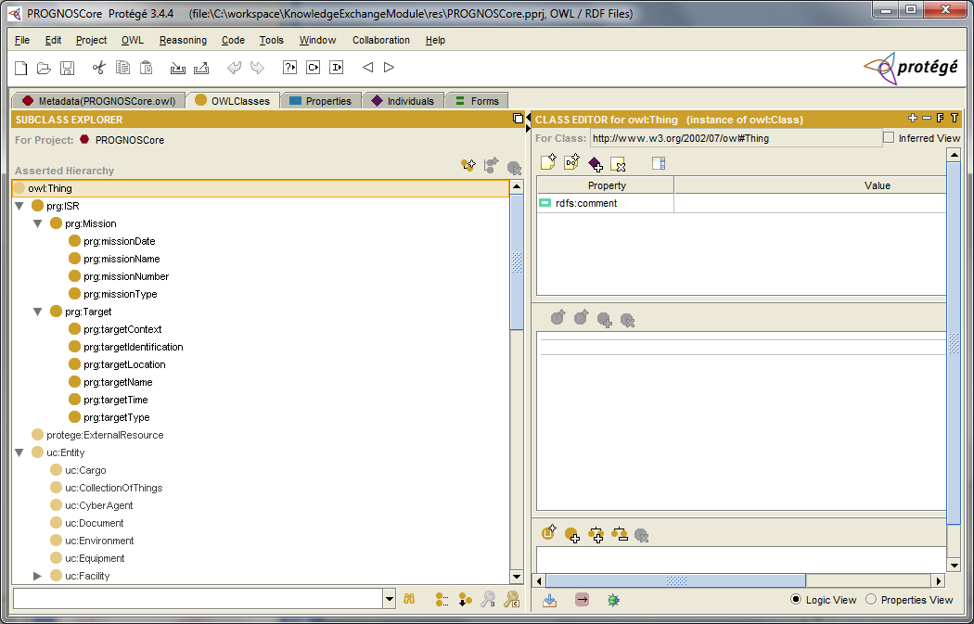
Developed PROGNOS Core OWL
Notes:
[Young]

Slide 24
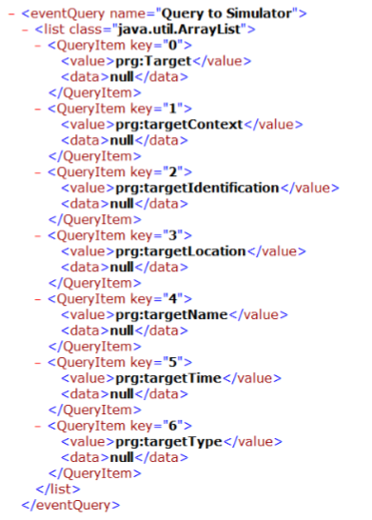
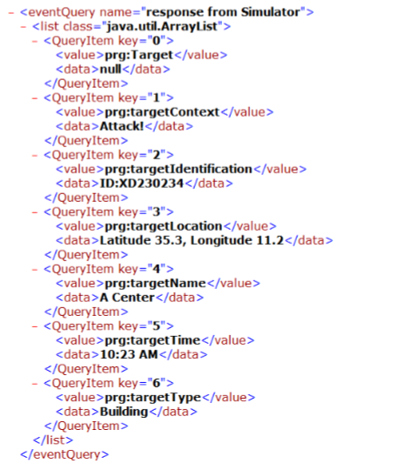
Generated Query-Response XML Message
Query
Response
Notes:
[Young]Change new one

Slide 25
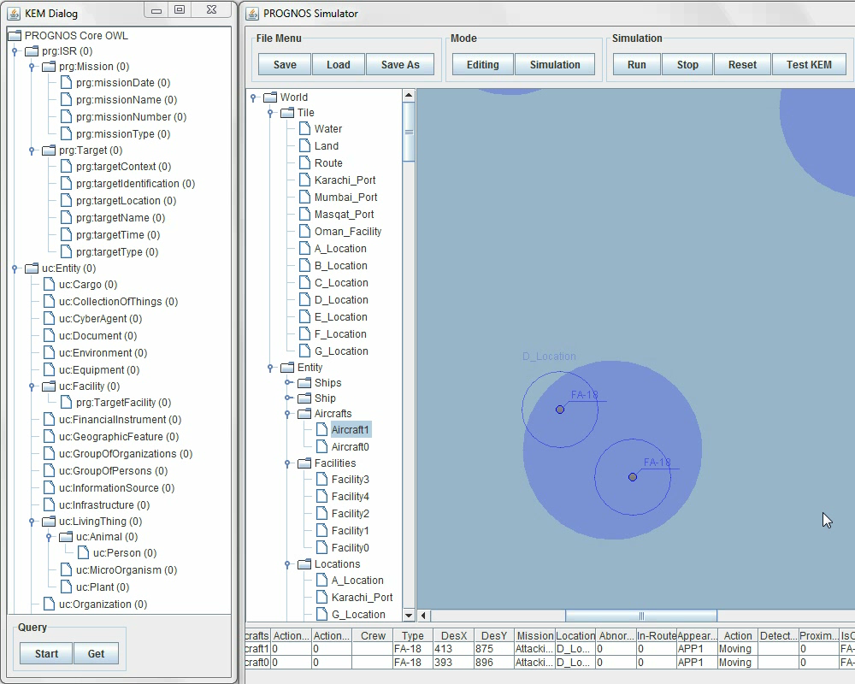
DEMO Animation
Notes:
Nhan – State purpose of simulation relates it back to verification requirements. Let audience know what message will pop up and when to expect.
[Young]
Add popup message boxes, when an event happens
Add XML showing
F-16 should move correctly
Check screen size

Slide 26
Verification & Validation Results
Verified XML requirements
Validated KEM interface approach to another XML based system
Demonstrated interoperability (using standards – DDMS, GML, ISR COI)
Demonstrated feasibility

Slide 27
Future Way Ahead
GMU-PROGNOS team follow-on work
  Continue our approach to expand other UCORE to incorporate other DOD COI schemas
  Define VMF, TDL, and USMTF interfaces
  Implement SOAP interface
  Devise interface definition for the Naval Tactical Command Support System (NTCSS) logistics system

Slide 28
Conclusion
Met Objectives:
  Provided an integration approach to integrate PROGNOS with DCGS-N and NECC
  Defined external interfaces for the PROGNOS Knowledge Exchange Module
Deliverables:
  System Architecture
  Interface Control Document
  System Requirement Document
  Simulation
  Final Report
  Project Website

Slide 29


Acknowledgement
PROGNOS KEM team would like to extend our thanks to Dr. Paulo Costa, and Dr. Kathryn Laskey for their guidance and direction

Slide 30
QUESTIONS/COMMENTS?

Slide 31
Requirements
External Interfaces:
Decision Makers / War Fighters
Future Navy C2 & ISR systems
DCGS-N
NECC
Messaging Formats
Extensible Markup Language (XML)
Joint C3 Information Exchange Data Module (JC3IEDM)
Web Ontology Language (OWL)
Command and Control Personal Computer (C2PC) VDX
United States Message Text Form (USMTF)
Joint Variable Message Format (JVMF)
Tactical Data Link Series (TDL) series of messages (TADIL-J)

Slide 32
Requirements
Data Protocols
Hypertext Transfer Protocol Secure (HTTPS) / Secure Socket Layer (SSL)
Simple Object Access Protocol (SOAP)
Security Compliance
Support PKI IAW X.509v3 certificates
Accept and provide PKCS#7, 12 public key formats
Support revocation checking of X.509 certificates via local CRL
System Wide Requirements
Reliability
  Mean Time Between Failures (MTBF) not less than 10,000 hours
  Mean Time To Repair (MTTR) shall be 0.25 hours
Safety
  PROGNOS shall require redundant operator confirmation for any decision or message that may result in fratricide.
Human Factors
  Enable system operators to perform routine equipment tasks under MOPP IV conditions with no more than 15 percent degradation in time.

Slide 33
Requirements
System Wide Requirements
System integration into a host platform system (to include, power systems) shall be unobtrusive and shall not degrade either host platform primary mission performance or safety.
Use of the system shall not degrade the functionality of the host platform.
The system must survive shock and impulse levels associated with the operation of the host platform and harsh environments.

Slide 34
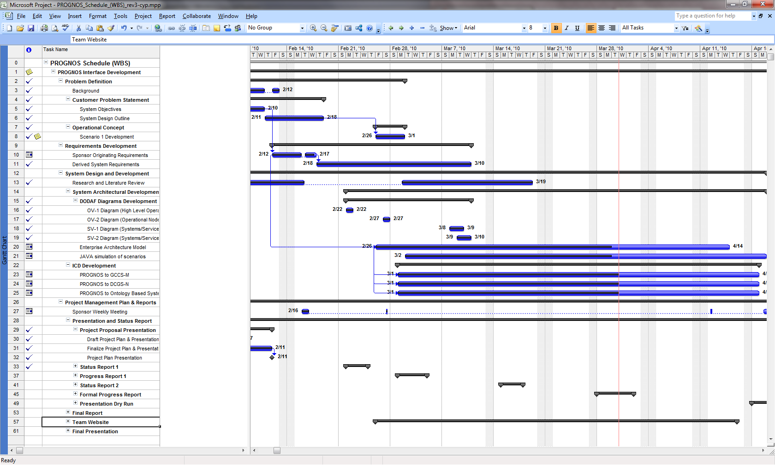
Work Breakdown Structure (WBS)

Slide 35
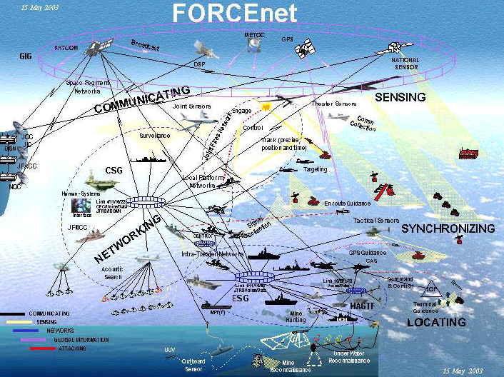
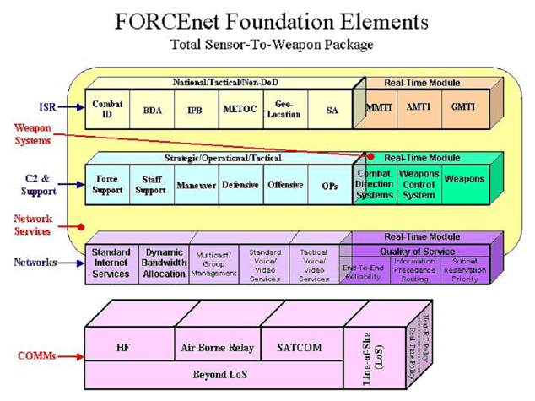
What is FORCEnet?
The operational construct and architectural framework for Naval Warfare in the Information Age, to integrate WARRIORS, sensors, networks, command and control, platforms, and weapons into a networked, distributed combat force, scalable across the spectrum of conflict from seabed to space and sea to land.
The naval command-and-control component for Sea Power 21 and Expeditionary Warfare.
The future implementation of Network Centric Warfare in the naval services.
An enterprise alignment and integration initiative to serve as a change agent and an engine for innovation, potentially touching every naval program.

Slide 36
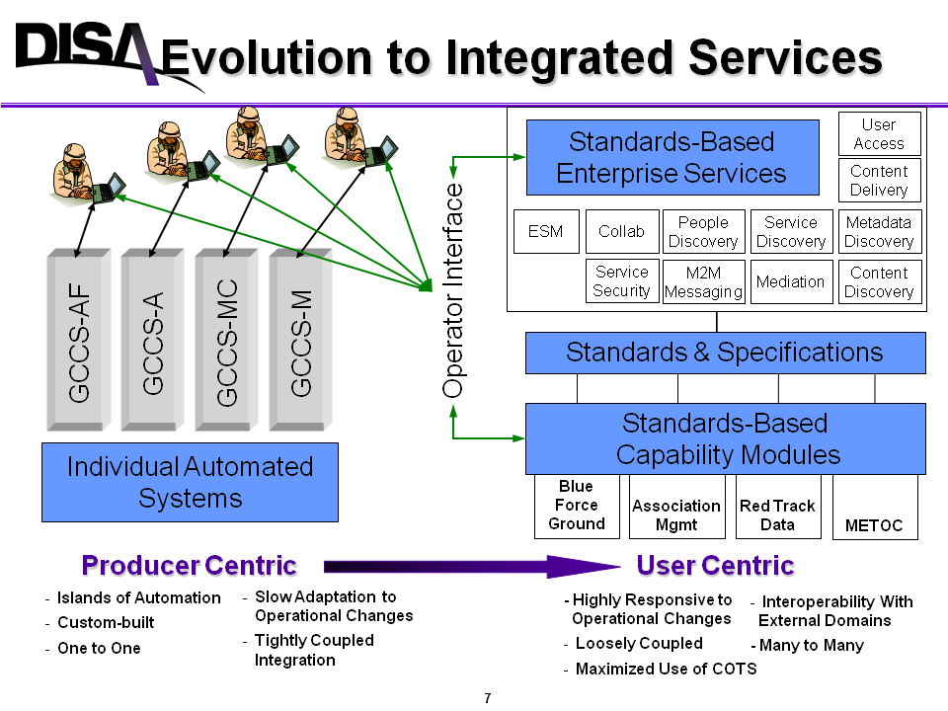
Network-Enabled Command Capability (NECC)

Slide 37
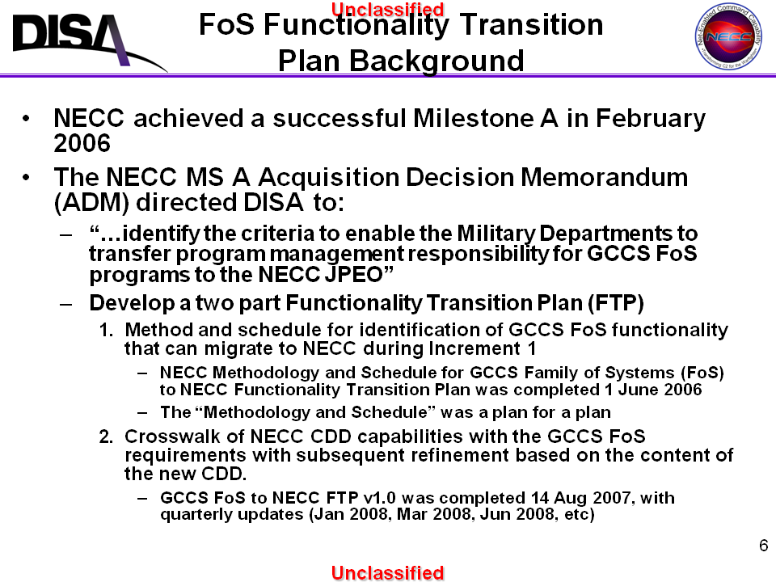
GCCS FoS to NECC

Slide 38
NECC Layered Approach

Slide 39
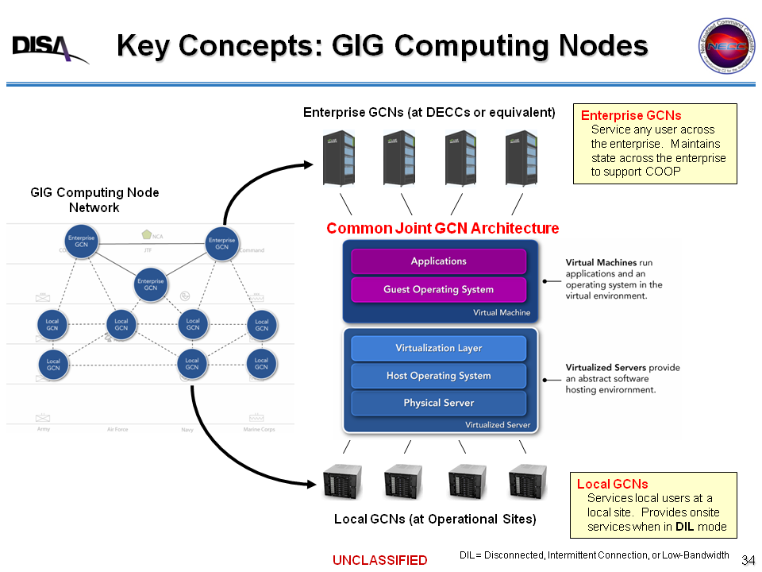
NECC GIG Computing Node (GCN) Approach

Slide 40
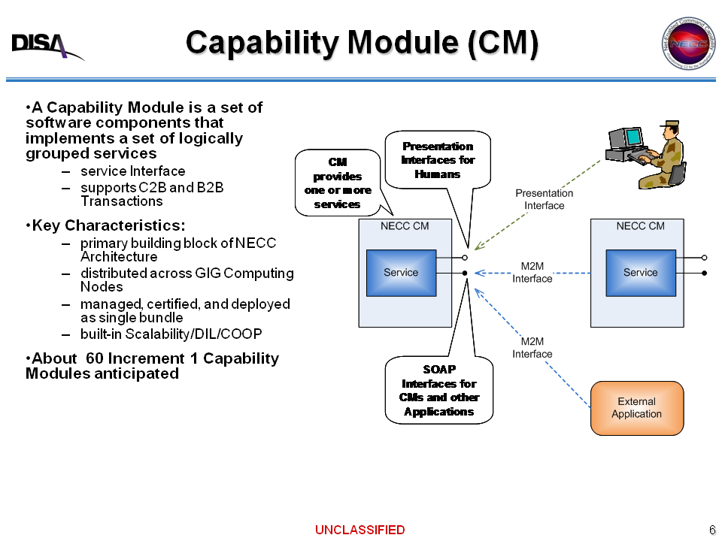
NECC CM

Slide 41
