Slide 1
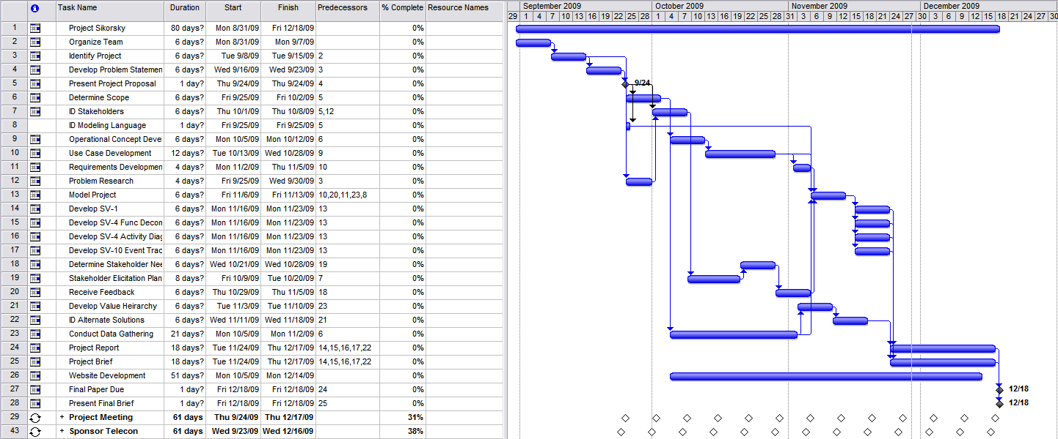
Schedule (Gantt Chart)

Slide 2
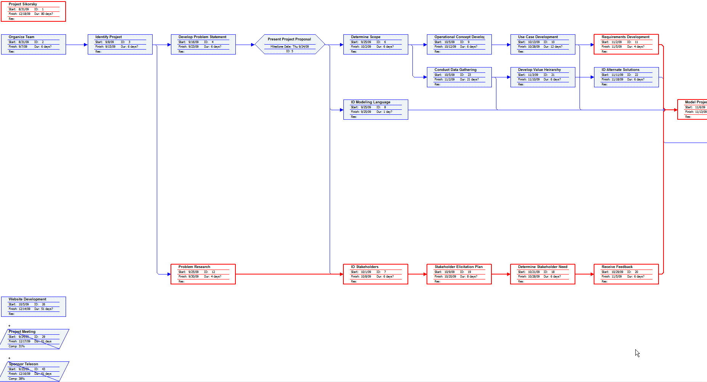
Schedule (Network Diagram) (1 of 2)

Slide 3
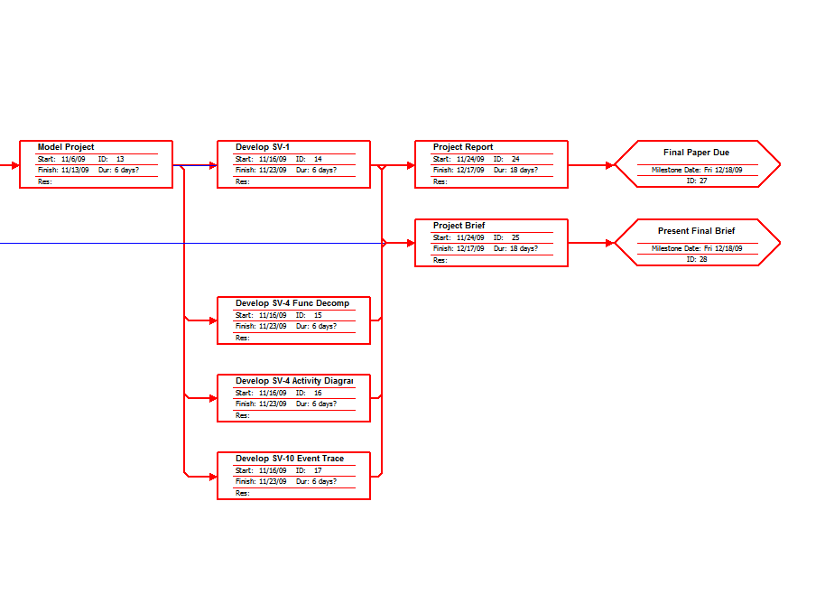
Schedule (Network Diagram) (2 of 2)

