Slide 1

Architecture for a Future National Power Grid
Presented by:
Ada Ononiwu
Nate Welch
Denis Avila
Sponsor: Dr. Dwight Williams, U.S. Department of Energy

Slide 2
Agenda
Background
Problem
Mission Statement
Strategy and Approach
Stakeholder Identification
Requirements
Concept of Operations
Technology Strategy
System Architecture
Business Case
Conclusion and Recommendations

Slide 3
Agenda
Background
Problem
Mission Statement
Strategy and Approach
Stakeholder Identification
Requirements
Concept of Operations
Technology Strategy
System Architecture
Business Case
Conclusion and Recommendations

Slide 4
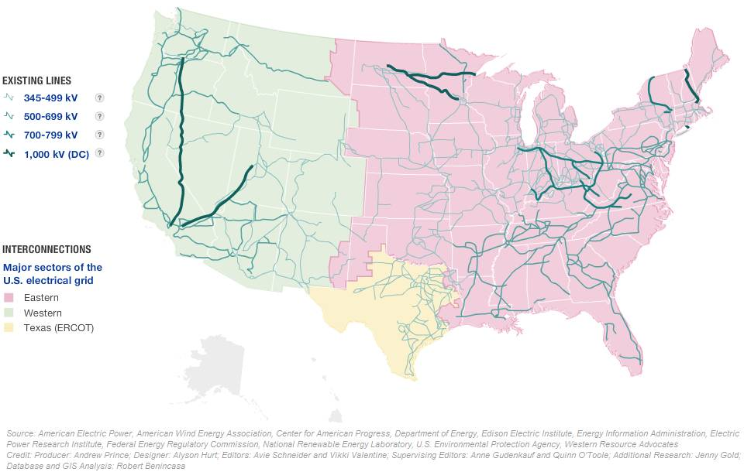
Background
U.S. Power Grid covers the 48 contiguous states (and parts of Canada and Mexico).
The grid is divided into three interconnected systems
  Eastern Interconnected System
  Western Interconnected System
  Texas Interconnected System
Predominantly operate independently, but also are redundantly connected by direct-current (DC) lines.

Slide 5
Agenda
Background
Problem
Mission Statement
Strategy and Approach
Stakeholder Identification
Requirements
Concept of Operations
Technology Strategy
System Architecture
Business Case
Conclusion and Recommendations

Slide 6
Problem
The current U.S. power grid is aging, inefficient, congested, and is vulnerable to power outages and power disturbances
With the consumer power demand expected to increase by 26% over the next 20 years and exceed power generation by 2024, there is a need to upgrade the current U.S. power grid

Slide 7
Agenda
Background
Problem
Mission Statement
Strategy and Approach
Stakeholder Identification
Requirements
Concept of Operations
Technology Strategy
System Architecture
Business Case
Conclusion and Recommendations

Slide 8
Mission Statement
The project development team will serve as an energy consulting firm to the DOE, where an architectural solution will be sought to support the ongoing efforts to improve the U.S. power grid.
The objective of the development team is to implement a systems engineering methodology that will result in a completed, proof-of-concept future power grid architecture.
The project report will serve as an informal submission that provides an alternative conceptual approach to addressing the many current grid problems.
Deliverables will include:
  Documentation of the methods used to develop multiple grid architectures
  An evaluation of each architecture
  A Business Case that will recommend a specific architecture

Slide 9
Agenda
Background
Problem
Mission Statement
Strategy and Approach
Stakeholder Identification
Requirements
Concept of Operations
Technology Strategy
System Architecture
Business Case
Conclusion and Recommendations

Slide 10
Strategy and Approach (1 of 2)

Slide 11
Strategy and Approach (2 of 2)
Department of Defense Architecture Framework (DoDAF) was selected for the design and development of the Future National Power Grid Architecture
An architecture modeling tool, MagicDraw, was implemented to design and model DoDAF Operational View (OV) and Systems View (SV) products

Slide 12
Agenda
Background
Problem
Mission Statement
Strategy and Approach
Stakeholder Identification
Requirements
Concept of Operations
Technology Strategy
System Architecture
Business Case
Conclusion and Recommendations

Slide 13
Stakeholder Identification (1of 3)
By using the stakeholders involved in the development of the DOE’s “Grid 2030 Vision” and the “Modern Grid Strategy”, the pertinent stakeholders that would have some influence on the mission of this project were identified

Slide 14
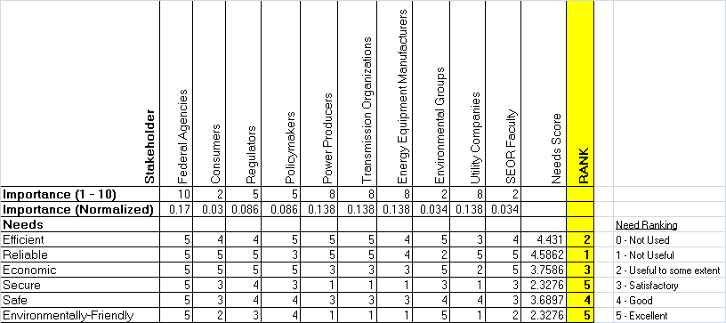
Stakeholder Identification (2of 3)
Used stakeholder analysis tool by Mind Tools to determine which stakeholders had the greatest influence or impact to the project.
The resulting value map allows the project development team to trace the origin of each of the system requirements

Slide 15
Stakeholder Identification (3of 3)
The Quality Function Deployment (QFD) model was used to transform stakeholder needs into the power grid quality characteristics (or functional requirements)
The final results of the QFD analysis defined which functional requirements are most important based on their relative weights
The top five functional requirements is what this project will focus on, at a minimum

Slide 16
Agenda
Background
Problem
Mission Statement
Strategy and Approach
Stakeholder Identification
Requirements
Concept of Operations
Technology Strategy
System Architecture
Business Case
Conclusion and Recommendations

Slide 17
Requirements (1 of 2)
Based on the analysis from the QFD model, the following functional requirements (in priority order) will be taken into consideration when designing a future architecture power grid:
  Minimize system costs
  Increase power quality
  Reduce power loss
  Tolerant to security threats and attacks
  Accommodate energy storage options
  Decrease system peak demand
  Increase reliability
  Decrease transmission line congestion
  Decrease system restoration time
  Decrease need for new power stations and transmission lines
  Incorporate interoperability government standards & policies
  Increase environmental benefits
  Decrease time to develop system
Intent is to address these requirements at a minimum

Slide 18
Requirements (2 of 2)
The following system attributes would be taken into consideration:
  Extensibility –The power grid architecture will allow for the modification of existing functions and inclusion of new functions
  Feasibility – The power grid architecture will be of a viable design to realistically implement
  Reliability – The power grid architecture will eliminate or minimize power outages. Based on the mean time before failure (MTBF) (or number of steps to balance the nodes), the grid architecture that has the lowest MTBF (or number of steps) will mostly likely be selected.
  Flexibility – The power grid architecture will adapt when external changes occur and must be flexible to meet future demands and new technologies
  Scalability –The power grid architecture will meet consumer demands during peak and off-peak seasons
  Interoperability – Existing power grid components will be able to operate with the proposed power grid architecture
The pertinent power grid standards, codes, and regulations are also taken into consideration (e.g., OSHA, IEEE, etc.)

Slide 19
Agenda
Background
Problem
Mission Statement
Strategy and Approach
Stakeholder Identification
Requirements
Concept of Operations
Technology Strategy
System Architecture
Business Case
Conclusion and Recommendations

Slide 20
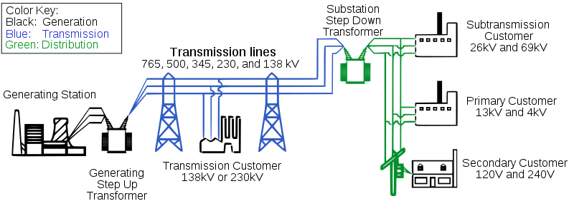
Concept of Operations (1of 3)
Project Scope
  The U.S. power grid has three primary operations—electricity generation, electric power transmission, and electricity distribution
  This project will focus solely on two of the power grid operations, generation (the implementation of) and top-level transmission

Slide 21
Concept of Operations (2of 3)
From the perspective of the project scope, the OV-1 displays the high-level graphical description of the operational concept.

Slide 22
Concept of Operations (3of 3)
Use case diagrams were developed to explore the operational activities necessary to address the problem and meet requirements
Two use cases have been developed:
  Generate Power – provides constant power to end user
  Regulate Power – regulates power demand on extra high voltage grid with a successful end result that does not interrupt the grid’s power with the addition and removal of end users
Generate Power Use Case
Regulate Power Use Case

Slide 23
Agenda
Background
Problem
Mission Statement
Strategy and Approach
Stakeholder Identification
Requirements
Concept of Operations
Technology Strategy
System Architecture
Business Case
Conclusion and Recommendations

Slide 24
Technology Strategy (1 of 2)
Critical to the Future National Power Grid architecture are the properties of extensibility and flexibility
The developed architecture must adhere to the ideal of technological acceptance as new energy technologies are developed and implemented
The project development team envisions their architecture to provide such a compliant capability

Slide 25
Technology Strategy (2 of 2)

Slide 26
Agenda
Background
Problem
Mission Statement
Strategy and Approach
Stakeholder Identification
Requirements
Concept of Operations
Technology Strategy
System Architecture
Business Case
Conclusion and Recommendations

Slide 27
System Architecture (1 of 7)
Functional Decomposition

Slide 28
System Architecture (2 of 7)
The following key characteristics were vital to the design of the proposed power grid architecture:
  Extra High Voltage (EHV) Transmission Line Specification
  Nodal Connectivity
  Auto-Regulation
Colored Petri Nets (CPN) were developed to aid in the conceptual development and analysis of multiple EHV power grids:
  Energy Source Transition
  Energy Distribution
    Power source to consumer transmission
    Geographically dispersed
    Congestion alleviation

Slide 29
System Architecture (3 of 7)
Power source to consumer transmission: Based on the current production and consumption of each state, main power flow was determined within the country. This layout attempts to broaden those paths. While the location of power production will change over time, the current layout is assumed to serve as a guide.

Slide 30
System Architecture (4 of 7)
Geographically dispersed: This model attempts to provide broad area coverage throughout the country to facilitate its interconnection with the HV grid.

Slide 31
System Architecture (5 of 7)
Congestion alleviation: This model focuses of alleviating current power congestions. While this configuration will continue to provide the advantages of the prior models, it will also provide quicker relief to the current power distribution problems.
Future Congestion
Current Congestion

Slide 32

System Architecture (6 of 7)
Run CPN Simulation

Slide 33
System Architecture (7 of 7)
CPN Results:

Slide 34
Agenda
Background
Problem
Mission Statement
Strategy and Approach
Stakeholder Identification
Requirements
Concept of Operations
Technology Strategy
System Architecture
Business Case
Conclusion and Recommendations

Slide 35
Business Case (1 of 4)
The business case analysis focused on the 3 physical layout lifecycle costs
Lifecycle costs were based upon top-level physical components of the power grid architecture, EHV transmission lines and substations
The following cost factors were considered:
  Engineering and construction costs of implementing EHV transmission lines over different environmental terrain (e.g., mountains),
  Integration of EHV substations, and
  Operations and Maintenance (O&M) costs

Slide 36
Business Case (2 of 4)
Cost Methodology
  Superimposed each physical layout of the grid architecture and a U.S. terrain map*
  Identified the nearest city at each power grid node
  Using a distance calculator tool, all transmission line distances were determined
  Using various online sources, commercial costs for transmission lines and substations were:
    Transmission line engineering and construction costs (cost per mile): $2.5M
    Transmission line O&M costs** (cost per mile): $4K
    Substation engineering and construction costs (cost per unit): $32.7M
    Substation O&M costs** (cost per unit): $250K
* Assumed 1.3X cost factor for mountain terrain in western U.S. states
** Assumed 50 year lifespan

Slide 37
Business Case (3 of 4)
Lifecycle Cost Results
Power Source to Consumer had the least expensive lifecycle cost

Slide 38
Business Case (4 of 4)
Analysis of Alternatives:
  Although minimizing total system cost was defined as the top priority functional requirement, the project development team strived to select the architecture layout which balanced both performance and cost
  Layouts that required more simulation steps to self-balance were increasingly expensive
  Increased redundancy promotes greater reliability; however, at the expense of efficiency

Slide 39
Agenda
Background
Problem
Mission Statement
Strategy and Approach
Stakeholder Identification
Requirements
Concept of Operations
Technology Strategy
System Architecture
Business Case
Conclusion and Recommendations

Slide 40
Conclusion and Recommendations
Successfully developed 3 future architecture grids
Recommendation is to implement “Power source to consumer” layout to the DOE
Due to the limited time and scope of this project, all aspects of the power grid architecture could not be explored and analyzed. Future research should be considered for the purposes of expanding the grid architecture in the following areas:
  EHV substation placement using more detailed statistics;
  A detailed cost analysis assuming more realistic industry standards (i.e. underground/overhead transmission lines, a mix of tubular steel pole transmissions and lattice towers, etc.);
  Architecture expansion at the regional/local level; and
  Simulation of power outages and point failures for grid analysis.
For more information, please visit our project website at: http://mason.gmu.edu/~davila/index.htm
Recommend Power Source to Consumer architecture to DOE

Slide 41
Special Thanks
Project Sponsor
  Dr. Dwight Williams, Senior Science Advisor, U.S. Department of Energy
SEOR Faculty

Slide 42
Questions?

Slide 43
Backup

Slide 44
Cost Model: Power Source to Consumer Transmission

Slide 45
Cost Model: Power Source to Consumer Transmission

Slide 46
Cost Model: Geographically Dispersed

Slide 47
Cost Model: Geographically Dispersed

Slide 48
Cost Model: Congestion Alleviation

Slide 49
Cost Model: Congestion Alleviation

Slide 50
CPN Model: Power Source Transition

Slide 51
CPN Model: Line Balance

Slide 52
CPN Model: Power Source to Consumer

Slide 53
CPN Model: Geographically Dispersed

Slide 54
CPN Model: Congestion Alleviation

